Slide 1
#2 of 3 PowerPoints
Budget 2022-2023
Motion 5
#1: Motions 1- 4
#3: Background & work
of the cycle
All materials: www.na.org/conference
Notes:
This is the second of three PowerPoints covering material in the 2022 Interim Conference Agenda Report/Conference Approval Track material (or ICC for short).
This PowerPoint covers the Conference Approval Track material in the ICC, which is the proposed budget and a motion to pass the budget. The first PowerPoint covers the four CAR motions, about the FIPT, term limits, and SPAD. The third PowerPoint covers the background information in the ICC about the conference and a summary of the work of NA World Services during this conference cycle.
These PowerPoints cover only the main points of the ICC. We encourage all members to read the document itself for more information. Please visit www.na.org/conference for the complete 2022 ICC, the SPAD approval draft, the other ICC PowerPoints, and other conference materials. Paper copies will not be mailed to participants and regions nor will they be available for sale.

Slide 2
Budget published in CAT
90 days before WSC
Not translated due to time constraints
Many groups do not workshop the CAT
Notes:
As you may know, we typically publish the proposed budget 90 days before the Conference as part of the CAT or Conference Approval Track. Under normal circumstances, we don’t translate the CAT given time constraints and a focus in many groups on the motions in the Conference Agenda Report (or CAR). The CAT includes materials intended for committees or boards, and even in English-speaking NA communities, many groups choose not to vote on the budget or other CAT motions. Some regions give their delegates a vote of confidence to vote as they deem appropriate.
We say all of that to say this: If you’ve been doing CAR workshops for decades but looking at the budget feels unfamiliar, it may be because you haven’t encountered it in the past.

Slide 3
Notes:
If you find yourself a bit overwhelmed by such a complex document, take a deep breath. You don’t need to be a mathematician, and there won’t be a test!
Our objective in this PowerPoint is to highlight a few items that may be of interest and point out how this budget is different from those of recent cycles. Then, if you’re interested and want to know more, we encourage you to read the essay on the budget in the ICC and write us with any questions you may have.
We won’t go over the budget in a lot of detail here. It’s a bit too complex to do it justice in a short PowerPoint. Its complexity reflects the nature of our organization: It covers five offices in different countries with different currencies that handle hundreds and hundreds of items in different languages.

Slide 4
The 2021-22 budget reflects projections based on real income and expense from the previous fiscal year (2020-2021) and trends we anticipate continuing in the coming year. Those changes are:
Income | Expenses
member contributions by 12% literature income by 5% | Cost of goods sold by 18% WSC support by 3%
Notes:
On the screen, you’ll see a few notable differences between this year’s budget and those that have come before. Perhaps this is a good time to mention that this is a ONE-year budget due to the changes to the conference cycle noted at the beginning of this PowerPoint.
A few of these changes may seem obvious:
We anticipate an increase in literature income since it seems likely that more literature may be purchased as in-person meetings resume, that members may have a thirst for literature after having limited access during the darkest days of the pandemic.
We should note that anticipated income and cost of goods associated with the potential new book are in the budget as “contingent” entries and shown in purple. Obviously, this is contingent on the decision made about the approval draft of the book by the interim WSC in 2022.
Many of us have seen increasing costs in our personal lives, and NA World Services is not immune to rising cost as the kinks in the supply chain are worked out. The cost of paper alone has had an enormous impact on our cost of goods. Other costs ranging from shipping to infrastructure have also increased, so you’ll notice that the budget contains corresponding increases. Please see the ICC essay for more details about projected expenses.
We’ll spend a few more minutes discussing the budgeted increase in member contributions and the increase in the percentage allotted to literature production and distribution in the slides that follow.

Slide 5
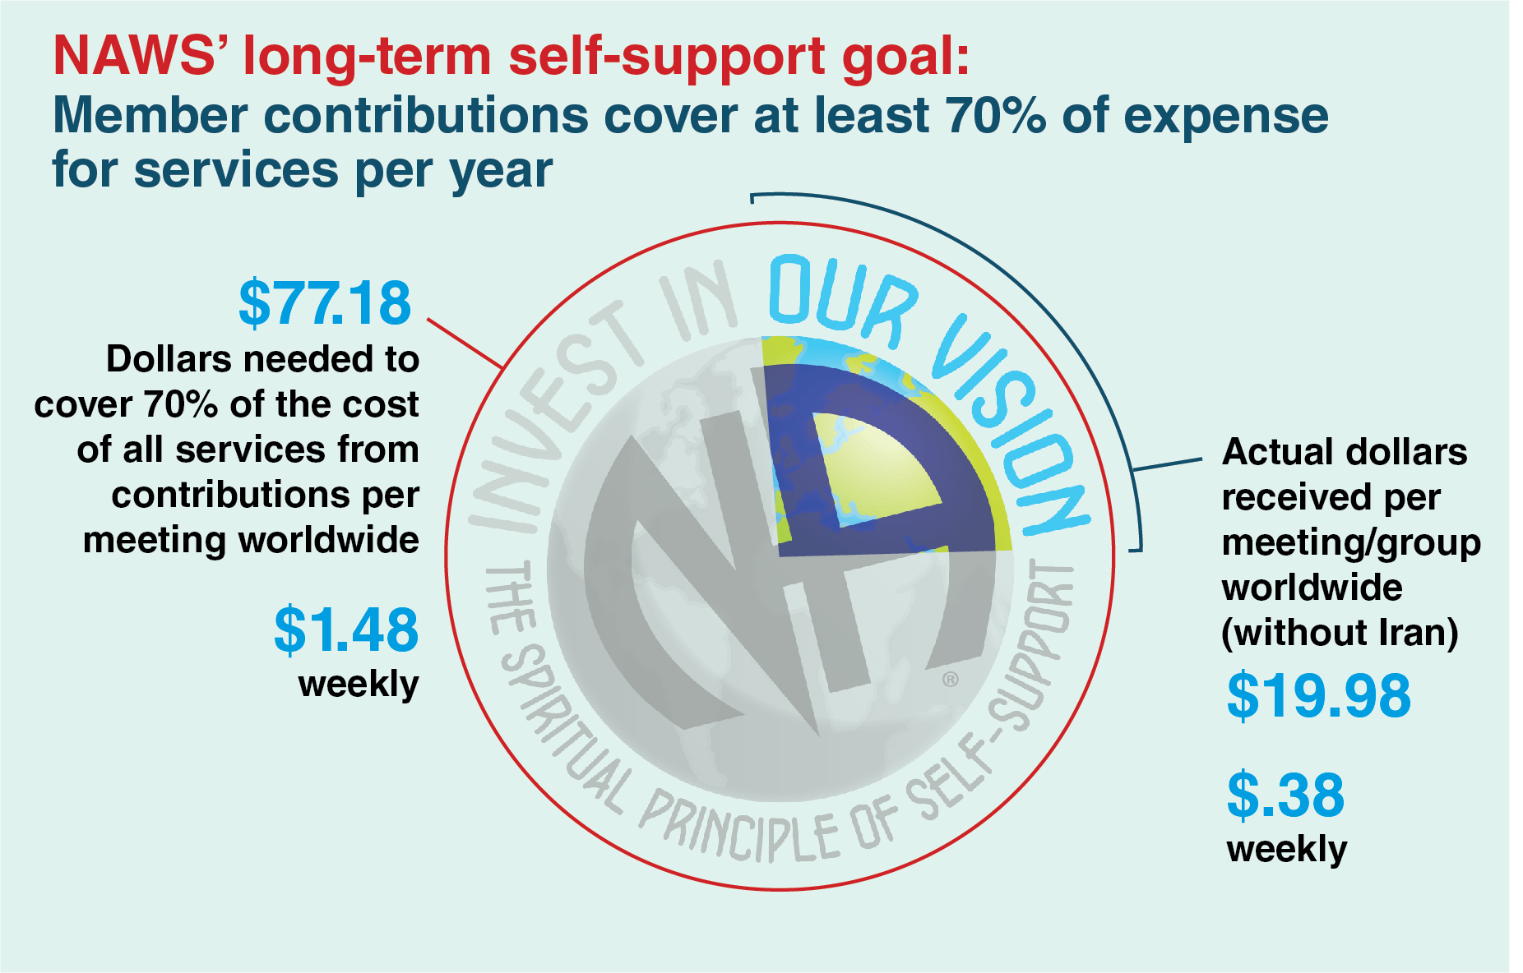
As of the 2019–2020 fiscal year.
Notes:
As the budget essay in the ICC notes, one of the bright spots of the pandemic has been seeing the Fellowship step up in support of NA World Services. We’ve long lamented our dependence on literature sales as a source of income. When lit sales virtually stopped in March of 2020, members upped their contributions and organized events that raised both awareness and funds. As a result and rather remarkably, Fellowship contributions increased from 10% of our operating income before the pandemic to 24% as of June 2021.
The proposed budget for 2022–2023 projects that almost 25% of NA World Services’ operating income will come from Fellowship contributions. The amount listed in the budget is 12% more than was contributed in the 2021 fiscal year.
Even before the pandemic, the World Board had been making headway with our “Invest in Our Vision” discussions. We’ve since established a goal that member contributions cover at least 70% of NAWS expense for services.
As noted in the ICC: “Only NA members can contribute to NA, so the only way to mature as a Fellowship in our practice of self-support is to create a culture that recognizes the importance of doing that. Funding our services with Fellowship contributions seems more consistent with the philosophy of self-support than our historical reliance on the sale of literature, moreover, it is a more sustainable and reliable approach for funding the services that the Fellowship expects and desires from NA World Services.”

Slide 6
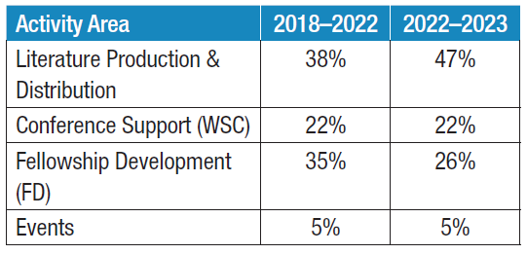
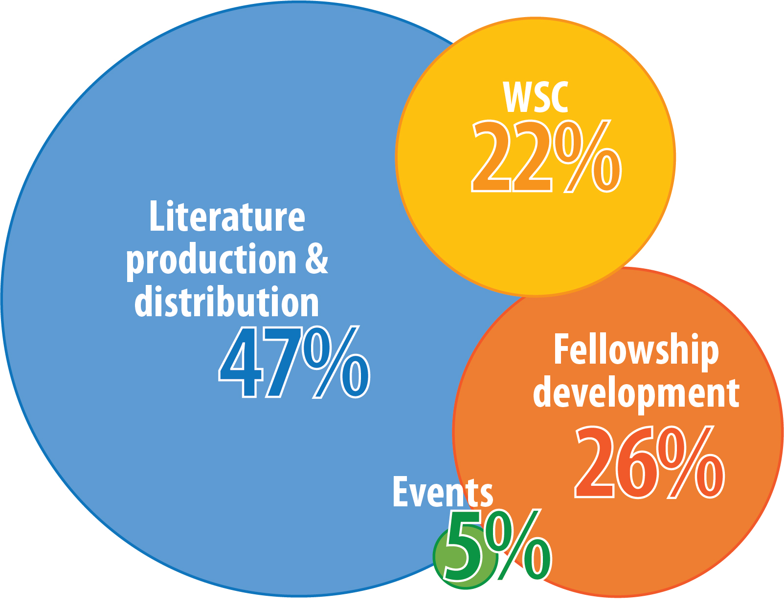
Notes:
Those who read the Annual Report may be familiar with this bubble graph. As you may know, we allocate fixed operational costs including accounting, personnel, overhead, and technology to these four activity areas in our budget based on factors such as the number of staff and amount of hours devoted to an activity and the percentage of overhead such as building space, equipment, and bank charges required.
The percentages of fixed costs allocated for each area of activity change over time but never this dramatically. The majority of our staff now work to support “literature production and distribution.” This is a result of both the reduction in other staff and the complexity of supporting our current inventory, with more titles in more languages than ever before. To ensure the sustainability of NA World Services and to meet our responsibilities as assigned by the WSC, under the present circumstances, it was necessary to prioritize the operability of literature production, distribution, translations, and accounting.
We’ve adjusted allocations to reflect current conditions, but this should not be taken as a change in our mission or a projection for the future after this budget period. This is an adjustment due to crisis conditions.
For context, it may be helpful to compare this budget’s allocations with those in the two most recent cycles. The chart on the right reflects the 9% shift from FD to literature.
For more information on this proposed budget, please see the ICC essay. For more info on NAWS finances, see the annual report at www.na.org/AR. For more information on the budgeting process, consult A Guide to World Service in Narcotics Anonymous.

Slide 7
Other PowerPoints and videos available online
ICC and SPAD draft can be downloaded. Hard copies of SPAD draft can be ordered from NA World Services
www.na.org/conference
worldboard@na.org
Notes:
We hope this video has helped in your discussion of this material. Please note that there are other PowerPoints that focus on other ICC content. These resources are available online at www.na.org/conference. We welcome your questions and your feedback on the budget, anything else in the ICC, and all other issues at worldboard@na.org.

