Slide 1
#1 of 3 PowerPoints
Motions 1-3 / required business
Motion 4 / SPAD
#2: Budget / Motion 5
#3: Background & work
of the cycle
All materials: www.na.org/conference
Notes:
This is the first of three PowerPoints covering material in the 2022 Interim Conference Agenda Report/Conference Approval Track material (or ICC for short). This PowerPoint covers the Conference Agenda Report material in the ICC. The second PowerPoint covers the proposed budget and CAT motion for its approval. And the third covers the background information in the ICC about the conference and a summary of the work of NA World Services during this conference cycle.
These PowerPoints cover only the main points of the ICC. We encourage all members to read the document itself for more information. Please visit www.na.org/conference for the complete 2022 ICC, the SPAD approval draft, the other ICC PowerPoints, and other conference materials. Paper copies will not be mailed to participants and regions nor will they be available for sale.

Slide 2
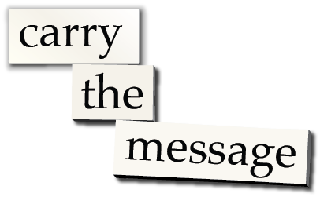
Conference participants voted to postpone the World Service Conference until 2023 and have a short business meeting in 2022 to address legally essential business as well as a decision about the Spiritual Principle a Day book.
Poll Results: 110 yes (92%), 7 no (6%), 3 abstain (3%), 3 present not voting
Notes:
In August 2021, conference participants voted to postpone the WSC until 2023, with the hope that the meeting can then be in person if financial and public health pressures have eased enough. In the meantime, there will be an interim, virtual WSC meeting in 2022 to make decisions required by law and policy as well as a decision about the Spiritual Principle a Day book. All of the business for the 2022 meeting is contained in the Interim CAR/CAT.

Slide 3
Interim Virtual WSC 2022 Interim Conference Agenda Report Material The Fellowship Intellectual Property Trust (FIPT) Term Lengths Spiritual Principle A Day Interim Conference Approval Track Material Budget for 2022–2023
ICC
2022
contents
Notes:
The ICC contains the material for consideration at the 2022 meeting. Typically this material would be in two separate publications – the CAR in November (December for translated versions) and the CAT in January – but this is not a typical conference cycle. The ICC is a single document containing motions related to the Fellowship Intellectual Property Trust (the FIPT), extending the terms for WSC trusted servants, approving the Spiritual Principle a Day book, and passing a one year NAWS budget.

Slide 4
Motion 1: Acting as the trustor, the delegates present at the virtual WSC 2022, are continuing the suspension of Article 5, Section 3 of the FIPT Operational Rules, while we make a decision about the future. This suspension will expire at the close of WSC 2023.
Intent: To extend the existing FIPT moratorium on the FIPT inspection clause in the Operating Rules for one year.
Notes:
The CAR section of the ICC contains four motions for the Fellowship’s consideration. The first three motions are only to keep current circumstances until the 2023 WSC meeting. The first of these is related to the Fellowship Intellectual Property Trust, known as the FIPT for short.
Motion 1: Acting as the trustor, the delegates present at the virtual WSC 2022, are continuing the suspension of Article 5, Section 3 of the FIPT Operational Rules, while we make a decision about the future. This suspension will expire at the close of WSC 2023.
Intent: To extend the existing FIPT moratorium on the FIPT inspection clause in the Operating Rules for one year.
Financial Impact: None

Slide 5
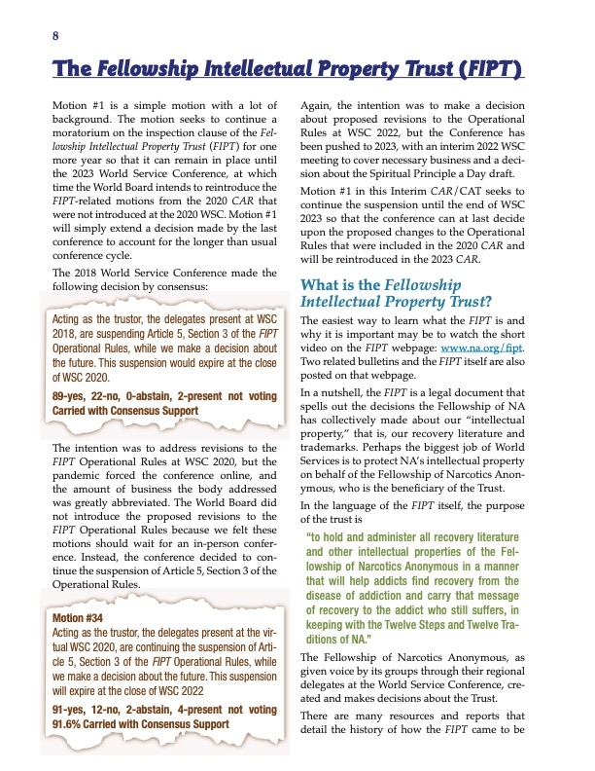
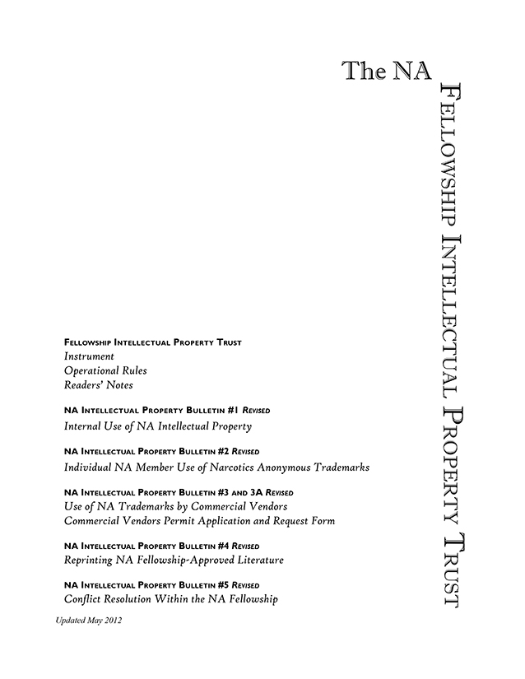
From ICC
www.na.org/fipt
video & documents
Notes:
Motion #1 is a simple motion with a lot of background. The ICC contains a brief explanation of the FIPT and the background to this motion. Much more information is available on the FIPT webpage (www.na.org/fipt) including a short informational video about the FIPT, the document itself, and its accompanying bulletins. We encourage any interested member to review that material as it will answer many of the questions they may have, but here are some of the main points to be aware of.

Slide 6
Legal document — the decisions the Fellowship has made about its “intellectual property” (literature and trademarks) and how these are protected. The Operational Rules describes how FIPT is to be administered.
Article 5, Section 3: suspended temporarily at 2018 WSC.
WSC 2020 continued the suspension until WSC 2022 so that revisions to the Operational Rules could be discussed in-person.
Pause
for discussion
Notes:
The FIPT is a legal document that describes the decisions the Fellowship has made collectively about its “intellectual property” – its literature and its trademarks – and how these are protected.
The Operational Rules describe the way that the Fellowship Intellectual Property Trust is to be administered. Article 5, Section 3 of the Operational Rules was suspended temporarily at the 2018 Word Service Conference and it was decided to continue the suspension at WSC 2020 until WSC 2022.
Motion #1 will continue the inspection moratorium that the 2020 WSC approved and intended to keep in place until proposed revisions to the Operational Rules could be discussed at the next in-person WSC.

Slide 7
Motion 2: To extend the terms of the WSC elected positions for the two Human Resource Panel members and one WSC Cofacilitator currently set to expire in 2022 to 2023.
Intent: To acknowledge the change in conference cycle due to the global pandemic.
Motion 3: To extend the terms of the three WSC elected positions on the World Board currently set to expire in 2022 to 2023.
Pause
for discussion
Intent: To adjust for the change in conference cycle due to the global pandemic.
Notes:
Because the WSC has been postponed until 2023 the conference cycle has been extended by one year. Motions 2 and 3 seek to extend the term lengths of the trusted servants elected by the WSC whose terms would expire mid-cycle: three World Board members, two Human Resource Panel members, and one WSC Cofacilitator. The World Board is a separate motion only because it is a legal entity and has specific time frames for terms established by the WSC.
Similar decisions will need to be made in the future about trusted servants whose terms may expire mid-cycle, since the pandemic has disrupted the conference cycle. But it’s impractical to try to make those adjustments until after decisions are made about the WSC cycle itself. If no decisions are made to the contrary, the next WSC after 2023 will be 2025. This is part of an ongoing discussion about the future of the WSC.
Motion 2: To extend the terms of the WSC elected positions for the two Human Resource Panel members and one WSC Cofacilitator currently set to expire in 2022 to 2023.
Intent: To acknowledge the change in conference cycle due to the global pandemic.
Financial Impact: None
Motion 3: To extend the terms of the three WSC elected positions on the World Board currently set to expire in 2022 to 2023.
Intent: To adjust for the change in conference cycle due to the global pandemic.
Financial Impact: None

Slide 8
Motion 4: To approve the book contained in Addendum B, “A Spiritual Principle a Day” as Fellowship-approved recovery literature.
Intent: To have an additional piece of Fellowship-approved material available for use by NA members, groups, and service committees.
Financial Impact: The cost of creating this material has already been incurred. The only additional costs that would result from adopting this motion are initial production costs, which would be minimal.
Notes:
The final CAR motion in the ICC is to approve the draft of the new book, A Spiritual Principle a Day.
Motion 4: To approve the book contained in Addendum B, “A Spiritual Principle a Day” as Fellowship-approved recovery literature.
Intent: To have an additional piece of Fellowship-approved material available for use by NA members, groups, and service committees.
Financial Impact: The cost of creating this material has already been incurred. The only additional costs that would result from adopting this motion are initial production costs, which would be minimal.

Slide 9
Notes:
The approval draft is posted on the WSC webpage at www.na.org/conference. You can download it for free, and paper copies are available to purchase from our webstore at www.na.org/webstore for $10.00 plus shipping and handling.

Slide 10
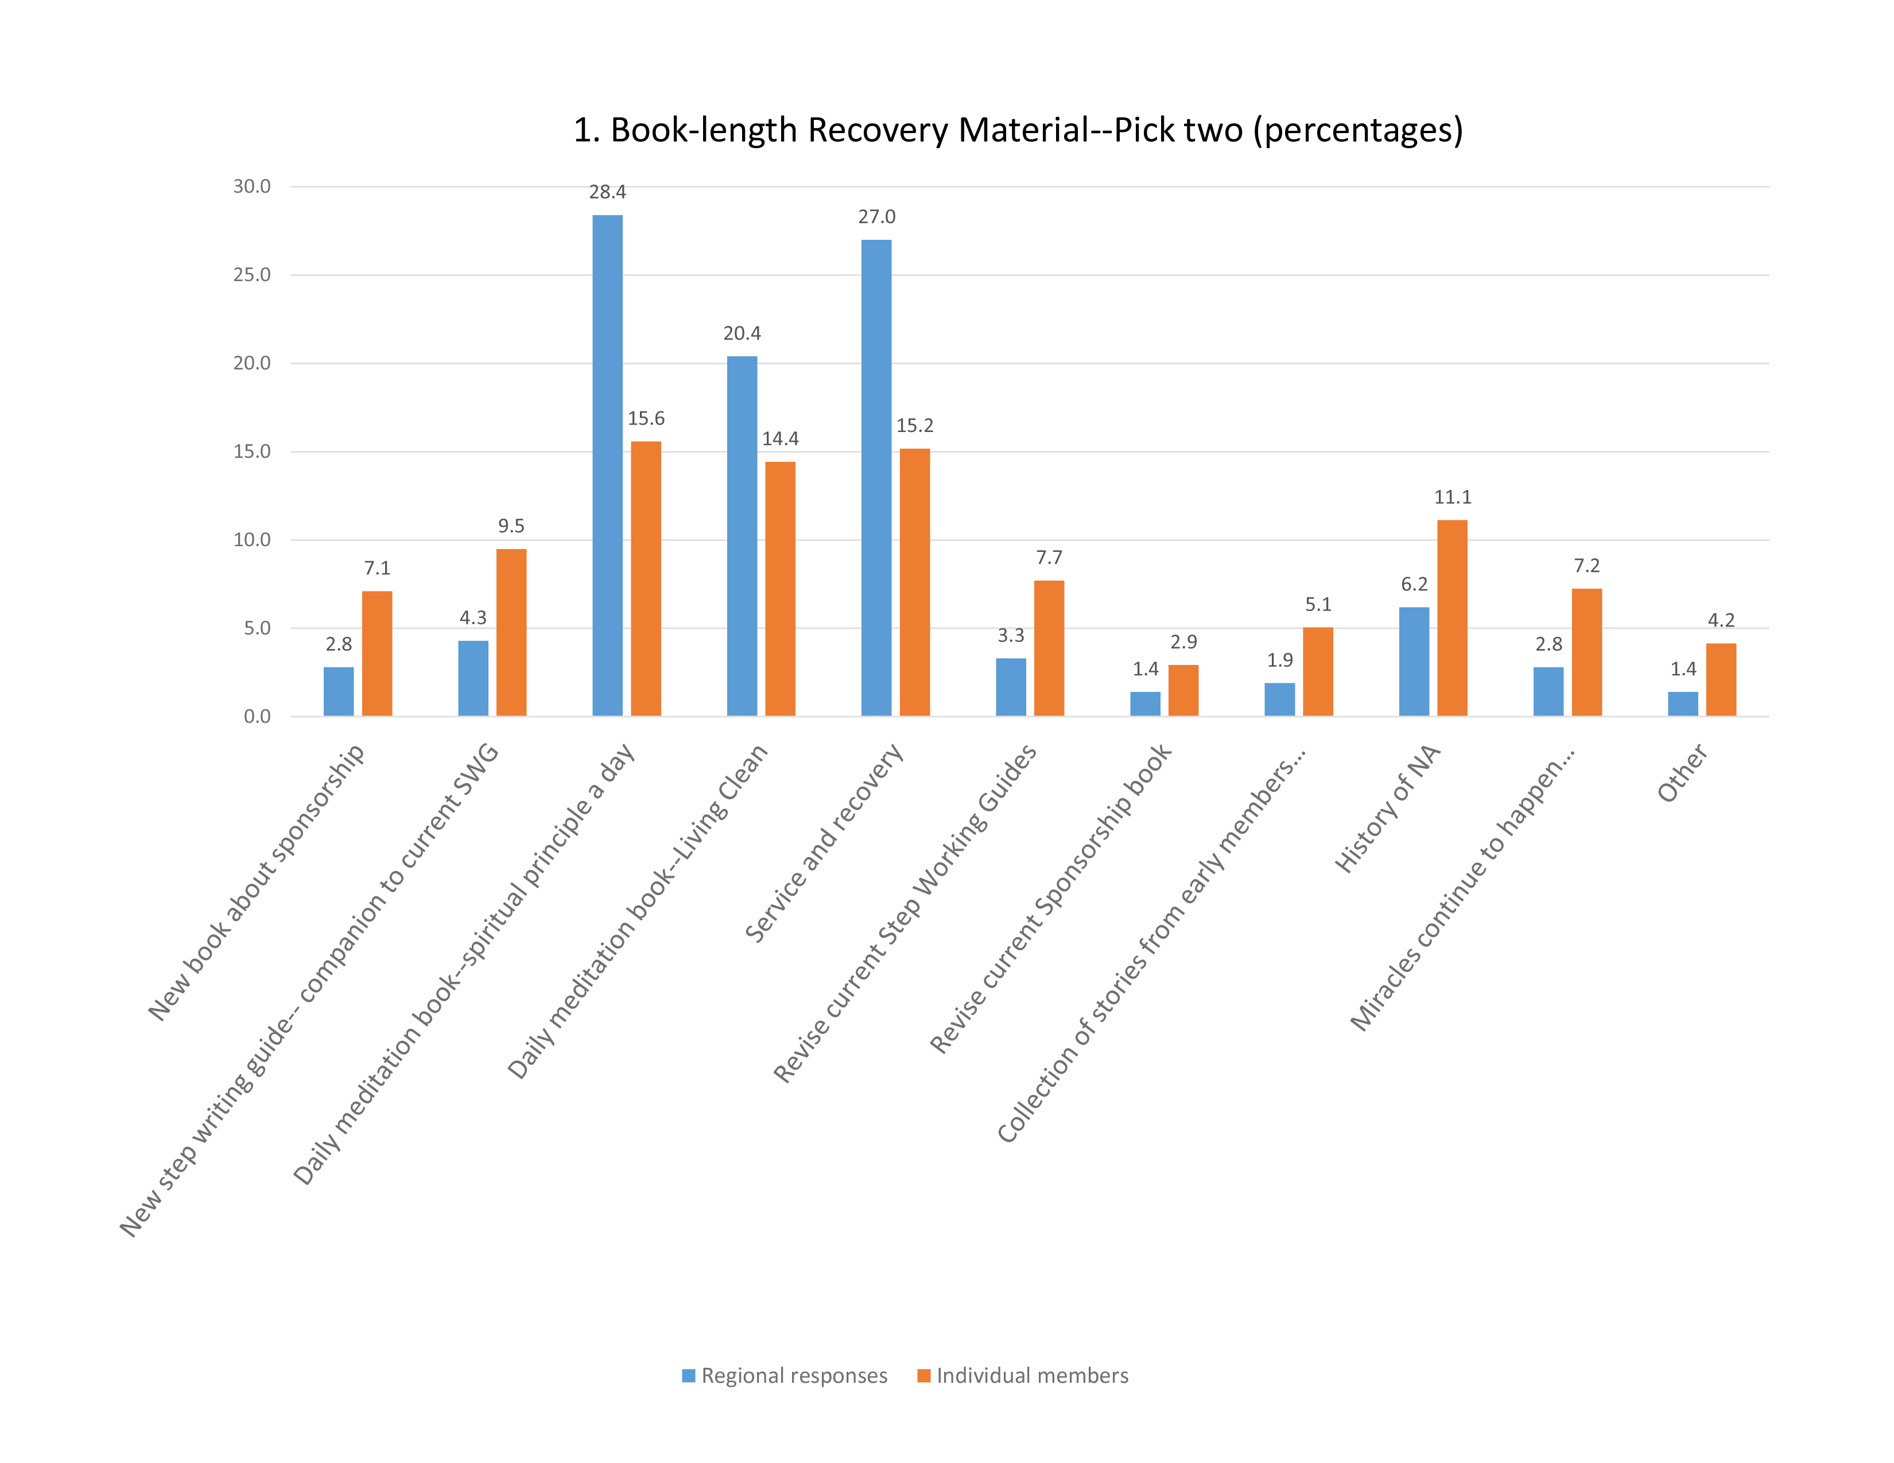
2016 CAR Survey results
Notes:
The background of the project and process of creating the draft is described in full in the essay in the ICC. We encourage you to review that material. Here are some of the main points.
The idea for a project to create the book came from the survey contained in the 2016 CAR that was designed to help conference participants establish priorities for new literature, service material, and Issue Discussion Topics. In 2016, the highest rated of the ten options for book-length recovery material in the survey was “Daily meditation book—spiritual principle a day.” Another option for a daily meditation book based on Living Clean also scored very high.
After discussing the survey results with participants at the 2016 WSC, the Fellowship was surveyed about their preferences for a new daily meditation book. All NA literature is written “by addicts, for addicts.” The results of this survey helped to frame the project plan for the new book that was included in the 2018 Conference Approval Track material and presented at WSC 2018.

Slide 11
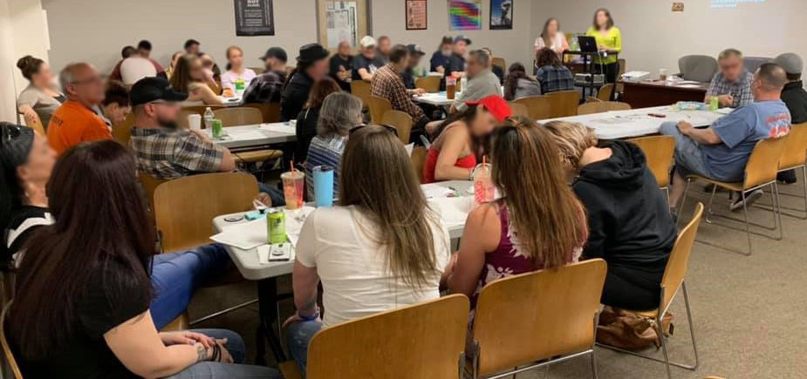
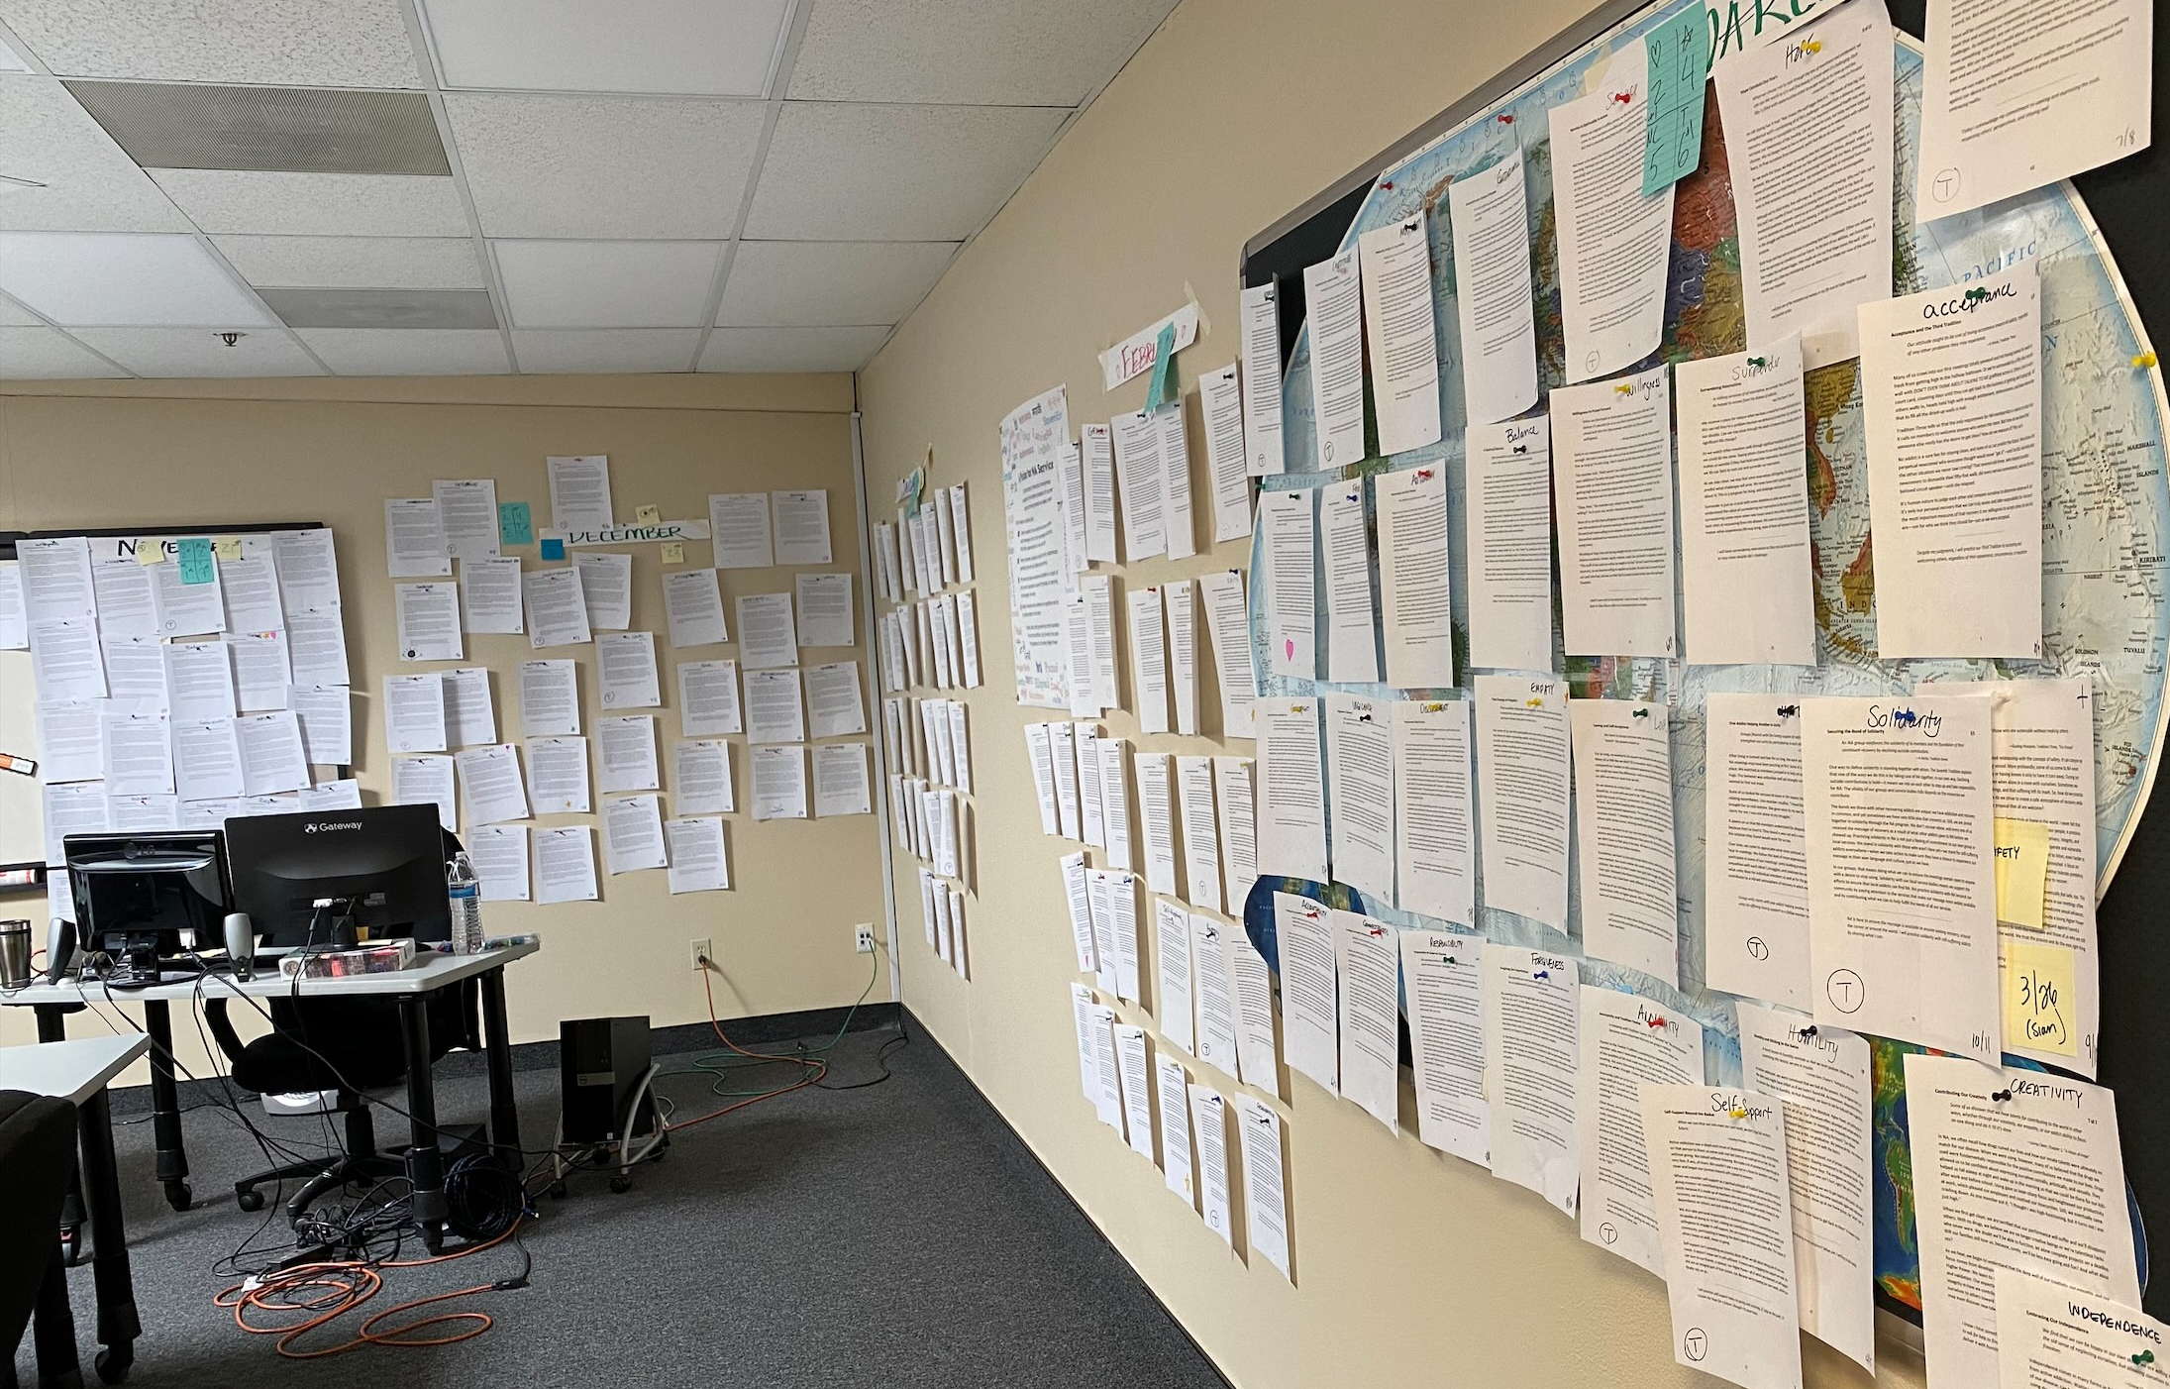
SPAD workshop, Northern New England Region
Putting all of the entries together
Notes:
The SPAD project was approved at WSC 2018, and a workgroup of nine members from around the world, plus a World Board member, and a number of staff people quickly began work.
Typically, World Services workgroups have a board member acting as a point person. In the case of SPAD, the point person was MaryEllen P. Tragically, she passed away during the project. We are so grateful for her service.
Part of the miracle of this book draft is that the work continued despite the global lockdown and subsequent financial crisis that began in March 2020. The final in-person meeting of the workgroup took place just as the world was shutting down, and the board member who was then the point person, Hammed, got stuck in Los Angeles at the close of the meeting. It took him 62 days to get home to Kuwait.
By the time the project was again approved at the 2020 WSC, two batches of entries had been drafted and reviewed by the Fellowship. Members around the world continued to submit advance material, the workgroup continued to meet to shape this material into individual entries, and the Fellowship continued to review drafts and provide input. All of this work happened virtually and with drastically reduced staff numbers.

Slide 12
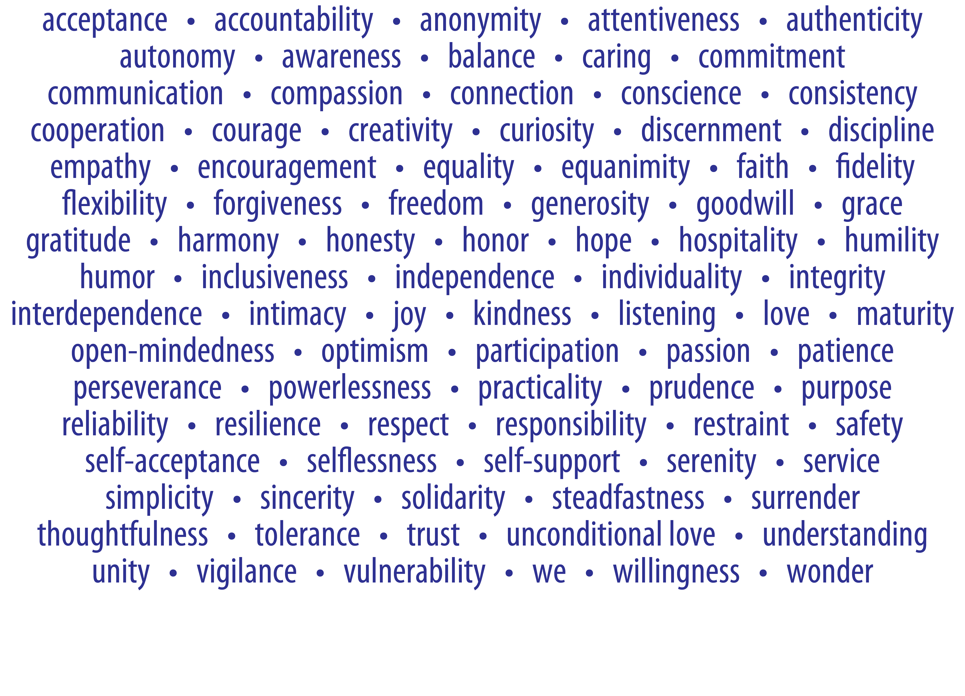
SPAD contains entries on 89 spiritual principles
Notes:
The book contains entries on 89 spiritual principles. Over 98 percent of the members who responded to the survey about the project wanted the book to be similar in format to Just for Today—quotation, elaboration, reflection, and input during review reinforced that approach. Review and input drafts of the material were released in six batches for 90 days at a time. Input was received from dozens of countries on every continent except Antarctica.

Slide 13
SPAD workgroup set of standards
be realistic, relatable, and inclusive
hit different notes and have different functions
tug at our heartstrings
expand understanding
help us laugh at ourselves
Pause
for discussion
Notes:
Early on, the workgroup developed a set of standards for the entries that seem almost like words to live by. The workgroup believed that entries should not be agenda-driven, or be too sweet, precious, righteous, or otherwise cause eyes to roll. And that entries should:
be realistic, relatable, and inclusive
hit different notes and have different functions
tug at our heartstrings
expand understanding
and help us laugh at ourselves.
We hope you feel all of that when you read the draft.

Slide 14
Other PowerPoints and videos available online
ICC and SPAD draft can be downloaded. Hard copies of SPAD draft can be ordered from NA World Services
www.na.org/conference
worldboard@na.org
Notes:
We hope this PowerPoint has helped in your discussion of this material. Please note that there are other PowerPoints that focus on other ICC content. These resources are available online at www.na.org/conference.
We welcome your questions and your feedback at worldboard@na.org.

