Slide 1
This is the fifth of five PowerPoints covering material in the 2018 Conference Agenda Report
NAWS Strategic Plan
CAR Survey
Notes:
This is the fifth of five videos covering material in the 2018 Conference Agenda Report (or CAR for short).

Slide 2
2018 CAR PowerPoints
Introduction to CAR, Motions 1-6—literature and products
Fellowship Intellectual Property Trust, Motions 7 & 8
Motions 9-14—DRT/MAT, special events, and IDTs
Future of the WSC, Motions 15-25—role of zones, zonal seating, and other WSC issues
NAWS Strategic Plan and CAR survey
Notes:
This video covers the NAWS Strategic Plan and the CAR Survey

Slide 3
2018 CAR PowerPoints
These PowerPoints only cover the main points of the CAR. We encourage all members to read the CAR itself for complete information and essays.
Please visit www.na.org/conference for the 2018 CAR, the other PowerPoints, and other Conference materials.
Notes:
These videos only cover the main points of the CAR. We encourage all members to read the CAR itself. Please visit www.na.org/conference for the complete 2018 CAR and the other videos.

Slide 4
NA World Services Strategic Plan
Notes:
First we are going to briefly talk about the strategic plan.

Slide 5
The Strategic Plan
Addresses changes and improvements
Is updated every two years
Is inspired by A Vision for NA Service
Guides efforts toward long-term goals
Notes:
Much of the work of NA World Services remains relatively consistent from year to year, and is not specifically outlined in the plan. The NAWS Strategic Plan addresses activity related to changes and improvements and is updated each cycle. It is inspired by A Vision for NA Service, and guides our efforts toward long-term goals.

Slide 6
Making a plan…
Input from several sources:
Discussion at past WSC
Interactions with members around the world
Correspondence with NA members
Factors within and outside of NA that may affect us
Relationships with the public and outside organizations
Effectiveness of groups and service bodies
Notes:
Input from several sources influences the development of the strategic plan. These include Conference discussions and communications with NA members and service bodies. We also look at factors within and outside NA that may affect us, such as our external relationships and the effectiveness of NA groups and service bodies.

Slide 7
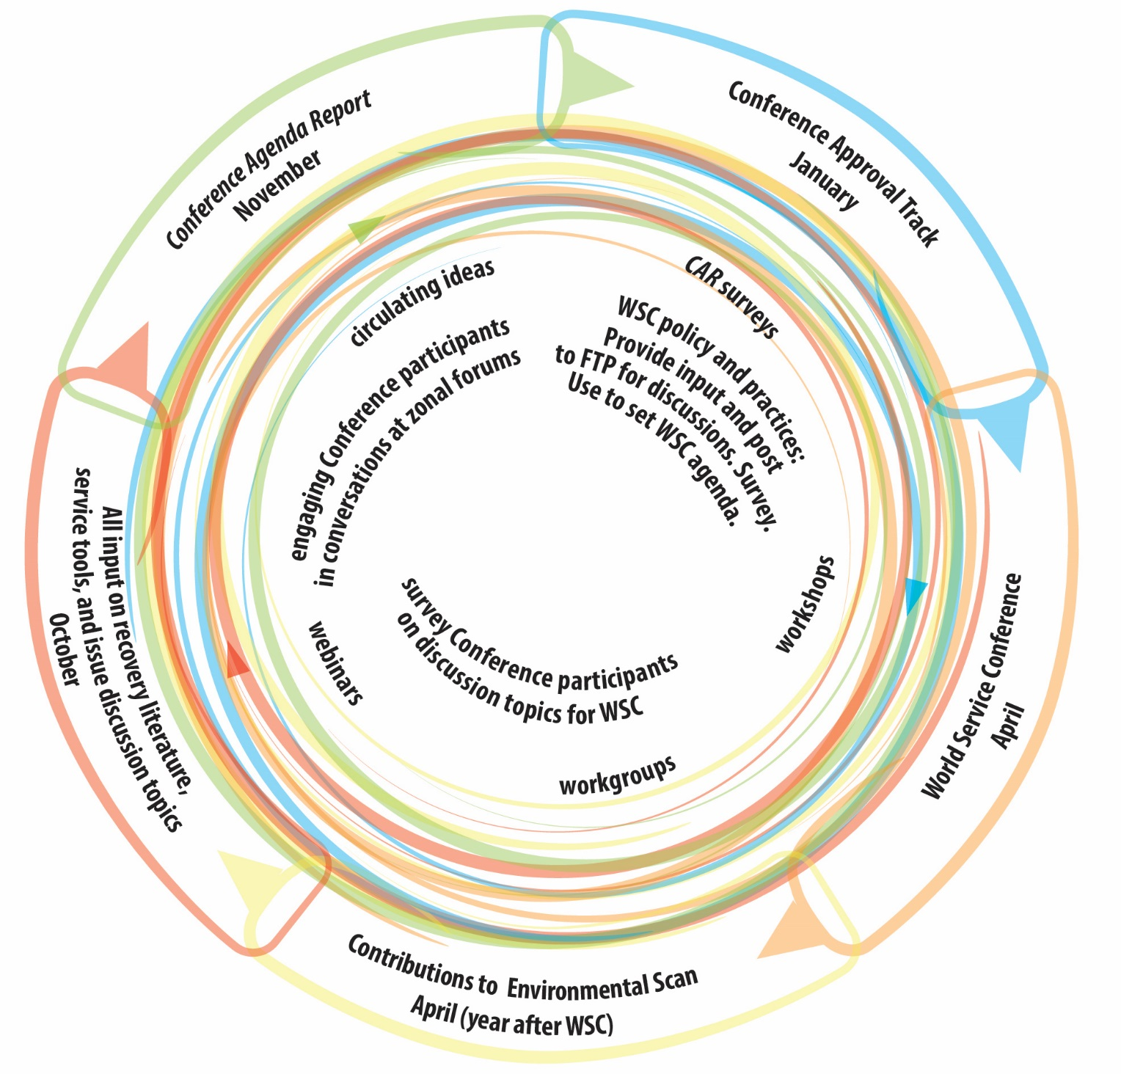
Collaborative Strategic Planning Process
Creating the strategic plan:
Environmental scan
Objectives and strategies
Project plans and budgets
Conference Approval Material
Always more work than we can achieve
Notes:
This diagram from the first Future of the WSC report represents our collaborative strategic planning process. It is an ongoing, interactive process throughout each two-year cycle with many opportunities for input from members, trusted servants, and service bodies around the world. The report can be found online here www.na.org/future.
The strategic plan starts with an environmental scan. This past cycle, for the first time, we distributed a survey asking regions to help us map the trends the plan should address. The scan data helps to determine goals for the upcoming cycle, which are the plan’s objectives. The strategies to achieve these objectives are used to create project plans, which are distributed with the Conference Approval Track material for review.
The strategic plan always contains more goals than we know we can achieve in a cycle, and usually there are more projects proposed than we expect to complete. This allows flexibility to utilize resources where and when they are available while still remaining accountable to the Fellowship.

Slide 8
2016-2018 Strategic Plan: “Develop new recovery literature and/or revise existing literature to meet Fellowship needs.”
Publish Guiding Principles: The Spirit of Our Traditions Accomplished with approval and publishing of Guiding Principles
Identify and pursue recovery literature priorities based on the results of the 2016 CAR Fellowship survey Meditation book and mental health/mental illness IP project plans will be included in 2018 Conference Approval Track Material for consideration by WSC 2018
Notes:
An example of this process is the objective included in the 2016–2018 Strategic Plan to “Develop new recovery literature and/or revise existing literature to meet Fellowship needs.” The two strategies to work toward that objective were:
To publish Guiding Principles: The Spirit of Our Traditions, and
To identify and pursue development of recovery literature priorities based on the results of the 2016 CAR Fellowship survey on recovery literature.
This first strategy was accomplished when the 2016 World Service Conference approved Guiding Principles and the book was published a few months later.
The second strategy describes a broader goal. At the 2016 WSC, delegates decided to focus on framing two projects with the highest priority in the survey—a new meditation book and an IP on recovery and mental health/mental illness. To prepare those project plans during this two-year cycle we collected thousands of pieces of input from NA members around the world about these potential pieces of literature. The input will help us frame the project plans and the focus of the pieces, and will provide some material to begin a draft. These project plans will be included in the 2018 CAT material for consideration by the 2018 WSC. If those project plans are approved, work will begin drafting the texts during the 2018-2020 cycle.

Slide 9
Environmental
Scan
internal
external
Objectives
goals
next 2 years
Strategies
approaches to accomplish goals
Project Plans
CAT
WSC decision
Notes:
In short, the strategic planning process looks like this:
We begin with the environmental scan, which helps us develop objectives for the next two years, along with strategies to work toward those objectives. From there, we develop project plans to organize the work. The project plans are included in the Conference Approval Track materials, which are reviewed and voted on by the World Service Conference.

Slide 10
Thank You!
We are grateful for thoughtful input from members and service bodies around the world to help frame the NAWS Strategic Plan.
Your participation ensures that we are working toward the goals that are most important to the Fellowship, and toward achieving A Vision for NA Service.
Notes:
We are grateful for the thoughtful input from members and service bodies around the world that helps to frame the World Services Strategic Plan. Your participation ensures that we are working toward the goals that are most important to the Fellowship, and toward achieving A Vision for NA Service.
.

Slide 11
Literature, Service Material, and Issue Discussion Topics Survey
Notes:
Let’s move on now to the CAR survey covering literature, service material, and issue discussion topics.
In 2016, we included a survey in the Conference Agenda Report to help set priorities for recovery literature, service material, and Issue Discussion Topics (or IDTs). The survey results helped the 2016 Conference select IDTs and focus the recovery literature and service material projects it approved. The 2016 survey was such an effective way to get this input from the Fellowship that we have included another survey in the 2018 CAR.

Slide 12
How was the survey developed?
Many ideas from Conference participants and from members
Regional input to our strategic planning process
Emails and calls to World Services
Workshop results
Conversations with Board members
Conference participant input on the draft of this survey
Notes:
This survey is longer than the previous one because we received so many ideas from Conference participants for what should be on the list. We also received helpful ideas through regional input to our strategic planning process, emails and calls to World Services, workshop results, conversations with Board members, and Conference participant input on an initial draft of the survey.

Slide 13
How can the survey help?
Tells us what the Fellowship believes are priorities for new recovery literature and/or service material
2016 WSC reviewed CAR survey results, and decided to frame
Two literature projects with highest priority—a new meditation book, and an IP on recovery and mental health/mental illness
Service material projects for conventions and events, and local service tools
Notes:
The CAR survey is a way for the Fellowship to tell us what it believes are priorities for new recovery literature and/or service material. Items that gain traction—like a new meditation book and an IP on mental health/mental illness in 2016—may get WSC approval for the next steps. This might involve collecting front-end input through surveys or web meetings to shape a project plan for consideration at WSC 2020.

Slide 14
Recovery Literature Survey
Unless otherwise directed by WSC 2018, we plan to prioritize work on focuses agreed upon by WSC 2016:
A meditation book
An IP on mental health/mental illness
These survey results will help prioritize possible future work/project plans.
Please choose at least one, but no more than two from the list
This survey begins on page 32 of the 2018 CAR and is available to complete online at www.na.org/conference
Notes:
Unless otherwise directed by WSC 2018, during the upcoming cycle we plan to prioritize work on the focuses agreed upon by WSC 2016: a meditation book and an IP on mental health/mental illness. The results of the 2018 CAR survey will help prioritize possible future work and project plans.
Please choose at least one, but no more than two from the list. The Recovery Literature Survey begins on page 32 of the 2018 CAR and is also available at www.na.org/conference.

Slide 15
Recovery Literature Survey
Literature targeted to: Younger members
Literature targeted to: Older members
Literature targeted to: Experienced members/“oldtimers”
Literature targeted to: LGBTQ members
Literature targeted to: Women in recovery
Literature targeted to: First nations/indigenous members
Literature targeted to: Members who are professionals
Literature targeted to: Members who are veterans
Literature targeted to: Atheists and members with non-mainstream spiritual beliefs
An IP: Regardless of age, race, sex, sexual identity, creed, religion, or lack of religion
What does it mean that NA is a spiritual, not religious, program?
Revise the Sponsorship book
Revise The Loner
Revise H&I Service and the NA Member
Revise PI and the NA Member
Revise another piece of NA literature:
Other:
No new recovery lit
Adapt Social Media and Our Guiding Principles to an IP from an SP
An IP for members: NA and addicts on DRT/MAT
Booklet of Step study questions taken from “How It Works” in the Basic Text
Booklet of Step study questions from It Works: How and Why and/or Living Clean
Step working booklet focused mainly on Steps 1–3 aimed primarily for new members and those in treatment and drug courts
Step working guide aimed at members not new to the Steps, as a follow-up set of Steps
Concepts book similar to Guiding Principles
List and definition of spiritual principles
The spiritual benefits of service
Members’ experience, strength, and hope on trustworthiness and trusting
Atmosphere of recovery in service
Appropriate meeting behavior
Pamphlet on the First Tradition
Notes:
This is the full list of items in the recovery literature section of the survey. Again, we encourage you to share your ideas.
Recovery Literature Survey
Adapt Social Media and Our Guiding Principles to an IP from an SP
An IP for members: NA and addicts on DRT/MAT
Booklet of Step study questions taken from “How It Works” in the Basic Text
Booklet of Step study questions from It Works: How and Why and/or Living Clean
Step working booklet focused mainly on Steps 1–3 aimed primarily for new members and those in treatment and drug courts
Step working guide aimed at members not new to the Steps, as a follow-up set of Steps
Concepts book similar to Guiding Principles
List and definition of spiritual principles
The spiritual benefits of service
Members’ experience, strength, and hope on trustworthiness and trusting
Atmosphere of recovery in service
Appropriate meeting behavior
Pamphlet on the First Tradition
Literature targeted to: Younger members
Literature targeted to: Older members
Literature targeted to: Experienced members/“oldtimers”
Literature targeted to: LGBTQ members
Literature targeted to: Women in recovery
Literature targeted to: First nations/indigenous members
Literature targeted to: Members who are professionals
Literature targeted to: Members who are veterans
Literature targeted to: Atheists and members with non-mainstream spiritual beliefs
An IP: Regardless of age, race, sex, sexual identity, creed, religion, or lack of religion
What does it mean that NA is a spiritual, not religious, program?
Revise the Sponsorship book
Revise The Loner
Revise H&I Service and the NA Member
Revise PI and the NA Member
Revise another piece of NA literature:
Other:
No new recovery lit

Slide 16
Service Material Survey
Work is currently underway on two service material project focuses agreed upon by WSC 2016:
Local Service Toolbox
Conventions and Events Toolbox
These survey results will help prioritize possible future work/project plans. Most of the items in this survey could easily fit into a Local Service Toolbox.
Please choose at least one, but no more than two from the list
This survey begins on page 33 of the 2018 CAR and is available to complete online at www.na.org/conference
Notes:
Work is currently underway on two service material project focuses agreed upon by WSC 2016:
Local Service Toolbox
Conventions and Events Toolbox
The results of the current survey will help prioritize possible future work or project plans. Most of the items in this survey could easily fit into a Local Service Toolbox along with the two pieces already in development.
Please choose at least one, but no more than two from the list. This survey begins on page 33 of the 2018 CAR and is available to complete online at www.na.org/conference.

Slide 17
Service Material Survey
Regional inventory process/questions
Description of service commitments at areas and regions [Note: We already have a service pamphlet on group trusted servants. If this piece is prioritized, it might make sense to somehow combine this information.]
Effective report writing
GSR orientation material
Literature on mentorship, including as it relates to service bodies and new meetings
Service system basics
Local service conference and local service board basics
Role of zones in the service structure
Policy in NA—different kinds of policy styles and approaches
Information for creating legal entities/incorporating
The Fellowship Intellectual Property Trust (FIPT) and local websites
Dealing with banks and government financial regulations
Dealing with misappropriation of NA funds
Area treasurers’ basics
Area budgeting basics
Revise Translation Basics
Revise and update PR Handbook
Other:
Carrying the NA message
Principles in service
Atmosphere of recovery in service
Applying the Concepts—videos of members sharing in their own words how they applied each Concept
What is NA World Services and how does it work?
Our public image: dealing with loss of confidence in NA
More social media guidelines above and beyond the service pamphlet
More short, focused PR resources
Tools to assist PR efforts to reach the medical community
Literature for justice department professionals/referrers
Sponsorship behind the walls basics
Fellowship development basics
FD—it’s not just something that happens “somewhere else”
Collaborating among service bodies
When service bodies split or reunify
How to hold a virtual service meeting
Facilitation basics
How to plan a learning day
Best practices for service workshops
How to put on a planning assembly (including sample agendas)
Getting started with project-based services
Revise Planning Basics
Notes:
This is the full list of items in the service material section of the survey. We look forward to seeing your thoughts.
Service Material Survey
Carrying the NA message
Principles in service
Atmosphere of recovery in service
Applying the Concepts—videos of members sharing in their own words how they
applied each Concept
What is NA World Services and how does it work?
Our public image: dealing with loss of confidence in NA
More social media guidelines above and beyond the service pamphlet
More short, focused PR resources
Tools to assist PR efforts to reach the medical community
Literature for justice department professionals/referrers
Sponsorship behind the walls basics
Fellowship development basics
FD—it’s not just something that happens “somewhere else”
Collaborating among service bodies
When service bodies split or reunify
How to hold a virtual service meeting
Facilitation basics
How to plan a learning day
Best practices for service workshops
How to put on a planning assembly (including sample agendas)
Getting started with project-based services
Revise Planning Basics
Regional inventory process/questions
Description of service commitments at areas and regions [Note: We already have a service pamphlet on group trusted servants. If this piece is prioritized, it might make sense to somehow combine this information.]
Effective report writing
GSR orientation material
Literature on mentorship, including as it relates to service bodies and new meetings
Service system basics
Local service conference and local service board basics
Role of zones in the service structure
Policy in NA—different kinds of policy styles and approaches
Information for creating legal entities/incorporating
The Fellowship Intellectual Property Trust (FIPT) and local websites
Dealing with banks and government financial regulations
Dealing with misappropriation of NA funds
Area treasurers’ basics
Area budgeting basics
Revise Translation Basics
Revise and update PR Handbook
Other:

Slide 18
Issue Discussion Topics Survey
Issues that are discussed throughout the Fellowship for two years between World Service Conferences
Results of your IDT workshops and discussions can help create the foundation for service pamphlets and other tools and literature
These survey results will help decide the 2018-2020 IDTs
Please choose at least one, but no more than two from the list
This survey begins on page 34 of the 2018 CAR and is available to complete online at www.na.org/conference.
Notes:
Issue Discussion Topics are subjects of interest to the NA Fellowship that are discussed throughout the Fellowship for the two years between Conferences. The results of IDT workshops and discussions can help to create the foundation for service pamphlets and other tools and literature. These survey results will help delegates decide on the Issue Discussion Topics for the 2018-2020.
Please choose at least one, but no more than two from the list. This survey begins on page 34 of the 2018 CAR and is available to complete online at www.na.org/conference.

Slide 19
IDTs Survey
Our Symbol—a closer look
Group conscience
Carrying the NA message and making NA attractive
Remaining nonprofessional and carrying the NA message
PR 101
Simplicity and flexibility in service
Empathy in service
Attracting members to service
Getting youth and newcomers involved
Becoming a better sponsor
Creating community in NA
Mentorship and how members learn in service
Leadership in NA
The integrity and effectiveness of our communications
Eleventh Concept
Respecting our differences and building our unity
Regardless of . . . race, ethnicity, culture
Retaining members
In Times of Illness and what our literature says about illness and medication
Other:
Notes:
This is the full list of topics in the final section of the 2018 CAR survey. We look forward to seeing your priorities for discussions in the upcoming cycle.
IDTs Survey:
Our Symbol—a closer look
Group conscience
Carrying the NA message and making NA attractive
Remaining nonprofessional and carrying the NA message
PR 101
Simplicity and flexibility in service
Empathy in service
Attracting members to service
Getting youth and newcomers involved
Becoming a better sponsor
Creating community in NA
Mentorship and how members learn in service
Leadership in NA
The integrity and effectiveness of our communications
Eleventh Concept
Respecting our differences and building our unity
Regardless of . . . race, ethnicity, culture
Retaining members
In Times of Illness and what our literature says about illness and medication
Other:

Slide 20
Four other PowerPoints available online
Surveys available online
CAR can be downloaded or hard copies ordered from NA World Services
www.na.org/conference
worldboard@na.org
Notes:
We hope this video has helped in your discussion of this material. Please note that there are four other videos that focus on other CAR contents. These videos, the Conference Agenda Report, and the CAR survey are available online at www.na.org/conference. Hard copies of the CAR may be purchased from NA World Services.
We welcome your questions and your feedback on these videos, the CAR, and all other issues at worldboard@na.org.

