Slide 1
The Service System Proposals
Introduction & Background
Group Support Forums
Local Service Conferences
2014 World Service Conference
More information: www.na.org/servicesystem

Slide 2
2014 Conference Agenda Report
The Service System Proposals
This is the third of three videos covering the material in the 2014 Conference Agenda Report.
Please visit www.na.org/conference to download all three videos and access any other conference material.

Slide 3
Background: Underpinning Principles
Group support
Planning
Collective decision-making
Adaptable:
Field testing is offering shared experiences so communities can adapt to fit local needs.

Slide 4
Background: Project Origins
Grew from the need to address struggles NA service bodies have reported, like:
Too few trusted servants
Poor atmosphere of recovery at service meetings
Duplication of efforts
Poor communication…

Slide 5
Background: Where to start?
Our Traditions & Concepts
A shared vision
A Vision for NA Service approved by 2010 WSC

Slide 6
Background: Our Primary Purpose
Everything that occurs in the course of NA service must be motivated by the desire to more successfully carry the NA message to the addict who still suffers.
Basic Text

Slide 7
Background: Our Primary Purpose
Our Fifth Tradition: to support the groups in achieving their primary purpose
Proposed: A forum to support the groups

Slide 8
Group Support Forums (GSFs)

Slide 9
GSFs: Group-focused
Discuss group problems & successes
The service equivalent of one addict helping another
Share introductory or basic information about NA
How the NA service system works

Slide 10
GSFs: Group-focused
GSFs might be a place for
Literature distribution
Workshops and training sessions
Planning neighborhood-based activities
Whatever will help the needs of the groups

Slide 11
GSFs: Participants
All interested members attend (not just GSRs)
GSFs are discussion-based gatherings
Newer members can learn about NA
Veteran members can share experience with and mentor newer members

Slide 12
Size of GSFs
May be neighborhood-sized
Less distance to travel
Easier to keep discussion informal
Field testing: some communities prefer a group-focused gathering that includes all groups
Better communication across the whole community
Could achieve this by simply changing the focus of area service committee meetings.

Slide 13
GSFs: Representation & Delegation
Some group support forums have a delegate who attends & reports on the groups at the local service conference.
GSRs can attend the local service conference or delegate that responsibility to the GSF delegate
Flexibility is one of the foundational principles of the proposals.

Slide 14
Local Service Conferences (LSCs)
Group
focused
Flexible
Purpose
driven
Collaborative
Geographically based

Slide 15
Local Service Conferences (LSCs)
According to the proposals:
Quarterly, plan-driven meetings
Attended by
All GSRs and/or GSF delegates
Trusted servants of the LSC
All interested members
The annual assembly
Attended by all interested local members
Prioritize service for the year ahead
Ensures that the groups set the direction of services
Communication, oversight, and selection of leaders

Slide 16
LSCs: Delegation & Responsibility
Strategic direction and oversight
Administrative decisions & details delegated to the local service board (LSB)
Third Concept delegation
Second Concept responsibility
and authority

Slide 17
How often do they meet?
Proposals suggest quarterly LSCs, monthly LSBs
Some prefer having all GSRs meet together more frequently
Local service conference meeting preferences are flexible, adaptable by each community

Slide 18
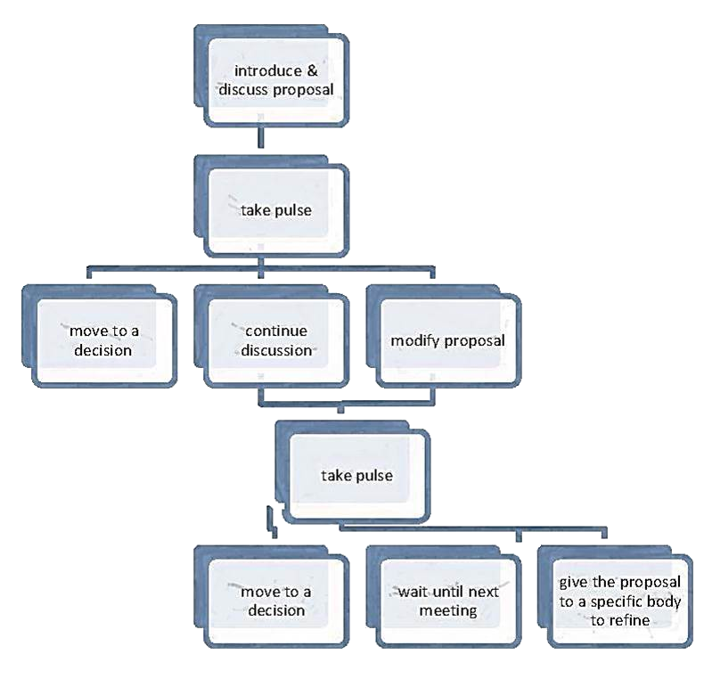
Decision-making
Decision-making is consensus-based where practical
Chart: CBDM Basics, available at www.na.org/servicesystem

Slide 19
Local Service Boards (LSBs)
Does the day-to-day work to accomplish the goals and realize vision of the local service conference
Administers the work prioritized by the local service conference annual planning assembly
The local service conference participants are the architects; the local service board members are the builders and contractors

Slide 20
LSBs: Accountability
Reports to and is overseen by the local service conference
Creates plans and a budget, which are approved at the local service conference
Service may be accomplished by workgroups led by coordinators or committees
LSC decides based on board’s recommendations
Form follows function

Slide 21
A purpose-driven system
The service system proposals suggest:
Group issues handled at group support forum
Strategic decisions & general oversight handled at local service conference
Day-to-day administration handled by local
service board

Slide 22
Geographic boundaries
US: county, town, or city
In order to:
Avoid duplication of services
Ensure all parts of a state or nation are covered by a service body
Make NA more visible and enhance PR efforts

Slide 23
Communication&Collaboration
Unifying with neighboring areas can be daunting
Most crucial is better communication & collaboration with our neighbors & possible unification in the future
Open communication with neighboring service bodies & bring trusted servants together
Consider sharing services between neighboring service bodies

Slide 24
Evolution, not revolution
Change is difficult.
Take it
We must realize that we are not perfect. There will always be room for growth.
Basic Text
slow.

Slide 25
2014 World Service Conference
Conference Agenda Report
Conference Approval Track materials

Slide 26
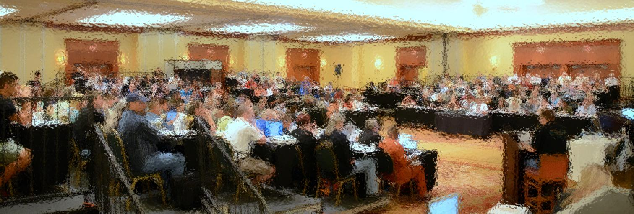
2014 World Service Conference
Decisions:
Whether to agree in principle to move forward with group support forums, local service conferences, and local service boards
Presented as motions in the Conference Agenda Report

Slide 27
Motion 4: Group Support Forums
Motion 4: To agree in principle to move in the direction of a service system that contains group support forums: discussion oriented gatherings focused on the needs of the group, as described by the characteristics below.
Discussion-oriented
Group-focused
Training-oriented
Open to all
Neighborhood-sized (recommended)
Meets monthly (recommended)

Slide 28
Optional
Pause
for
Discussion

Slide 29
Motion 5: Local Service Conferences
Motion 5: To agree in principle to move in the direction of a service system that contains local service conferences, strategic service oriented planning conferences as described by the characteristics below.
Plan-driven
Form follows function
Strategic
Consensus-based
Meets quarterly (recommended)
Defined by county, city, or town boundaries (recommended)

Slide 30
Optional
Pause
for
Discussion

Slide 31
Motion 6: Local Service Boards
Motion 6: To agree in principle to move in the direction of a service system that contains local service boards, a body overseen by the local service conference that administers the work prioritized by the LSC, as described in the characteristics below.
Responsible to the local service conference
Carries out the LSC’s priorities
Meets monthly (recommended)
Consist of administrative body and service coordinators (recommended)

Slide 32
Optional
Pause
for
Discussion

Slide 33
Why these motions?
Normally these ideas wouldn’t be in the form of a motion until there is written material to adopt, but these motions are offered in the spirit of unity.
These motions are not a mandate. World Services has no ability to mandate or enforce how services are delivered locally, nor do we desire such ability.
World Services’ purpose is “communication, coordination, information, and guidance.” It is in the service of that purpose that we have undertaken the work of the Service System Project.

Slide 34
Conference Approval Track (CAT) Material
(CAT)
If the CAR motions are approved, WSC will vote on a transition plan (which will be included in the Conference Approval Track material)

Slide 35
Ongoing Service System Discussions
Ideas that are still being discussed, but will not be decided on at WSC 2014:
State-, province-, or nationwide service bodies
World Service Conference seating
The role of zones

Slide 36
Questions Feedback Ideas Additional Information
worldboard@na.org
servicesystem@na.org
www.na.org/servicesystem
Download the Conference Agenda Report: www.na.org/conference
or order hard copies from NA World Services

