Slide 1
We welcome your feedback at worldboard@na.org

Slide 2
2014 Conference Agenda Report
World Board Motions
This is the first of three videos covering the material in the 2014 Conference Agenda Report.
Please visit www.na.org/conference to download all three videos and access any other conference material.

Slide 3
2014 Conference Agenda Report
World Board Motions
Download the CAR free at www.na.org/conference or order by mail ($8) from NA World Services

Slide 4
World Board Motions
Motion 1: An Introduction to NA Meetings IP
Motions 2 & 3: WSC future – delegate funding and alternate delegate attendance
Motions 4-6: Service System Project
The CAR contains six motions from the World Board. This video covers three of those motions.
Service System motions are discussed in a separate video available at www.na.org/conference

Slide 5
Motion 1: IP Approval
Motion 1 is about approving the draft of An Introduction to NA Meetings.

Slide 6
Motion 1: An Introduction to NA Meetings
Available since 2008 as a service pamphlet
Published in six languages
Originally intended for professionals to give to addicts
Seems better suited as an IP

Slide 7
Motion 1: An Introduction to NA Meetings
Four-month review and input period
from members and service committees
19 US states and 4 other countries
Positive input with helpful suggestions
These changes are reflected in the draft in Addendum A.

Slide 8
Motion 1
To approve the draft contained in Addendum A as IP #29, An Introduction to NA Meetings.
Intent: To approve this IP for use in the Fellowship.

Slide 9
Optional
Pause
for
Discussion

Slide 10
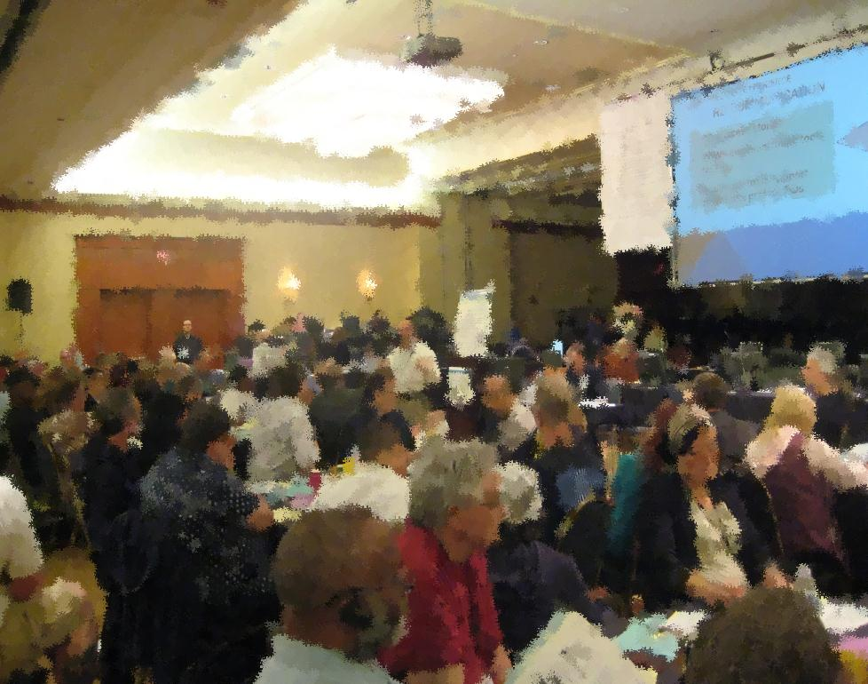
Motion 2: Future of the WSC
Motion 2 is about alternate delegate attendance at the WSC.

Slide 11
Motion 2: WSC Challenges
The desire for more equitable global representation
The size of the Conference and the difficulty discussing issues in a group this large
The cost to the Fellowship

Slide 12
Motion 2: WSC Challenges
World Services restructured in 1998, but we still have no consensus about WSC changes.
The Fellowship spent approximately $168,000 to have alternate delegates attend WSC 2012.

Slide 13
Motion 2: WSC Challenges
Current size makes it difficult to develop consensus in small group sessions
115 seated regions = 209 participants at WSC 2012
Adopting this motion would decrease small group sessions from 209 to 133 participants.

Slide 14
Motion 2: Alternate Attendance
WSC 2012
91% of US regions sent alternates
48% of non-US regions sent alternates

Slide 15
Motion 2: RDs who were ADs
Percentage of delegates who attended the previous WSC as alternates*
 | Total | Non-US | US
2006 | 35% | 19% | 42%
2008 | 47% | 42% | 50%
2010 | 47% | 34% | 55%
2012 | 37% | 23% | 47%
*Delegates who were alternates at previous WSC, not those serving 2-cycle terms or who attended an earlier WSC as an alternate

Slide 16
Motion 2
To adopt the following as WSC policy: “Seating at the biennial meeting of the WSC is limited to one delegate per region.”
Intent: To reduce the size and cost of the WSC and create an environment more conducive to discussion based decision making.

Slide 17
Optional
Pause
for
Discussion

Slide 18
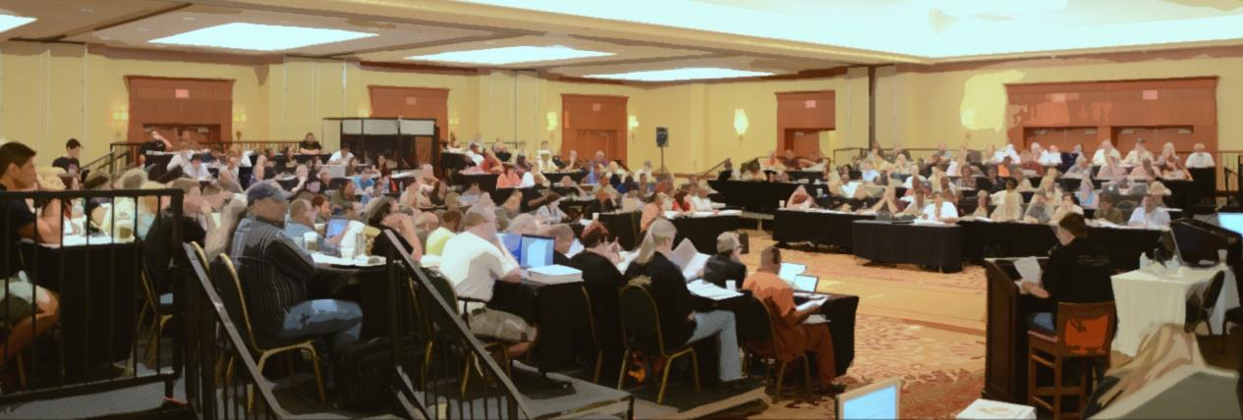
Motion 3: Future of the WSC
Motion 3 is about the funding
of delegates to the WSC.

Slide 19
Motion 3: NAWS Funding of RDs
NAWS has funded all delegates to the past six WSCs.
Full funding for all regions was originally intended as a way to equalize costs
Full funding for all participants has not been counterbalanced by an increase in regional contributions to World Services.

Slide 20
Motion 3: Our Collective Responsibility
Many regions could afford to pay for their delegates to attend the Conference.
A small number of regions will still need our collective support to participate.
If this motion passes, we’ll ask that funding requests will include information to demonstrate need.

Slide 21
Motion 3
To adopt the following as WSC policy: “The World Service Conference does not automatically fund attendance of delegates. Delegates from regions that are unable to fully fund themselves may request funding from the World Board.”
Intent: To have NA World Services no longer bear the sole responsibility for funding delegate attendance at the WSC.

Slide 22
Optional
Pause
for
Discussion

Slide 23
2014 Conference Agenda Report
The CAR always contains information beyond motions and proposals

Slide 24
For more information
Download the CAR free at www.na.org/conference or order by mail ($8) from NA World Services
We welcome your feedback! worldboard@na.org

Slide 25
We welcome your feedback at worldboard@na.org

