Slide 1
A Vital Community Resource
Narcotics
Anonymous

Slide 2
Origin of our name – Why “Narcotics?”
Commonly used for all illegal substances at the time of our inception in 1953
N.A. is not a drug-specific program but has universal appeal to all who share the disease of addiction

Slide 3
Historical Background
Adapted from AA; regular NA meetings started in Los Angeles, CA in 1953
Explosive growth coincided with publishing of the book Narcotics Anonymous, in 1983
As of April 2018, there are over 70,000 meetings in 144 countries

Slide 4
What is NA? A Vital Resource
Therapeutic value of one addict helping another — support network
Process for change through the Twelve Steps
Adjunct to treatment professionals in continuing care

Slide 5
The NA Meeting – Primary vehicle for delivering the NA message of recovery
2 or more NA members gathering constitute a meeting
Meetings promote atmosphere of recovery from drug dependence
Members often share their personal experiences with addiction and recovery
Experienced older members support newer members
NA meetings are self supporting by those who choose to contribute (no fees)
Guidelines of how to conduct an NA meeting are available

Slide 6
The NA Meeting – Primary vehicle for delivering the NA message of recovery
NA meetings provide an environment within which people can help one another stop using drugs and learn to live drug free

Slide 7
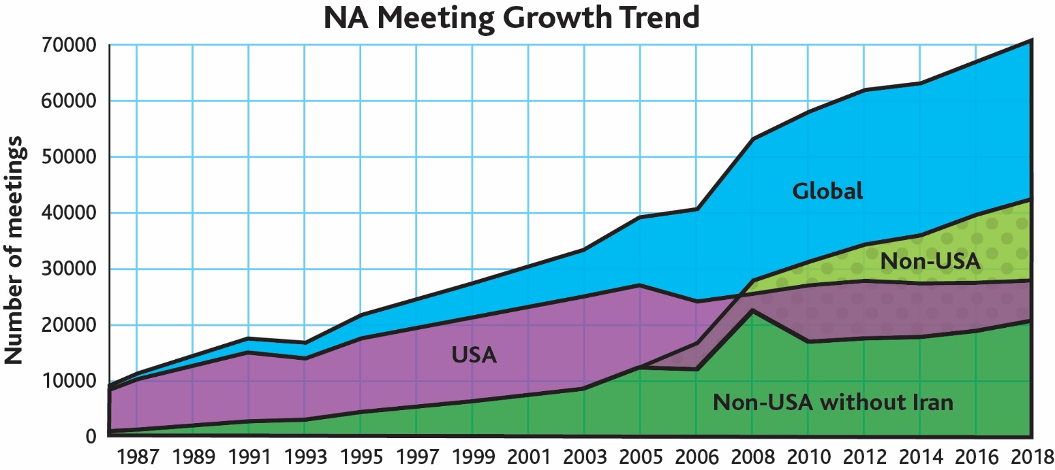
Notes:
NAWS serves the global NA Fellowship, as the meeting data represented on this graph demonstrates. The top line above the blue shows the trend for all of NA. The good news is that we are growing.

Slide 9
Cultural Adaptability of NA
Long Term NA Communities: Indian sub continent, Japan, Western Europe, Latin America, Middle East
Recent Growth: Asia-Pacific, Eastern Europe and Africa
Published NA literature in 47 languages and meetings held in 80 languages.

Slide 10
2018 Membership Survey
Carried out biennially since 1996
55% rated first NA meeting Important or Very Important
Top three influences to attend first NA meeting:
Another NA member
Treatment / counseling agency
Family
Members surveyed averaged 2.19 meetings per week

Slide 11
Gender

Slide 12
Age

Slide 13
Employment Status

Slide 14
Years Drug-Free

Slide 15
Areas of Improvement

Slide 16
Cooperating with Professionals
Welcoming your clients to meetings
Presentations to professionals and clients
Printed material, audio-visual, helplines, websites
Subscription to NA newsletters and literature useful for client introduction to NA
There is no charge or fee to attend NA recovery meetings or for NA presentations

Slide 17
Benefits to…
The Client:
Assists with transition back into the community
Can support clients while in treatment and correctional facilities
Provides a peer-based support network
Drug-free role model reinforcement
The Professional:
Research indicates: improves retention
Immediate access to aftercare support

Slide 18
NA Literature
Notes:
Literature – printed tool to reaffirm or transmit key core principles.

Slide 19
Contacting NA
NA World Services
P.O. Box 9999
Van Nuys, CA 91409
Website: www.na.org
Phone: 818.773.9999
FAX: 818.700.0700
Notes:
May wish to add local contact information

