Slide 1
Public Relations Basics
Anonymity - please respect the privacy of all who are attending this event.

Slide 2
Public Relations Basics
Anonymity - please respect the privacy of all who are attending this event.
Photography – If you do take pictures, please ask all who are in the direction of the shot if it’s ok to photograph them, if not, allow them the opportunity to move out of the shot. Please do not take crowd shots.

Slide 3
Public Relations Basics
Housekeeping
Cellphones to silent (vibe)
Restrooms are located
Be courteous and take side discussions outside

Slide 4
Notes:
“Public relations” is just another way of saying “taking care of our relationships.” This can apply to our relationship with the general public, with law enforcement and
addiction professionals, and with each other.
We fulfill our primary purpose when we effectively carry the message of recovery to the addict who still suffers. In order to do this, NA has to be known
and respected in the community.
When professionals who treat addicts know about NA and have a positive opinion, they are more likely to refer potential members to our
program. We strive to treat the people outside of the rooms with the same respect, care, and concern we would extend to a fellow
member.

Slide 5
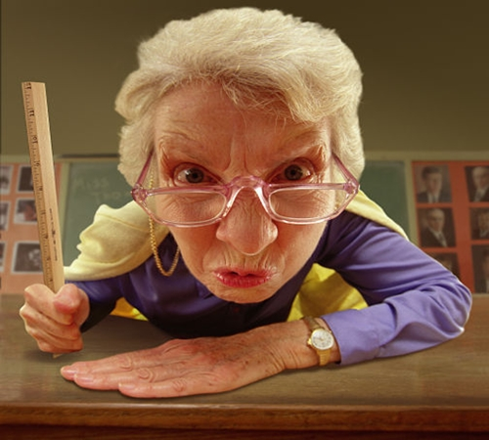
Spiritual Principles of PR in Action!
Show Mutual Respect
Be Trustworthy
Be Flexible
Be Consistent
Notes:
We share information with outside groups and community organizations about NA’s program of recovery and our traditions in an effort to create a more successful interaction. This means that we should also
take the time to learn about the goals, language, and values of the organizations we are working with.
We operate under the guidelines set forth in our traditions and concepts, with the constant goal of carrying the message to the addict who still suffers. With this in mind, we are able to act with integrity and
honesty that allow our partners in the community to rely on our clear, consistent message and reliable actions.
We may need the organizations we are working with to respond to our needs with flexibility, and we can work to do the same. We take care to listen to their requests and, while keeping in mind our underlying principles,
consider whether or not we can accommodate them. In some cases, we may want to reach out to the larger NA service body to help us fulfill requests.
In providing services to the larger community, we strive to provide accurate information and facilitate an ongoing dialogue. When other organizations know they can count on us, we are in a better position to carry the
NA message over an extended period of time to addicts seeking recovery.

Slide 6
Our Traditions and Service
Can We Even Do Public Relations?
What Is Promotion?
Self-support and Public service announcements
Are We Violating Our Anonymity with Public Relations?
Doesn’t Self-Support Mean We Can’t Accept Any Help from Anyone Outside NA?
You Can’t Affiliate with Other Organizations!
Notes:
Our Eleventh Tradition states that “our public relations policy is based on attraction rather than promotion,” so it seems pretty clear that NA is meant to have a public relations policy. Public relations is simply the building
and maintaining of relationships. With this action in our relationships, we help to ensure that NA is seen as attractive. We want NA to be known and respected in the community so that potential members can find us. We
don’t engage in promotion in the course of our PR work.
In It Works: How and Why, promotion is described as “fanfare, overblown claims, [and] celebrity endorsements.” In PR service, all we are charged with doing is informing the public that we are a credible
program of recovery. We must be visible in order to be attractive. The still-suffering addict cannot hear our message if they don’t know where to find us.
Public service announcements can be an opportunity for us to build a cooperative relationship with members of the public in our community. This offering of services to charitable organizations is a way that public
organizations and businesses enter into cooperative relationships within the community. By combining our efforts with these organizations and taking a team approach, we demonstrate our ability to cooperate.
We are not attaching ourselves or affiliating ourselves with these organizations. Rather, we can enter these relationships based on the spirit of cooperation.
Remember that our Eleventh Tradition talks about anonymity in mass media—press, radio, and films (and, by extension, the Internet). Our Twelfth Tradition discusses anonymity as it pertains to placing “principles
before personalities”—within NA, we are all equals. Almost every type of service requires us to interact with members of the public.
Our Seventh Tradition ensures NA’s independence. We don’t solicit money from the public; this keeps our service efforts and our message free from outside influences. We gratefully accept charitable rates for
meeting spaces or public service announcements that would be available to any not-for-profit organization. If NA is not being singled out for special treatment, our self-support is not compromised.
True! However, cooperation and affiliation are vastly different. Affiliation means being joined or connected. Public relations service involves cooperating with other organizations by building and maintaining relationships.
We can work together with other organizations in ways that are helpful for both of us. We are careful to follow NA’s guiding principles and realize that other organization

Slide 7
Developing the PR/PI Committee
What Is Public Information?
What Do We Do in a Public Relations/Public Information Committee?
What Is the Individual NA Member’s Responsibility?
Notes:
Being part of a committee that ends with suffering addicts finding our fellowship is a reward that cannot be expressed, only experienced. Public information service in Narcotics Anonymous has naturally evolved.
Many communities have renamed their committees “public relations,” which fosters the building and maintaining of relationships with the public.
We probably didn’t realize when we picked up an NA pamphlet and meeting schedule in the emergency room, found an ad in the phone book, or copied the NA phoneline number
off a poster on our college campus that these were all the result of the efforts of a public information committee. The PI/PR committee provides a chance for us to give back to our communities. We make a positive difference
in the lives of others by carrying our message to the public.
Public information service happens in a variety of ways. PI and PR committees can evaluate the needs of the community and decide how best to get our message out. Often PI service includes responding to requests
for information or presentations about Narcotics Anonymous.
A form of public information so simple that it is often overlooked occurs when we accept responsibility for our behavior in public. When we identify ourselves as NA members, each one of us may be seen as a representative
of NA to those not familiar with our program. The way we interact with personnel of the facilities we use for our meetings and functions affects how the public views NA as a whole.

Slide 8
Developing the PR/PI Committee
We clarify what services NA can and cannot provide to the community
We make NA members more aware of their role in NA’s public image
We aim for the public to recognize NA as a positive and reliable organization
We develop valuable relationships with professionals and the generl public.
Notes:
Before we start coming up with new projects or start filling requests from professionals, let’s consider what
we are doing, how we want to proceed, and why we are choosing to perform this NA service. Our service actions
have an effect on our worldwide fellowship. Our aim is to further the vision that every addict in the world
has an opportunity to experience recovery in their own language and culture.
To help us achieve our service, we have a two-part Public Relations Statement—one part is focused toward the NA
member and the other is aimed toward professionals and the public. We move forward toward public
relations goals that help us to make NA a visible and attractive choice for addicts.

Slide 9
PI at Work in the Community
Responding to requests for presentations from treatment facilities, civic organizations, schools, healthcare organizations, or the media
Distributing posters, billboards, fliers, and other public service announcements to inform the public of how to reach us
Holding community learning days to inform professionals and the public, and workshops to educate and train our members.
Notes:
Providing website information, meeting directories,
informational letters, and pamphlets to people who
may come in contact with addicts.
Cooperating with the H&I and phoneline
committees in overlapping projects. Where a
separate phoneline committee does not exist,
a PI committee may be responsible for operating
a phoneline.

Slide 10
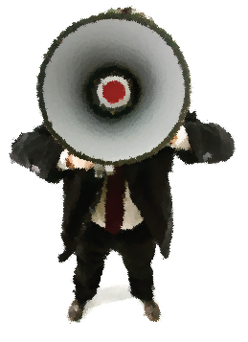
Public Relations Helps Addicts Find NA
Meeting lists
Website
Posters
PSAs (Public Service Announcements)
Radio
Television
Notes:
We are surrounded by the media! After we determine the needs and resources of our community, we can utilize newspapers, the Internet, TV, radio, bus benches, and billboards to carry the NA message of recovery to still suffering
addicts.
The media can be a great way to inform the public about NA and reach potential members, but there area few things to consider when presenting facts about NA in the media. When you are planning your project,
Consider your community and decide what format is most likely to reach the potential member. For example, if you live in a city where many people use public transportation, a bus bench PR campaign may be
highly effective. Make sure you are presenting an announcement that will generate interest and invite people to seek out NA, but also clearly and simply communicate information about our program.
When presenting information to the public about NA, you will definitely want to consider the human and financial resources of the NA community. Some forms of media
are more expensive than others, and you will want to find what works best for your NA service community. Public service announcements and public access
television are ways to communicate with the public, usually at no cost. Putting together a media campaign can offer a great opportunity to combine forces with a
neighboring area and share the costs and the benefits. You may also find that an area or region near you has developed local resources that they are willing to share with you to further your PR efforts

Slide 11
What Is the Importance of Anonymity?
We do our best to avoid appearing in the media as members of Narcotics Anonymous and giving our last names in a public setting.
It is vital to consider the Eleventh Tradition and maintain our personal anonymity when we are carrying the NA message in the media.
Notes:
We also maintain accountability to our local
service body or subcommittee. It is important to
remember that it is not the responsibility of the public
to be familiar with our traditions, and we want to make
sure they understand that no one person or group
represents NA as a whole. In order to assure this, we
take responsibility by going in pairs or groups to talk to
the media.

Slide 12
How Do Members Get Involved?
Arizona Regional Public Relations Subcommittee
1800 East Van Buren Phoenix Az
meets 3 Sunday of odd months at 9:30am Behavior Health Auditorium,
H&I 10:30am Behavior Health Auditorium
Contact your local Public Relations Chair
Notes:
There is a role for every interested member in their local
PR or PI committee. Your input, suggestions, feedback,
and participation are needed and valued. We openly
invite you to come to a PI committee meeting.

Slide 13
Public Relations Basics
Questions?

