Slide 1
Gender Neutral and Inclusive Language in NA Literature

Slide 2
This is a workshop about how we carry the message and how we can be more inclusive.
Would changes to the use of language in our literature make our message more readily available to new and future members?

Slide 3
“I identify as nonbinary and feel ‘othered’ whenever I hear ‘men and women’ in the readings or literature. Like most addicts, I just want to belong. I feel welcome in meetings, but the language makes it hard for people to use my pronouns, so while I am getting recovery NA I still feel excluded because of the language.”

Slide 4
“I’m a history teacher, thanks to the education I got after I found NA. I’ve served in NA for decades and this is my home, but every time I hear ‘man’s entire history’ read during We Do Recover it makes me flinch. I sure hope one day we can change that line.”

Slide 5
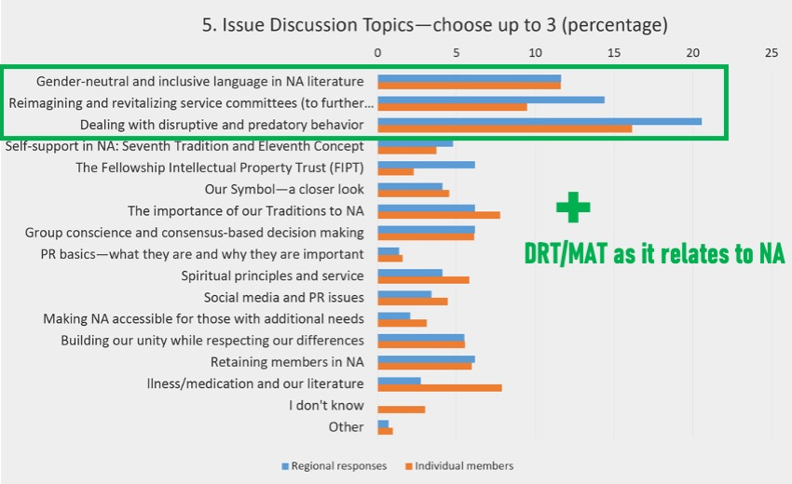
The 2023 World Service Conference (WSC) had consensus to select this as one of four Issue Discussion Topics (IDTs) for this cycle.

Slide 6
The 2023 World Service Conference also passed a CAR motion that reads:
To direct the World Board to create a project plan for consideration at the next WSC to investigate changes and/or additional wording to NA literature from gender specific language to gender neutral and inclusive language.
Intent: This motion will give the conference and the Fellowship the ability to meaningfully discuss changes to our literature to be more inclusive of all our members.
Final Vote: 92 yes, 31 no, 1 abstain, 1 present not voting 74% Strong Support

Slide 7
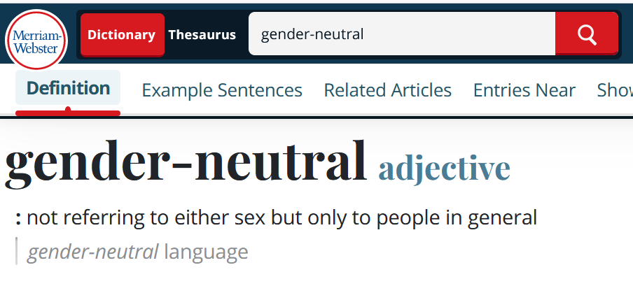
So, what does gender-neutral mean?
In terms of the English language, it means using words that do not refer to one gender only.
For example, a gender-neutral approach in English would be to use the word “people,” “addicts,” or “members” instead of the phrase “men and women.”

Slide 8
A Vision for NA Service
All of the efforts of Narcotics Anonymous are inspired by the primary purpose of our groups. Upon this common ground we stand committed.
Our vision is that one day:
Every addict in the world has the chance to experience our message in their own language and culture and find the opportunity for a new way of life;
Every member, inspired by the gift of recovery, experiences spiritual growth and fulfillment through service;
NA service bodies worldwide work together in a spirit of unity and cooperation to support the groups in carrying our message of recovery;
Narcotics Anonymous has universal recognition and respect as a viable program of recovery.
Honesty, trust, and goodwill are the foundation of our service efforts, all of which rely upon the guidance of a loving Higher Power.

Slide 9
BEFORE
Used to warn addicts not to take “that first fix, pill, or drink.”
NOW
It reads “that first drug.”

Slide 10
“We are men and women who have discovered and admitted that we are powerless over our addiction.”
“We are people who tend to learn things the hard way.”

Slide 11
Does anyone have related experience they would like to share?

Slide 12
Again, this is a discussion.
We are not making decisions at this time.
It may eventually begin to indicate a direction—what if anything the Fellowship wants to do—but for now, we are simply talking and listening to each other as members.

Slide 13
1
What would be the effect if the literature were to change to a more gender-neutral way of talking about members?
What would be the effect if the literature were to change to a more gender-neutral way of talking about God/Higher Power?
What would be the effect if the literature didn’t change?
2
3

Slide 14
What was the most interesting thing you heard today? How has your understanding changed from the beginning of this workshop?

Slide 15
Don’t forget to fill out the form at www.na.org/survey
This is one of four IDTs this cycle. The other three are:
Dealing with disruptive and predatory behavior
Reimagining and revitalizing service committees (to further the reach of the NA message, improve communication, provide mentorship and training, and make service more attractive and accessible, learning from our experience the past few years)
DRT/MAT as it relates to NA
As workshop material is available, it will be posted to www.na.org/idt

