Slide 1
Future of the WSC
Where we are
Where it looks
like we’re going
and
Notes:
This PowerPoint/video is part of an ongoing discussion about the future of the World Service Conference and the challenges we face related to sustainability and effectiveness. It is intended primarily for delegates to use in their regions to inform and gather input from members in preparation for discussions at the upcoming World Service Conference, but any interested member is encouraged to watch the video and participate in the discussion. The PowerPoint/video should give you a sense of the current composition of the Conference, where we could be headed, and why we need to think about a sustainable solution for seating. An informed group conscience always makes better decisions.

Slide 2
Background
Discussions for almost 30 years. For background info see the 2014 Conference Report essay at www.na.org/future.
Restarted conversation at WSC 2014 with Planning Our Future sessions.
We can shape our future together by
Sharing information
Gathering ideas and input
Continuing the conversation at WSC 2016
Notes:
The Conference’s continual growth impacts both its effectiveness and the cost to implement it. There have been discussions and workgroups considering the future of seating at the WSC for almost 30 years, but, we have not been able to come to a collective decision about the future. For background information see the Conference Report essay posted at www.na.org/future. At WSC 2014, we tried to restart the conversation; we scheduled a series of discussion sessions called Planning our Future to talk together about options for the future of the WSC—what would an effective and sustainable Conference look like in the future. No decisions were made at the Conference. The sessions were intended to be part of an ongoing discussion, and this workshop is part of the next steps in that discussion. We have a real opportunity to shape our future together by sharing this information, gathering ideas, and continuing the conversation at WSC 2016.

Slide 3
The WSC Now
Currently seated
116 Regions
16 (of 18 possible) World Board Members
Notes:
Right now we have 116 seated regions which means a potential of 232 regional delegates and alternates on the Conference floor. There are also 18 world board seats (only 16 are currently filled).

Slide 4
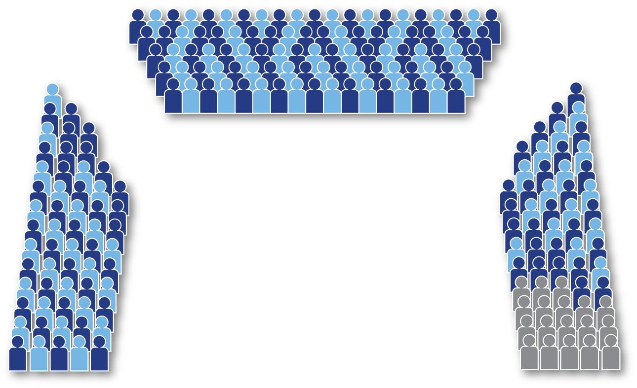
WSC 2014
112 Delegates
82 Alternates
18 WB members
Notes:
At the last Conference there were 194 delegates and alternates present and 18 Board members. For the past several Conference cycles, we have been moving toward a discussion-based Conference to break free from motion-driven business and foster an environment where delegates can more deeply and broadly discuss issues. That is extremely difficult with the Conference the size it is now. There is no way to have a conversation in one room where all voices can be heard. In order to become a truly discussion-based Conference, the number of participants has to be smaller.

Slide 5
WSC 2014
Travel, food & lodging for RDs, ADs, WB, translators, HRP, and cofacs: ~$465,000
Cost to NAWS:
almost $300,000
Cost to regions:
~$165,000
Notes:
The size of the Conference is not just an effectiveness issue. It is also a resource challenge. The WSC is seven days of official meetings and one day of pre-Conference activities which requires an average of ten nights in a hotel. We spent almost $300,000 on travel, food, and lodging for RDs and Board members, Human Resource Panel members, WSC Cofacilitators, and translators at WSC 2014. We estimate that alternate funding was an additional $165,000 expense from regions. Alternate delegates are funded by their regions, and for many regions, the expense is a significant portion of their budget. This means we collectively spent about $465,000 on travel, food, and lodging for the WSC. This does not include room set up, audio visual, equipment, and staff costs,
As NA grows, the question of how to have an effective and fiscally responsible Conference becomes an increasingly pressing issue. The more money we spend on the Conference, the less money regions and World Services are able to spend on fellowship development and public relations work, and ultimately getting literature in the hands of addicts.

Slide 6
Seating Moratoria
WSC 2008: Moratorium on the seating policy until after WSC 2012.
Carried by voice vote
WSC 2012: Continue the spirit of the moratorium for one more cycle, until WSC 2014.
Straw Poll 73-20
Notes:
Nonetheless, we do not seem to have made much progress on figuring out how to revise the Conference seating policy. At the 2008 Conference, participants approved a moratorium on the seating policy until after WSC 2012 with the understanding that the World Board would continue to make recommendations to the Conference in 2010 and 2012 concerning regions that did not result from a division of a Conference seated community. WSC 2012 supported continuing the spirit of the moratorium for one more Conference cycle, until WSC 2014.

Slide 7
WSC 2012 SNP Resolution
From the 2012 CAR:
Resolution 8:
State/national/province boundaries are the primary criterion for seating consideration at the World Service Conference.
60-46-1-3 (yes-no-abstain-present not voting)
Notes:
In the past two Conferences, the board has offered a couple of different options to reduce the number of participants at the Conference.
At WSC 2012, the Board offered an idea for the Fellowship to consider: a resolution that “State/nation/province boundaries are the primary criterion for seating consideration at the World Service Conference.” Resolutions are agreements in principle rather than immediate changes to policy. The Conference passed the resolution, but by a narrow margin (60-46-1-3). The idea of state/nation/province—or SNP—seating never seemed to get any real traction. If the Conference had decided to adopt an SNP seating policy the number of regions seated at the Conference could have been reduced by at least 15%. (Currently, 66 of the 116 seated regions are within the US). However, we never really seem to have reached consensus as a fellowship on SNP seating.

Slide 8
WSC 2014 Motion 2
From the 2014 CAR:
To adopt the following as WSC policy: “Seating at the biennial meeting of the WSC is limited to one delegate per region.”
Intent: To reduce the size and cost of the WSC and create an environment more conducive to discussion-based decision making.
Failed through voice vote
Notes:
At WSC 2014 the Board offered another idea for the Fellowship to consider—a motion that would limit Conference seating to one delegate per region. If that motion had passed it would not have affected the number of seated regions, but it could have reduced the number of people on the Conference floor by up to 116—the number of alternate delegates—which would have reduced the cost and size of the Conference, making it easier to have effective discussions. However, that motion failed by voice vote.

Slide 9
WSC 2014 Planning Our Future Sessions
How to serve NA’s needs, and plan for the WSC’s future.
No decisions were made at the WSC.
Ongoing discussion: We shape our collective future together
Notes:
In short, as a Conference and a Fellowship, it seems we have been stuck—we don’t yet have a shared vision of what an effective and sustainable conference might look like in the future. In an effort to get us “unstuck,” we scheduled a series of sessions at WSC 2014 called “Planning Our Future.” We hoped that by talking together as a conference, a consensus might begin to develop. The sessions were focused on the needs of NA as a whole and what kind of World Service Conference might best meet those needs now and in the future. We didn’t make any decisions at the Conference. The discussion that began at the Conference is ongoing, and gathering input at workshops like this is part of the process.

Slide 10
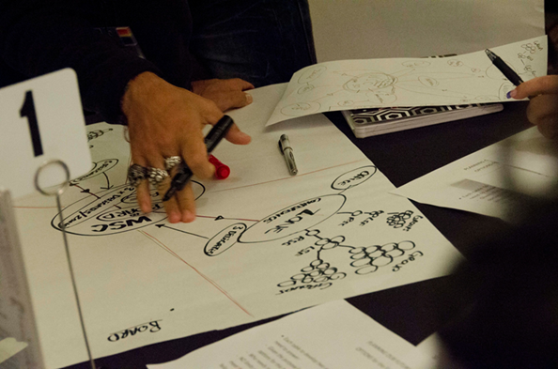
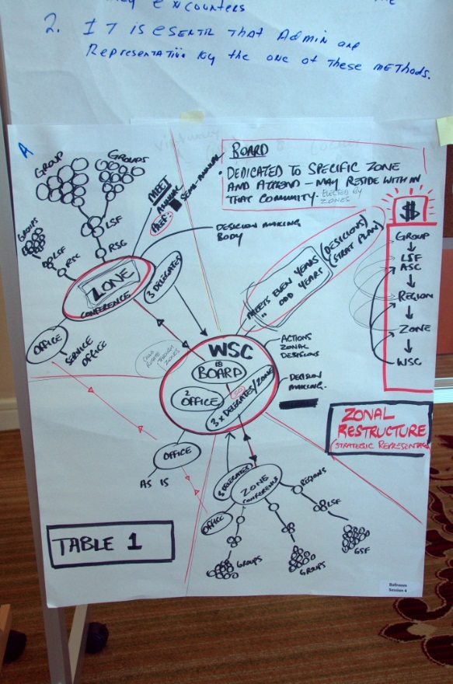
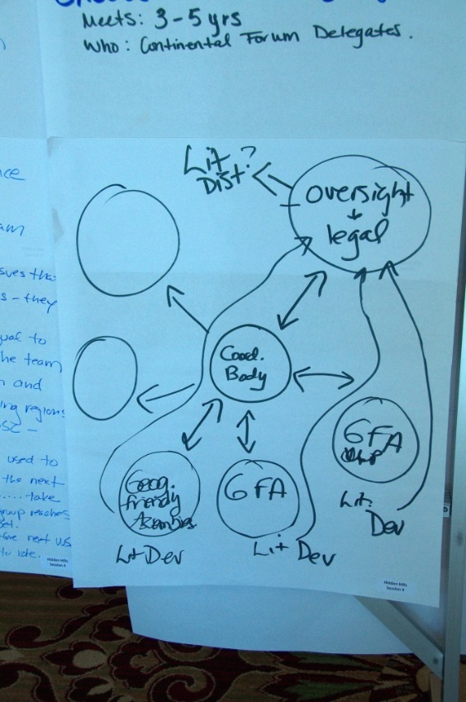
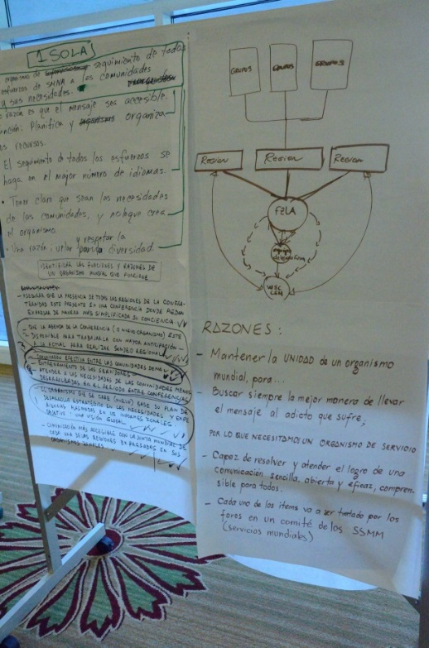
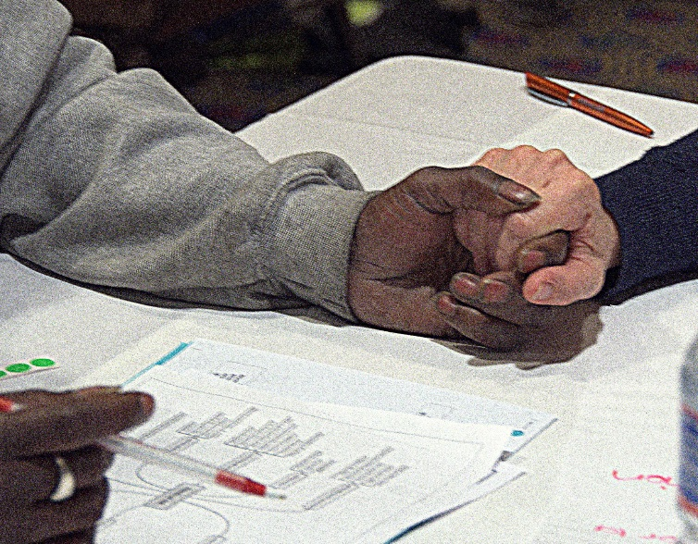
WSC 2014 Planning Our Future Sessions
212 people 112 regions
40 countries 21 languages
Notes:
The Planning Our Future sessions at WSC 2014 began by reviewing some of the history of these issues, we asked the 212 Conference participants, who came from 112 regions in 40 countries, and speaking 21 languages, to identify the needs of NA now and for the next five years.
Because the Conference is too large to hear from everyone in one session, we had to break into five smaller groups to have these discussions.

Slide 11
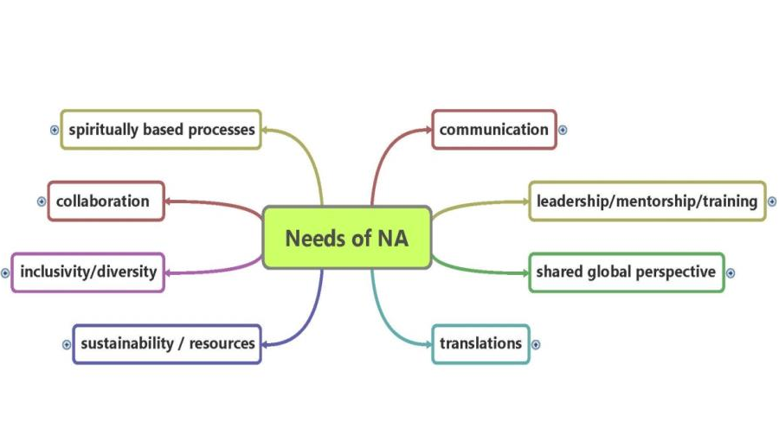
WSC 2014 Planning Our Future Sessions
Needs of NA Mind Map
Notes:
One of the most amazing things about each of these sessions was the degree to which the five breakout rooms prioritized similar things. What you see on the screen is a collapsed version of the mind map that resulted from those discussions. A full version of the mind map is posted at www.na.org/future

Slide 12
WSC 2014 Planning Our Future Sessions
Reasons We Come Together Mind Map
Notes:
After the discussion about needs, the next session focused on what Conference participants considered the most important roles and reasons for a worldwide service body to come together to help meet some of those needs. Again, the results from the five breakout rooms were remarkably similar—the five main reasons being community building, legal responsibilities, oversight, vision and purpose, and global coordination/sharing best practices. On screen is a collapsed version of the mind map that resulted from those discussions. A full version is posted at www.na.org/future.

Slide 13
WSC 2014 Planning Our Future Sessions
A substantial majority seemed to favor some form of zonal seating at the WSC, though not necessarily zones in their current functions and composition.
This was a discussion,
not a decision.
Notes:
After we collected and combined the results for the reasons to have a worldwide body, the next discussion looked at possible options for the future of that body.
The results of that discussion—and it was a discussion, not a decision—were that a substantial majority of conference participants seemed to favor some form of zonal seating at the WSC, though not necessarily zones in their current functions and composition. This was a discussion, not a decision.

Slide 14
Zonal Forums
Zones vary in focus and make-up.
“Service-oriented sharing and/or business sessions that provide the means by which NA communities can communicate, cooperate, and grow with one another.” GWSNA
For more information on zones see the material at www.na.org/conference.
Notes:
Part of the discussion at the Conference and the focus since then has been on the differences in zones’ focus and purpose and in their make-up.
A Guide to World Services in NA describes zones as “service-oriented sharing and/or business sessions that provide the means by which NA communities can communicate, cooperate, and grow with one another.”
This PowerPoint/video is part of a package that has two other pieces both of which go into more detail about the role and make-up of zones. One is a compilation of results from a workshop done at many zones and throughout the fellowship on the Role of Zones. The other is a collection of “data snapshots” that tries to give a picture of each zone today. You can find those materials on the page: www.na.org/future.

Slide 15
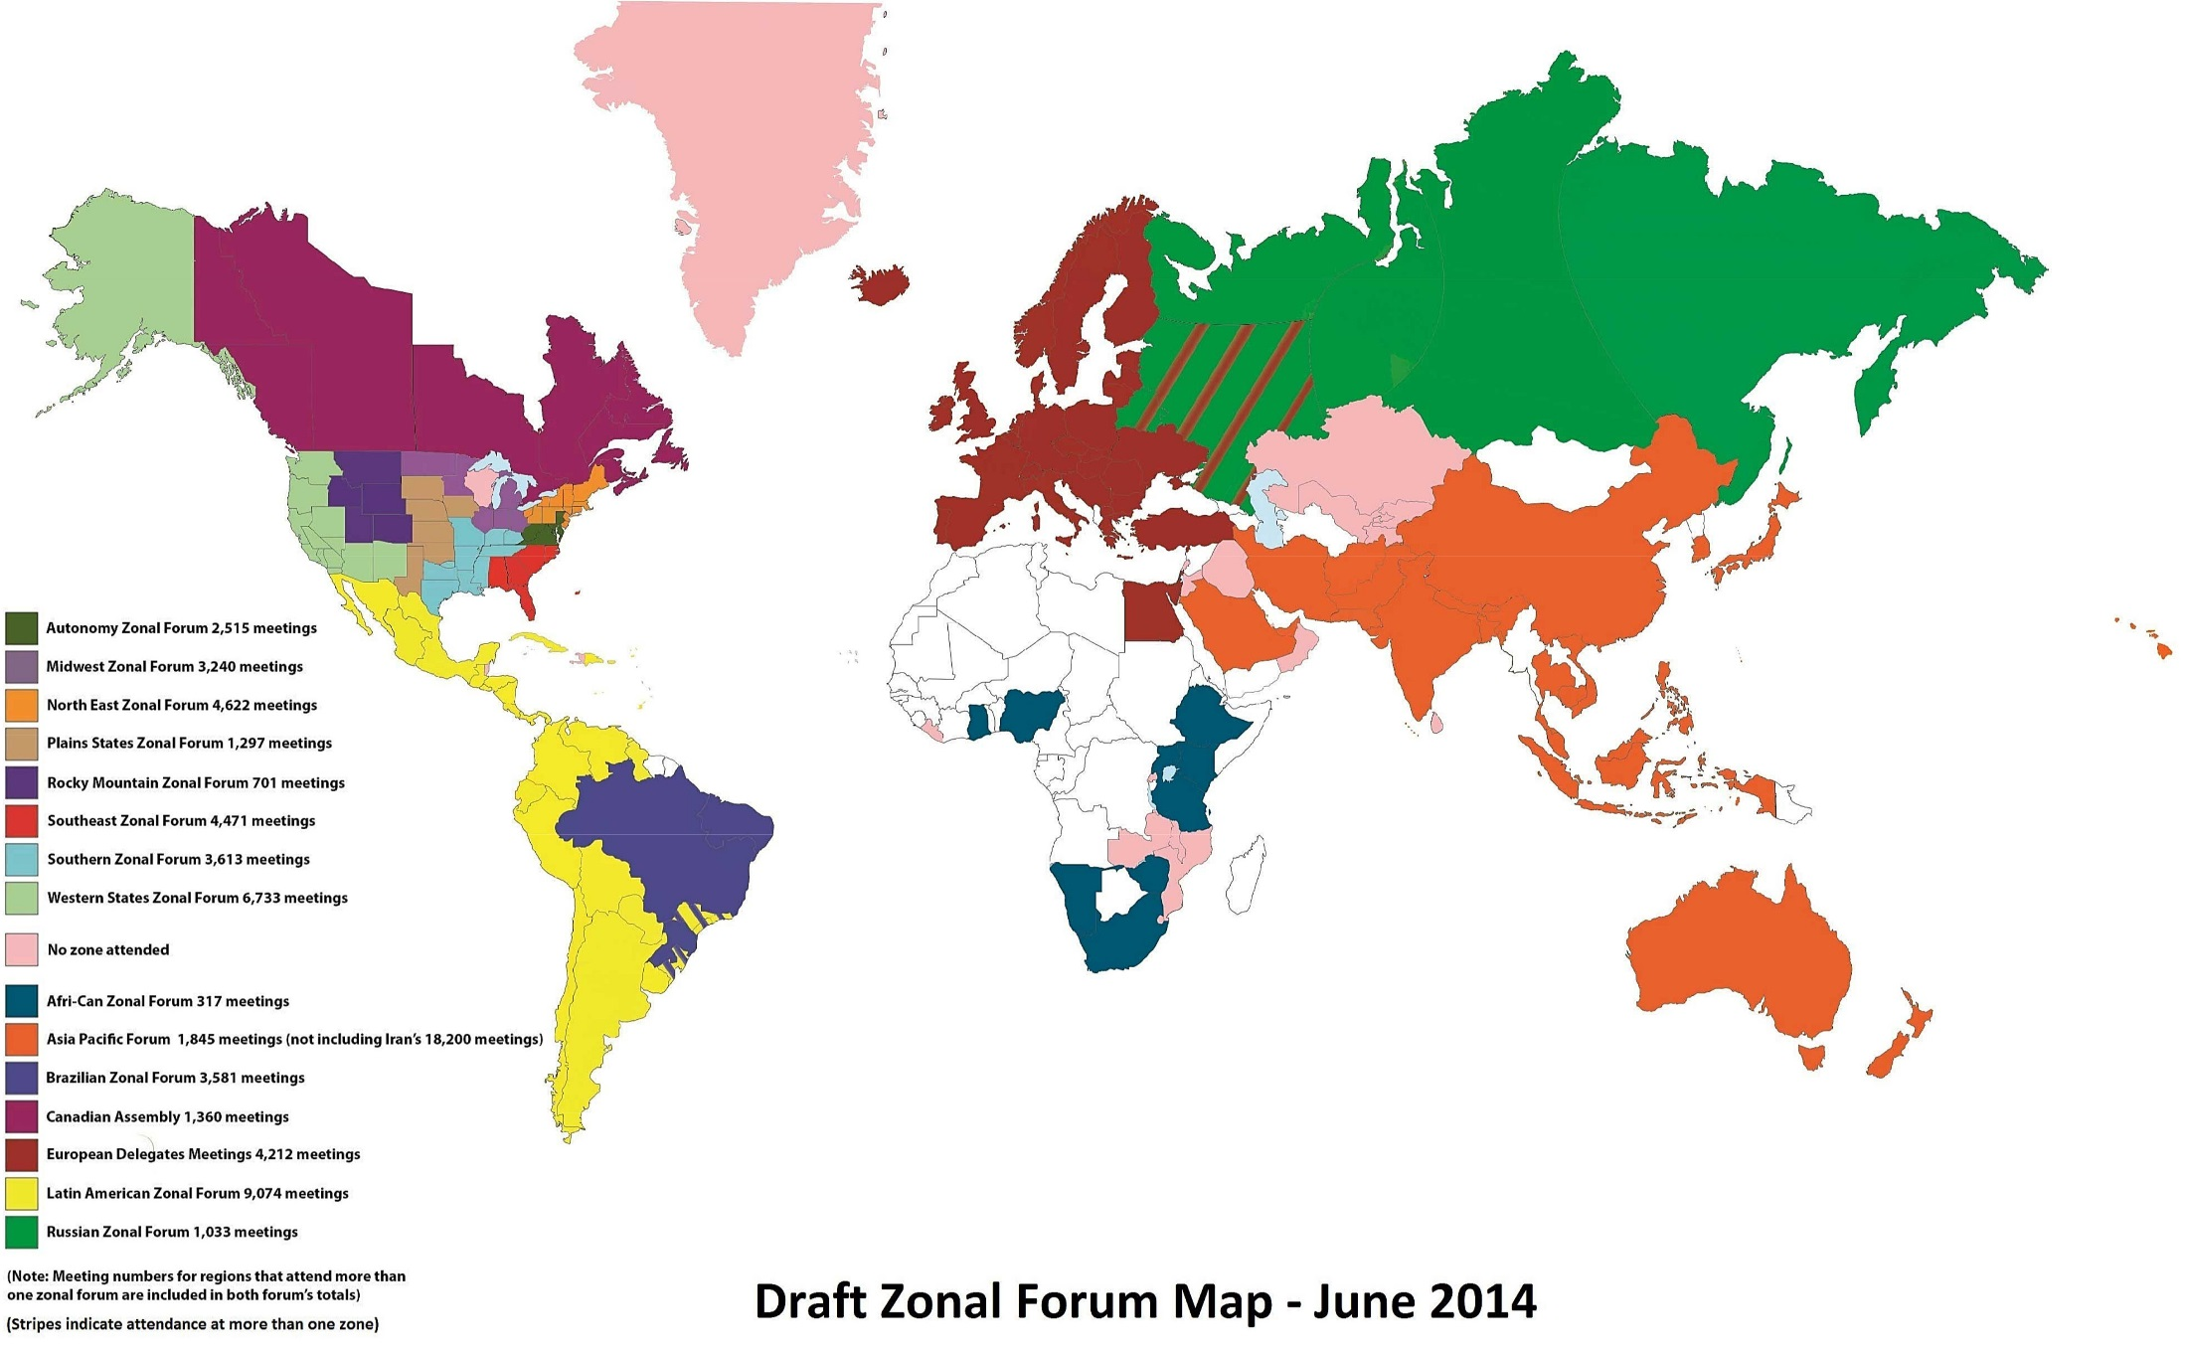
Zonal Map
Notes:
Currently there are 15 zones. Here’s a map of them. You can find a link to this map at www.na.org/future.
World Services visits each zonal forum every Conference cycle. While some zonal forums meet infrequently and do not provide any direct service beyond their meetings, others are integral to the ongoing development and growth of NA communities.
We’re going to talk a bit more now about zones and their member regions. This should give you a sense of the current composition of the Conference, where we could be headed, and why we need to think about a sustainable solution for seating.

Slide 16
Zones/Regions Seated
Autonomy
AZF
5
Midwest
MZF
10
Northeast
NEZF
12
Plains States
PSZF
6
Rocky Mountain
RMZF
5
Southeast
SEZF
6
Southern
SZF
8
Western States
WSZF
13
Afri-Can
A-CZF
1
Asia Pacific
APF
9
Brazil
BZF
2
Canadian Assembly
CANA
6
European
Delegates
Meeting
EDM
16
Latin America
LAZF
16
Russia
RZF
1
Notes:
There are eight US zonal forums: Autonomy, Midwest, Northeast, Plains States, Rocky Mountain, Southeast, Southern, and Western States. And there are seven zonal forums outside the US: the Afri-Can, Asia Pacific, Brazilian, Canadian Assembly, European Delegates Meeting, Latin American, and Russia zones.
Two of those zones have only one seated region, and one zone has only two seated regions, but looking deeper we find…

Slide 17
Zones/Regions UNSeated
Afri-Can
A-CZF
13
Brazil
BZF
7
Latin America
LAZF
5
Russia
RZF
4
Notes:
Although the Afri-Can zone has only one seated region, they have 13 unseated NA communities participating. Russia has four unseated regions participating, and Brazil has two seated regions and seven that are not seated.
The Latin American Zonal Forum has 16 Seated Regions and 5 unseated.

Slide 18
Zones/Regions UNSeated
Asia Pacific
APF
20
European
Delegates
Meeting
EDM
14
Notes:
If we look at the Asia Pacific Forum, and the European Delegates Meeting (Asia’s Zone and Europe’s Zone) we find 34 more NA communities participating who are not seated but eventually may want to be. Again, we have to note that the NA communities in many countries in places like the Afri-Can zone and the Asia Pacific Forum are still very small—not yet what one might call “regions.” Nonetheless, we know NA will grow and we need to plan for a future when these communities are larger.

Slide 19
Zones/Regions UNSeated
Autonomy
AZF
1
Midwest
MZF
0
Northeast
NEZF
0
Plains States
PSZF
0
Rocky Mountain
RMZF
0
Southeast
SEZF
0
Southern
SZF
2
Western States
WSZF
0
Canadian Assembly
CANA
2
Notes:
There are only five unseated regions in the US and Canadian zones. Some might argue that this is due to the age of the Fellowship in the US, that these regions have plateaued in growth. However, it’s also true that the seating moratoriums on regions, particularly on regions resulting from a split, may have discouraged the formation of new regions.

Slide 20
Zones/Regions UNSeated
Autonomy
AZF
1
Midwest
MZF
0
Northeast
NEZF
0
Plains States
PSZF
0
Rocky Mountain
RMZF
0
Southeast
SEZF
0
Southern
SZF
2
Western States
WSZF
0
Afri-can
A-CZF
13
Asia Pacific
APF
20
Brazil
BZF
7
Canadian Assembly
CANA
2
European
Delegates
Meeting
EDM
14
Latin America
LAZF
5
Russia
RZF
4
Notes:
Looking at unseated regions in each zone still does not give us a full picture of where our Fellowship growth is headed.

Slide 21
WSC Zones
Autonomy
5 SR
1 UR
2515 M
Midwest
10 SR
0 UR
3240 M
Northeast
12 SR
0 UR
4622 M
Plains States
6 SR
0 UR
1297 M
Rocky Mountain
5 SR
0 UR
701 M
Southeast
6 SR
0 UR
4471 M
Southern
8 SR
2 UR
3613 M
Western States
13 SR
0 UR
6733 M
Afri-Can
1 SR
13 UR
317 M
Asia Pacific
9 SR
20 UR
1845M
(18200M Iran)
Brazil
2 SR
7 UR
3581 M
Canadian Assembly
6 SR
2 UR
1360 M
European
Delegates
Meeting
16 SR
14 UR
4212 M
Latin America
16 SR
5 UR
5493 M
Russia
1 SR
4 UR
1033M
Country
No Zone
34 UR
Notes:
We need to look at meetings too. This gives a sense of where we are now.
SR stands for Seated Regions
UR stands for Unseated Regions
M stands for Meetings in each Zone
Places such as Africa, Russia, and India, have the potential to grow significantly, which could change the face of NA. Iran has already seen tremendous growth. Almost 30% of the world’s NA meetings are in Iran. Their current areas are as large as typical regions. If Iran were to follow the pattern Russia and Brazil have – they would be 23 regions and a zone. The future we imagined for NA years ago, is already here, and we need to begin developing a vision for the Conference that can accommodate our continual growth.

Slide 22
WSC 2014
112 Delegates
82 Alternates
18 WB members
Notes:
Remember this slide? This is how many people were seated on the floor of the last conference.

Slide 23
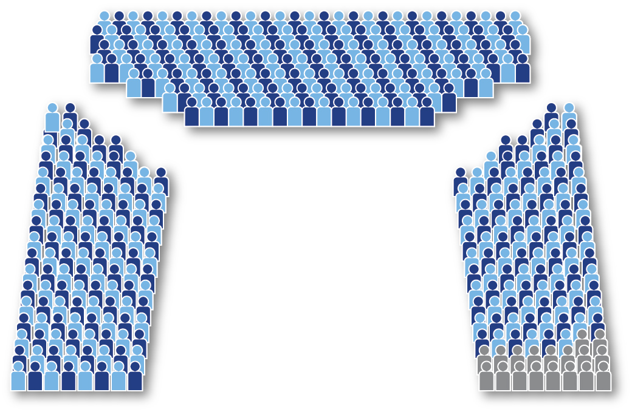
WSC if all zonal members were seated
184 Delegates
184 Alternates
18 WB members
Notes:
If we just seated the 68 unseated communities who are members of a zonal forum right now, this is what the WSC would look like.

Slide 24
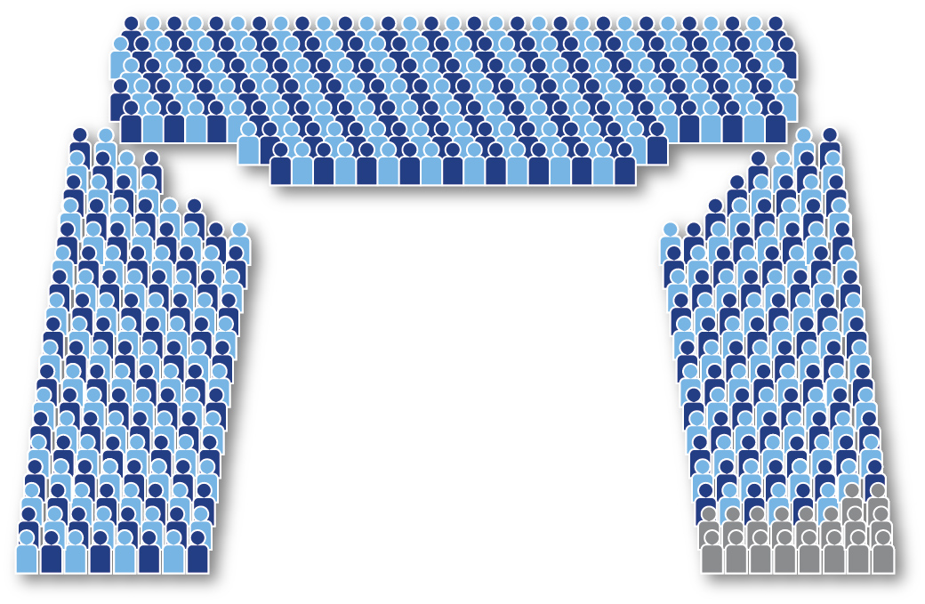
WSC if all additional countries were seated
217 Delegates
217 Alternates
18 WB members
Notes:
If we added the approximately 34 countries that have NA meetings but don’t yet participate in a zone, this is what the WSC would look like. That’s more than 450 possible participants and a potential cost of approximately a million dollars to fund delegates and alternates. Plus additional costs to obtain a larger space to have the conference. It’s hard to imagine having a meaningful discussion in a Conference that size.
It seems obvious that the direction we are heading in does not lend itself to an effective and affordable Conference.

Slide 25
WSC 2014 Planning Our Future Sessions
Where do we go from here?
Communication
Zonal forum discussions
World Services workgroup
Workshops for Fellowship discussion
www.na.org/future
Notes:
The final session in the Planning Our Future discussion at the WSC asked the question “Where do we go from here?” The results from that session highlighted the importance of communication and the need to continue the conversation within zonal forums and throughout the fellowship—to share the discussions that are taking place about the future of the conference, and to involve the Fellowship in those discussions.
Two of the other main ideas from that session were to have discussions in zonal forums about their roles and future roles and to create a world service workgroup focused on these issues. The Planning Our Future workgroup has met virtually throughout the Conference cycle and helped to put together the Role of Zones workshop and this presentation. The results of that workshop as well as a standardized snapshot of each zone are available at www.na.org/future.
This presentation is part of the effort to communicate these issues and to seek ideas and input on how to move forward. The discussion about the future of the WSC and the future of zones will continue at this Conference and we are trying to collect input for that discussion.

Slide 26
Mind Map: Reasons We Come Together
As we carry the message, NA grows.
How can we best fulfill these roles?
Notes:
Ultimately our collective task is to find a reasonable way for our fellowship to make the decisions needed to help carry the message of Narcotics Anonymous throughout the world and deliver the services necessary to do that. How can we best fill the roles identified at WSC 2014 for a worldwide body—build community, fulfill our legal and oversight responsibilities, coordinate and collaborate globally, and remain focused on our vision and purpose?
The more successful we are at carrying the message, the more NA will grow, and we must work together to develop a vision of the World Service Conference that can accommodate that growth.
Eventually the fellowship will need to make a decision about the size and the shape of the conference, and we hope conversations like this one will help people feel more prepared to make that decision and help to direct the conversation.

Slide 27
What do you think?
Do you agree with the WSC discussion results that seemed to favor some form of zonal seating?
Would another form of seating be better—SNP? Continental? Something else?
What can we do to ensure an effective and sustainable WSC in the future?
Ideas and input: worldboard@na.org
Notes:
What do you think?
Do you agree with the WSC discussion results that seemed to favor some form of zonal seating?
Would another form of seating be better—state/nation/province? Continental? Something else?
What can we do to ensure an effective and sustainable WSC in the future?

