Slide 1
Future of the World Service Conference
The World Board is recommending the first pieces of the road to a conference that is more effective and sustainable.
Notes:
Future of the World Service Conference
The World Board is recommending the first pieces of the road to a conference that is more effective and sustainable.

Slide 2
The World Board and Conference participants (Regional and Zonal Delegates and alternates) have been discussing what’s next for the World Service Conference (WSC).
These conversations have helped shape recommendations from the board.
Notes:
The World Board and Conference participants have been discussing what’s next for the World Service Conference this cycle. There have been conference participant webinars dedicated to the topic, a survey that delegates responded to, and a few sessions on the topic at the partial, interim WSC in April 2022.
These discussions have actually been ongoing for the last few decades, but more on that later.
These conversations have helped shape some recommendations from the board.

Slide 3
The Board recommendations are:
Try a three-year WSC cycle
Hold an interim, virtual WSC between in-person meetings
Post the CAR six months before the in-person WSC
Form a workgroup to help frame ideas
Make delegate funding available upon request rather than automatic
These are the first pieces of the road to a more effective and sustainable World Service Conference
www.na.org/conference
Notes:
The Board recommendations are to:
Try a three-year WSC cycle
Hold an interim, virtual WSC between in-person meetings
Post the CAR six months before the in-person WSC
Form a workgroup to help frame ideas
Make delegate funding available upon request rather than automatic
These are the first pieces of the road to a more effective and sustainable World Service Conference
There are several reports from the board on this topic. Those reports can be found at www.na.org/conference.

Slide 4
The World Board sees these as simply first steps in a broad transformation of the WSC.
As the WSC continues to grow, it becomes more expensive and, in some respects, less effective
The WSC—not just the meeting but the season leading up to it—requires a lot of human and financial resources
The board believes it our responsibility to say again that business as usual is not sustainable
There will be motions from the World Board on these recommendations in the 2023 Conference Agenda Report and Conference Approval Track.
Notes:
These two recommendations are just a starting place for change—the first steps in building a new, more effective WSC together.
As the WSC continues to grow, it becomes more expensive and, in some respects, less effective
The WSC—not just the meeting but the season leading up to it—requires a lot of human and financial resources
The board believes it our responsibility to say again that business as usual is not sustainable
The in-person WSC in 2023 will cost more money than in the past. Airfares and hotel costs are higher. There will be a need to hire temp help as there are fewer staff. Technology costs may rise as more participants join virtually.
A three-year cycle will allow NAWS to shift some of those resources.
There will be motions from the World Board on these recommendations in the 2023 Conference Agenda Report and Conference Approval Track.

Slide 5
The WSC is the last piece of the World Service system to adapt to the current circumstances.
Some of the changes:
Reduction in staff at the World Service Office
Publications halted (NA Way, Reaching Out, printed reports)
Scaled back resources related to the World Board
Budgeted for half the number of in-person meetings as in pre pandemic years
Flexible approach to projects
All workgroups met virtually
Notes:
The WSC is the last piece of the World Service system to adapt to the current circumstances
The conditions of the past two years have forced the rest of World Services to adapt.
Some of the changes:
A reduction in staff at the World Service Office. While some furloughed staff have been brought back and there have been job openings posted, the staffing levels are no where near where they were pre-pandemic. At the beginning of the 2020 fiscal year, there were 46 staff in the Chatsworth office. As of this writing, there are 27, with plans to add two more.
With the reduction in staff comes the inability to do some of the work. The NA Way and Reaching Out are two casualties. Due to the reduction in staff and the need to reduce printing and shipping costs, all printed reports are now posted electronically.
Similarly resources related to the World Board have been scaled back. Half the number of in-person board meetings have been budgeted for as in past years. The board has been meeting virtually throughout the pandemic, and met in person for the first time in more than two years in July.
A flexible approach to projects was approved at the 2020 WSC and will only be worked on when and if the resources become available.
A Spiritual Principle a Day workgroup met virtually from the start of the pandemic.

Slide 6
The board recommends trying a three-year conference cycle for two cycles—from 2023 to 2029
Adopt a three-year cycle for two cycles as an experiment
A three-year cycle would free up human and financial resources to help grow NA and support efforts to carry the message
No matter what happens, the conference cycle will change after 2023
(continued)
Notes:
First, the board recommends trying a three-year conference cycle for two cycles—from 2023 to 2029
Adopt a three-year cycle for two cycles as an experiment
There will likely be a motion from the World Board on this recommendation in the 2023 Conference Agenda Report.
Then at WSC 2029 a decision will need to be made as to whether to adopt the change on an ongoing basis.
A three-year cycle would free up human and financial resources to help grow NA and support efforts to carry the message
Allowing us to allocate some of those resources to the wider world of NA Fellowship development. Some of the resources that might go to CAR workshops and decision-making would be freed up. That amounts to more time to actually do the work that leads to more effective carrying the message
Provide more time for collaborative planning and for the discussions that help shape future work
No matter what happens, the conference cycle will change after 2023
If nothing is decided at WSC 2023, the following conference would be in 2025, effectively shifting the cycle so that the WSC happened every other odd year.
That is a big change in the cycle relative to how most service bodies think about and elect their delegates

Slide 7
The board recommends trying a three-year conference cycle for two cycles—from 2023 to 2029 (continued)
An interim virtual meeting could take place during the cycle to decide on items selected by conference participants
The English Conference Agenda Report (CAR) for the in-person WSC could be posted six months prior to the meeting
A workgroup of zonally selected members could be formed after WSC 2023
An interim meeting, an earlier CAR release, and the workgroup are suggestions from a number of participants. Thank you! There are many more good ideas that we anticipate discussing and trying in this evolutionary process.
Notes:
An interim virtual meeting could take place during the cycle
The meeting that was held last April, over the course of 4 days, was an interim decision-making meeting with discussions on strengthening relationships and the future of the WSC.
Conference participants can determine via survey in advance of the meeting what items to address.
The report with the interim items for decision would be released 90 days in advance of the meeting.
The English Conference Agenda Report for the in-person WSC could be posted six months prior to the meeting, with the translated versions posted a month later.
This would be 30 days before the current guidelines’ requirement.
Delegates would have more time for CAR workshops and informing members, and an earlier release would avoid the crunch created because the US holiday season is right on top of the current publication dates.
A workgroup of zonally selected members could be formed after WSC 2023
The workgroup can help to fill in some of the detail about what a transformed WSC and a three-year cycle might look like and help forge ideas for change.
Asking each zone to select a member for the workgroup will ensure a geographically diverse group selected by delegates.
The workgroup would make recommendations to the board for us all to discuss
These three ideas—an interim meeting, an earlier CAR posting date, and a workgroup—are suggestions from a number of participants. Thank you! There are many more good ideas that we anticipate discussing and trying in this evolutionary process.

Slide 8
The board recommends participant funding for the WSC in-person meeting be opt-in rather than opt-out.
Currently World Services automatically funds (including travel, food, and lodging) all seated delegates.
Funding would be available for delegates from seated regions or zones upon request.
What’s most important to say up front is that any delegate who requests partial or full funding would receive it.
This is really more about changing our collective culture.
Notes:
Second, the board recommends participant funding be opt-in rather than opt-out. Any delegate who requests total or partial funding will receive it.
Currently World Services automatically funds (including travel, food, and lodging) all seated delegates.
An increasing number of participants have chosen to opt out and fund their own delegates
Funding would be available for delegates from seated regions or zones upon request.
What’s most important to say up front is that any delegate who requests partial or full funding would receive it.
This is really more about changing our collective culture.

Slide 9
Together we are building the road to a more effective and sustainable World Service Conference.
We are just trying to lay down the first pieces.

Slide 10
Some of the other ideas that came up in discussions:
Incorporate WCNA into the work of the conference cycle in some way, since the two events, the conference and convention, would both be on three-year cycles.
Focus on what needs to be done in person and what can be done effectively virtually.
Work toward better handling and processing of CAR motions.
Develop processes for the body to build the CAR together, including mechanisms for delegates to prioritize, process, or vet motions.
Make decisions on some “old business” items virtually before the in-person WSC meeting so that the time together can be focused on the cycle ahead.
Evolve the WSC into a planning conference with more training, mentorship, and conversation.
Help participants disseminate information and build relationships within their regions and zones.
Strengthen the strategic plan “feedback loop” to help amplify the voices, role, and participation of participants and members.
Build a more collaborative planning processes.
Notes:
Some of the other ideas that came up discussions include the following…[see slide]
The board is not necessarily recommending these specific ideas.
They just want to give you a sense of the texture of the conversations and some of what excites them about the idea of a three-year cycle.
The board believes that a longer cycle could present opportunities to increase the participants’ impact on the NAWS Strategic Plan and the work that comes out of the WSC.

Slide 11
One question the board has been asked a lot is…
Don’t we need to know more about what a three-year cycle will look like in order to make a decision?
The board, conference participants and, to some degree, the Fellowship have talked for many years before the pandemic about how to improve the effectiveness of the WSC and use our limited resources more strategically. If our historical experience is any measure, discussion alone would not leave the conference in a substantially different place in 2025. In NA, we often learn by doing. In recovery, we are used to taking one step at a time.
The WSC is currently in the midst of a three-year cycle because of global health and economic circumstances. Adapting to the conditions of the pandemic has often been very difficult, but it has also increased our capacity to imagine a different future.
The Future of the WSC June 2022 report found at www.na.org/conference answers many of the questions the board has been asked so far.
Notes:
One question the board has been asked a lot is…
Don’t we need to know more about what a three-year cycle will look like in order to make a decision?
The board, conference participants and, to some degree, the Fellowship have talked for many years before the pandemic about how to improve the effectiveness of the WSC and use our limited resources more strategically. If our historical experience is any measure, discussion alone would not leave the conference in a substantially different place in 2025. In NA, we often learn by doing. In recovery, we are used to taking one step at a time.
The WSC is currently in the midst of a three-year cycle because of global health and economic circumstances. Adapting to the conditions of the pandemic has often been very difficult, but it has also increased our capacity to imagine a different future.
The Future of the WSC June 2022 report found at www.na.org/conference answers many of the questions the board has been asked so far.

Slide 12
We never imagined being able to do what we have done in the last 3 years
Meet online as a conference and make decision virtually
Utilize surveys and epolls
Communicate more than ever
Hold quarterly open webinars on topics important to the Fellowship
Publish more translated material than ever
Finish a book project
Launch two Instagram accounts
Upgrade our database
Build consensus on ideas about virtual meetings and material to support them
Forge agreements to load NA literature on inmate tablets
Hold a six-month Fellowship review for the first change to the FIPT
Post audio versions of the Basic Text for free streaming
Because of the extended time between in-person WSCs, we’ve been able to focus more attention on work that directly carries the message to the addict who still suffers
Notes:
We never imagined being able to do what we have done in the last 3 years
We learned that we can meet online as a conference and we can make decisions virtually.
Utilize surveys and epolls so the conference can take care of business before and after they meet.
Communication among conference participants, including the board, is more robust than ever in our history and that will continue. We have conference participant web meetings every other month. The board sends CPs more frequent email updates than ever before, and participants have access to detailed financial updates every two months.
Hold quarterly open webinars on topics important to the Fellowship
Publish more translated material than ever, and get caught up on posting already published IPs and booklets in 56 languages
Finish a book project, accomplishing workgroup tasks virtually that we typically do in-person
Launch two Instagram accounts
Upgrade our database
Build consensus on ideas about virtual meetings and material to support them through open surveys, web meetings, and discussions with conference participants
Forge agreements to load NA literature on inmate tablets in a number of places and are working on more
Hold a six-month Fellowship review for the first change to the Fellowship Intellectual Property Trust, which was to add zonal delegates
Post audio versions of the Basic Text for free streaming in seven languages
Because of the extended time between in-person WSCs, we’ve been able to focus more attention on work that directly carries the message to the addict who still suffers. And that’s with greatly reduced staffing levels.

Slide 13
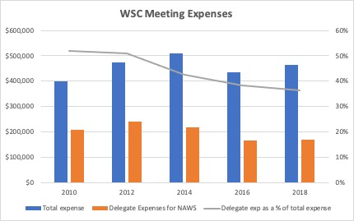
In putting together figures about the World Service Conference, there was a clear trend
NA World Services funds delegate travel, but over the last four in-person conferences that expense has decreased as more regions have begun funding their delegates.
Gathering hundreds of people together in a conference room for a week is expensive.
Notes:
NA World Services funds delegate travel, but over the last four in-person conferences that expense has decreased as more regions have begun funding their delegates.
From 2008 to 2018, the conference seated 22 regions and zones. That should translate to a 20% increase in travel funding over that time which clearly it did not.
Gathering hundreds of people together in a conference room for a week is expensive. The cost of the conference room, the sound system, the electronics, the set up and break down of the room—there is no way to avoid a large expense in a group our size.
In the past ten years, as the conference has grown, expenses such as risers and audio visual needs have increased, but delegate travel expense to NAWS has not.

Slide 14
The data tells the fundamentals of the story—that talking about the cost of the WSC and the possibility for regions to fund their delegates has made a difference.
Delegate travel is made up of hotel, meal, and travel expenses
Regions have taken on a variety of different ways to contribute to funding
The board’s recommendation is building on this change in culture or expectation. There could simply be something included on the reservation form each participant fills out to indicate if the delegate needs funding. If they do, NAWS will cover it.
Notes:
The data tells the fundamentals of the story—that talking about the cost of the WSC and the possibility for regions to fund their delegates has made a difference.
Delegate travel is made up of hotel, meal, and travel expenses.
Each of these three categories is roughly one-third of the total expenses, with minor variances from conference to conference.
Regions have taken on a variety of different ways to contribute to funding
some pay for air fare
some do not take meal expenses
some pay for the hotel
some cover all expenses, and all different combinations.
The board’s recommendation is building on this change in culture or expectation. There could simply be something included on the reservation form each participant fills out to indicate if the delegate needs funding. If they do, NAWS will cover it.

Slide 15
The Basic Text reminds us:
“Everything that occurs in the course of NA service must be motivated by the desire to more successfully carry the message of recovery to the addict who still suffers.”

Slide 16
A little background . . .
1990s and before
Resolution Group: How to make the WSC more effective and sustainable
WSC was an annual event
A number of WSC decisions:
World Board
Unified World Services budget
Two-year conference cycle
World Services’ funding of delegates
Up to 2000
late 1990s/ early 2000s
Notes:
Background Information
The conversation about how to make the WSC more effective and sustainable has been going on since before the board existed—back to the Resolution Group in the 1990s and earlier.
Up to the year 2000, the WSC was an annual event, and all participating regions funded their own delegates.
In the late 90s and early 2000s, a number of WSC decisions led to the creation of the World Board, a unified World Services budget, a two-year conference cycle, and World Services’ funding of delegates.
At that time, there were fewer than 100 seated conference participants. More than twenty years have passed since then, and, fortunately, NA continues to grow.
But in terms of the WSC, that growth creates challenges.

Slide 17
2014 CAR
The Board offered motions about delegate funding and alternate attendance
Here’s an excerpt from the 2014 Conference Report:
Neither motion passed
As a Fellowship, we have wrestled with how to improve our system for decades. We have a pattern of devoting significant resources to the issues, coming to the conclusion that we need to change, developing options, and then balking when we come to the decision point. The issues do not go away, we just keep “kicking the can” to the next group and going through the process again. . . .
Sometimes it feels impossible to move forward but we must, and we will. Together we can get past this place where we feel stuck.
Notes:
Some of you may remember the motions in the 2014 CAR about delegate funding and alternate attendance.
The board offered those motions in an attempt to decrease the cost of the WSC to World Services and to reduce the number of members seated on the floor of the WSC.
Here’s an excerpt from the 2014 Conference Report:
As a Fellowship, we have wrestled with how to improve our system for decades. We have a pattern of devoting significant resources to the issues, coming to the conclusion that we need to change, developing options, and then balking when we come to the decision point. The issues do not go away, we just keep “kicking the can” to the next group and going through the process again. . . .
Sometimes it feels impossible to move forward but we must, and we will. Together we can get past this place where we feel stuck.
Neither motion passed, and since that time, the conference has seated nine more regions and six zones, adding a total of 30 more seats on the floor of the WSC.

Slide 18
2014 & 2016 WSC
Participants had a series of sessions about the future of the WSC and how to best meet the needs of NA in an ever-growing Fellowship. Much of the discussion highlighted the possibility that the way forward rests, in part, with our use of zones.
Planning Our Future project was created to “to continue to evolve the ideas about the future of the WSC generated at WSC 2014.”
The Future of the WSC project was created to discuss future work and discussion on WSC seating, consensus-based decision making, and the use of time and focus between conferences.
WSC of the Future project was created to discuss what is an effective and sustainable WSC, gather ideas for a project on the role of zones, and strengthen collaboration among zonal forums and between NAWS and zonal forums while collecting and sharing best practices of zonal forums.
2014-2016
2016-2018
2018-2020
Notes:
At the 2014 & 2016 WSCs, participants had a series of sessions in breakout rooms about the future of the WSC and how to best meet the needs of NA in an ever-growing Fellowship. Much of the discussion highlighted the possibility that the way forward rests, in part, with our use of zones.
Planning Our Future was the name of the 2014–2016 project created to “to continue to evolve the ideas about the future of the WSC generated at WSC 2014.”
The following cycle, 2016–2018, the Future of the WSC Project was created to discuss future work and discussion on WSC seating, consensus-based decision making, and the use of time and focus between conferences
The WSC of the Future was the name of the 2018-2020 project. The project’s three main goals were to discuss what is meant by an effective and sustainable WSC, gather ideas for a project on the role of zones, and strengthen collaboration among zonal forums and between NAWS and zonal forums while collecting and sharing best practices of zonal forums.
The hope was that the conversations would help the Conference come to agreement about a vision for itself that would serve our collective needs as a Fellowship, use its fair share of Fellowship resources, and allow for effective discussions and decision making.

Slide 19
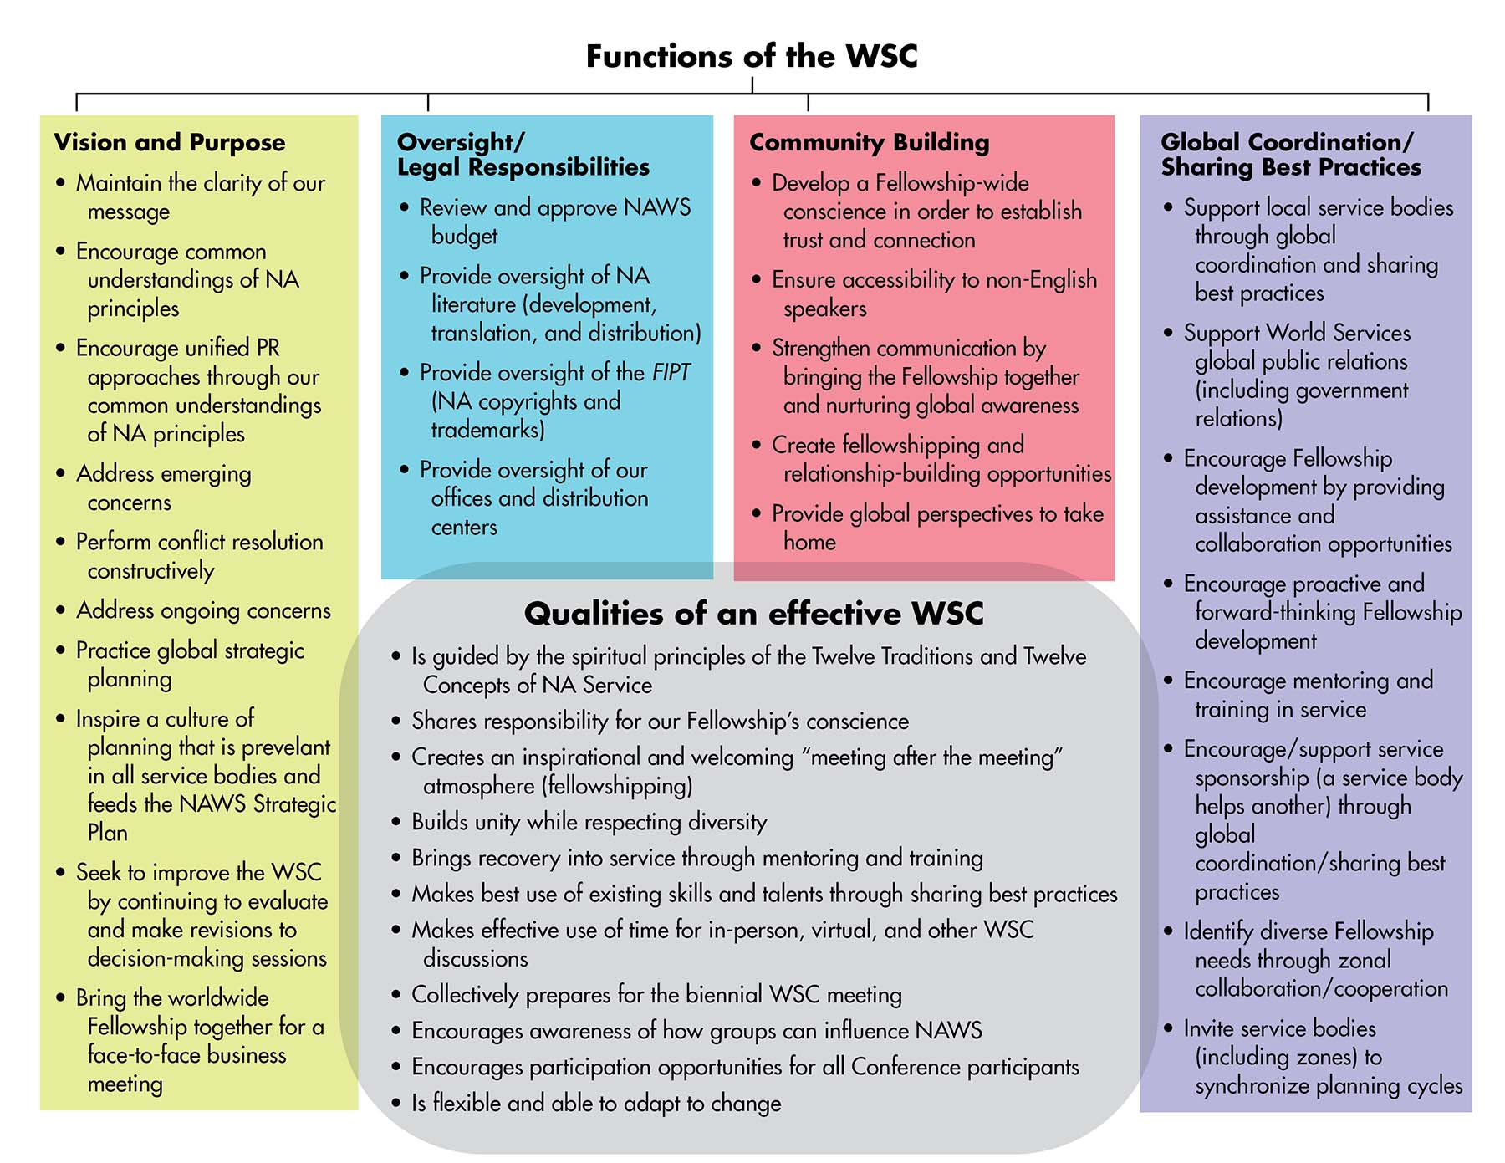
This graph is the result of discussions at the 2014 & 2016 WSC and the work of the 2018-2020 WSC of the Future project.
The complete document can be found at www.na.org/conference
“Foundation of this discussion”
Notes:
This graph is the result of the discussions Conference participants had at the 2014 & 2016 WSC and the work of the 2018-2020 WSC of the Future project.
Prior to a Conference participants web meeting in January 2022, a survey was sent out that contained a little history and this graph that highlights the functions of the WSC and what qualities an effective WSC would have. The survey asked questions based on When, How, Who, and What.
The complete document can be found at www.na.org/conference and is called “Foundation of this discussion.”

Slide 20
The results from the survey and web meeting discussion:
“So much of what we have heard, regardless of the question being answered, is about how we use our time between conferences. A three-year cycle seems to allow for more opportunities to really improve some of the WSC processes.”
The Future of the WSC April 2022 report can be found at www.na.org/conference
Notes:
The April Future of the WSC report includes a brief summary of what was heard from Conference participants in the Future of the WSC survey and the January web meeting small groups.
“So much of what we have heard, regardless of the question being answered, is about how we use our time between conferences. A three-year cycle seems to allow for more opportunities to really improve some of the WSC processes.”

Slide 21
Promising time to be discussing options for the future of the WSC
We are currently in the final year of a three-year conference cycle and there have been two virtual WSC meetings where decisions were made and delegates chose what to address at the meetings.
The conference approved policies to continue to meet and make decisions virtually, as needed. Surveys and epolls can happen in advance so the conference can take care of some business before and after they meet.
Notes:
This feels like a particularly promising time to be discussing options for the future of the WSC, because the pandemic has forced transformation upon the conference and all of World Services.
We are currently in the final year of a three-year conference cycle, and there have been two virtual WSC meetings where decisions were made and delegates chose what to address at the meetings.
The conference approved policies to continue to meet and make decisions virtually, as needed. Surveys and epolls can happen in advance so the conference can take care of some business before and after they meet.

Slide 22
These already feel like improvements.
We may not always be eager to embrace change, but we are living through it regardless.
The board always wants to hear your thoughts and answer your questions: wb@na.org
Notes:
These already feel like improvements.
We don’t have all of the answers, but we are hopeful we can find our way into the future together. We may not be eager to embrace change, but we are living through it regardless of our reluctance. The board is recommending we lean into those changes.
The board always wants to hear your thoughts and answer your questions: wb@na.org

