Slide 1
Drug Replacement Therapy/Medication Assisted Treatment as It Relates to Narcotics Anonymous

Slide 2
Motion #9:
To direct the World Board to create a project plan for consideration at WSC 2020 to create or revise one piece of recovery literature to directly address Drug Replacement Therapy (DRT) and Medication Assisted Treatment (MAT) as it relates to NA.
Notes:
At the last World Board meeting, the Board decided to add a third IDT, DRT and MAT as it relates to NA. They were inspired by Motion #9 that passed at WSC 2018, which reads:
To direct the World Board to create a project plan for consideration at WSC 2020 to create or revise one piece of recovery literature to directly address Drug Replacement Therapy (DRT) and Medication Assisted Treatment (MAT) as it relates to NA.

Slide 3
Potential Outcomes of this IDT
Increase understanding how NA members act toward addicts who are receiving DRT/MAT medications. This is not an outside issue.
Raise members’ awareness of Traditions 3, 10, 12
Reminder for unity and ties that bind us together

Slide 4
Discussion Question One
How can we focus on unity in NA meetings as more people are coming to NA on DRT/MAT medications?
Notes:
With those aims and background information in mind, here are the discussion questions that were prioritized by the Conference participants who discussed this topic last week. For the purposes of discussion today, let’s pick two of these questions and break into small groups to talk about them.

Slide 5
Discussion Question Two
What actions can we take to help make people receiving DRT/MAT medications feel more welcome in NA meetings?

Slide 6
Discussion Question Three
How can we demonstrate compassion toward potential members receiving DRT/MAT medication and assist them with understanding NA’s message
of recovery?

Slide 7
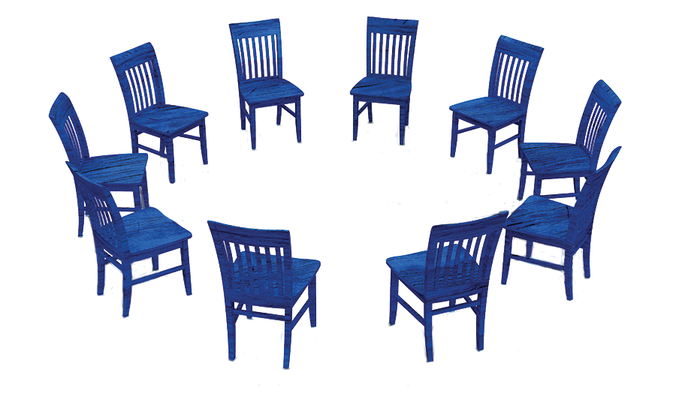
Thank you for participating
Hand in 3 actions notes on each question from each table.
Resources for this and other workshops can be found at: www.na.org/idt

