Slide 1

Carrying the NA Message and Making NA Attractive

Slide 2
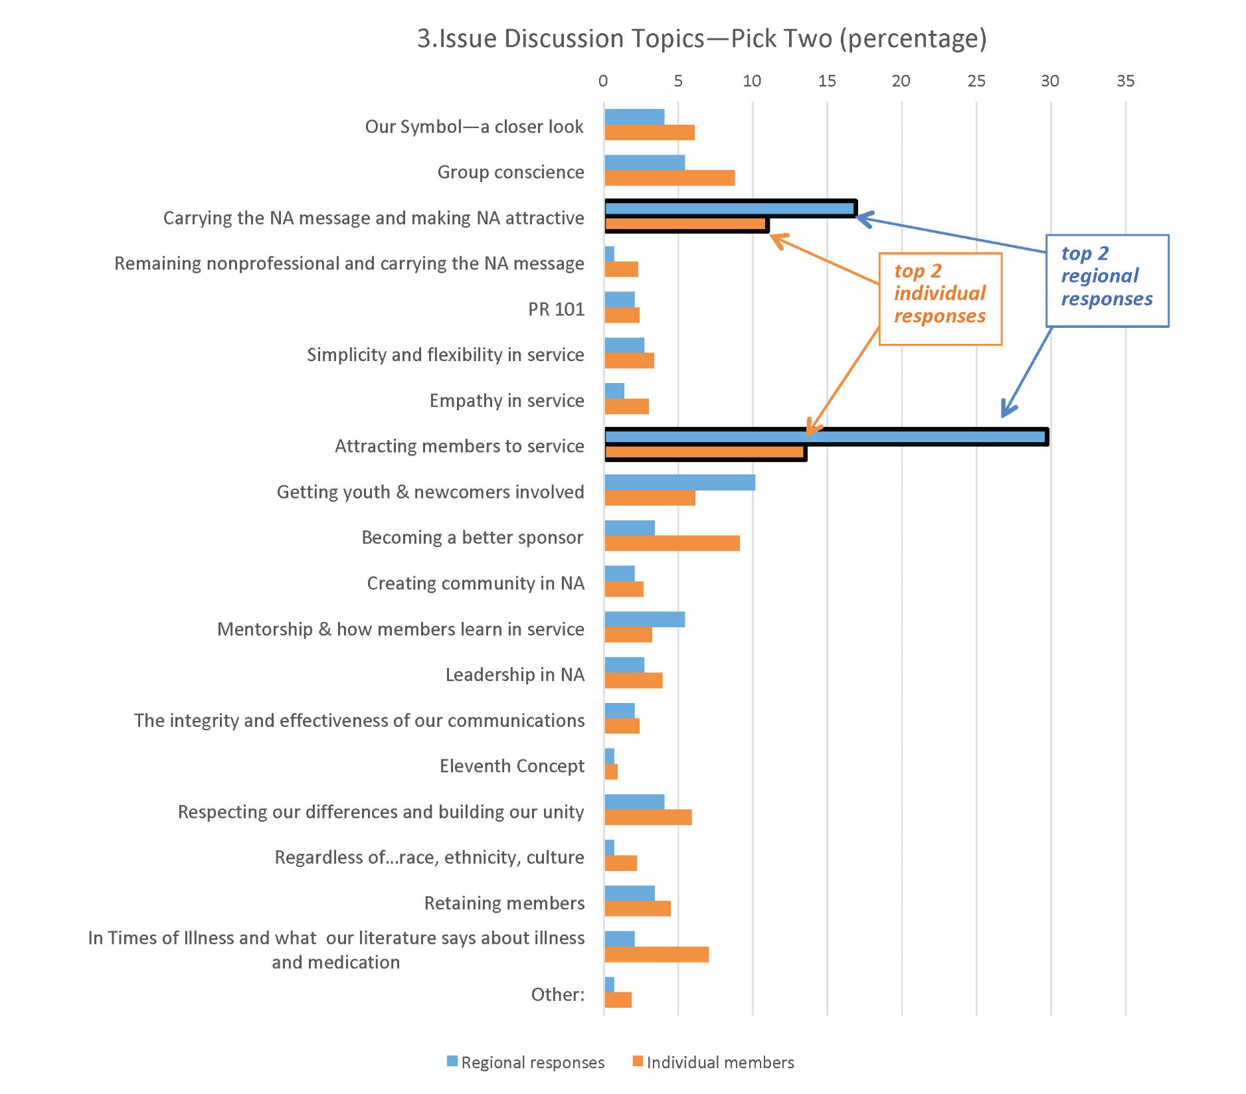

Slide 3
We want to make the newcomer feel welcome. We can all remember how frightened and apprehensive we were when we first came to NA. We welcomed that initial smile and learned a simple loving hug could make all the difference in the world when we felt alone. We needed to find others like ourselves…

Slide 4
Importance of First NA Meeting
Very important
Neutral
Important Somewhat important Not at all important
56%
16%
12%
9%
7%
0% 10% 20% 30% 40% 50% 60%
2015 Membership Survey

Slide 5
Large-group Discussion
What was your first positive experience in NA that attracted you and made you want to come back and stay?

Slide 6
Small-group Discussion
What is our message, and how does our group demonstrate a commitment to it?
How does this commitment affect our members and our group, and what effect does it have in the greater community?
How can I help ensure that newcomers are welcomed with an “attitude of helpfulness, acceptance, and unconditional love”?
(It Works: How and Why, Tradition Three)

Slide 7
Next Steps
All three IDTs are available at www.na.org/idt.
Thank you for helping.
We always welcome your feedback: wb@na.org

