Slide 1
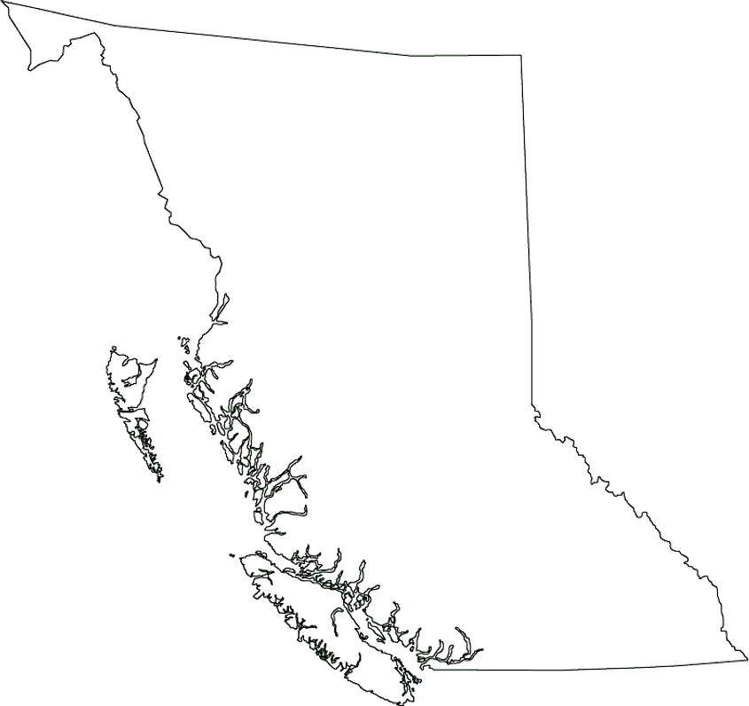
British Columbia Region

Slide 2
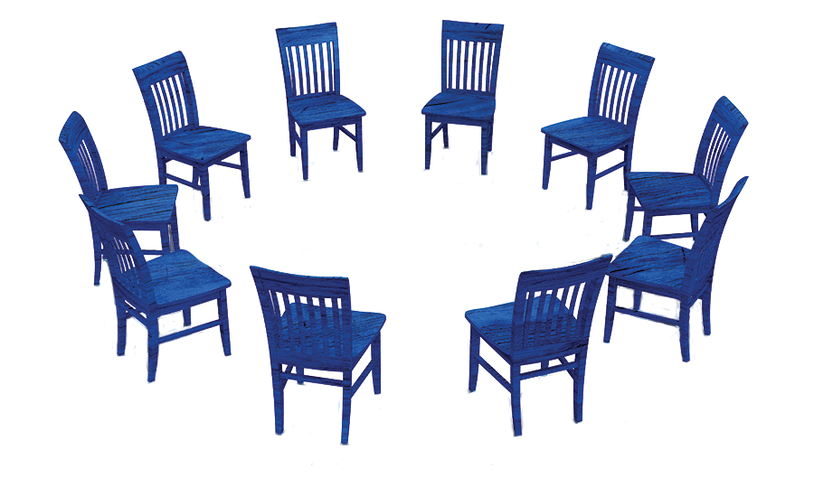
Carrying the NA Message
and Making NA Attractive

Slide 3
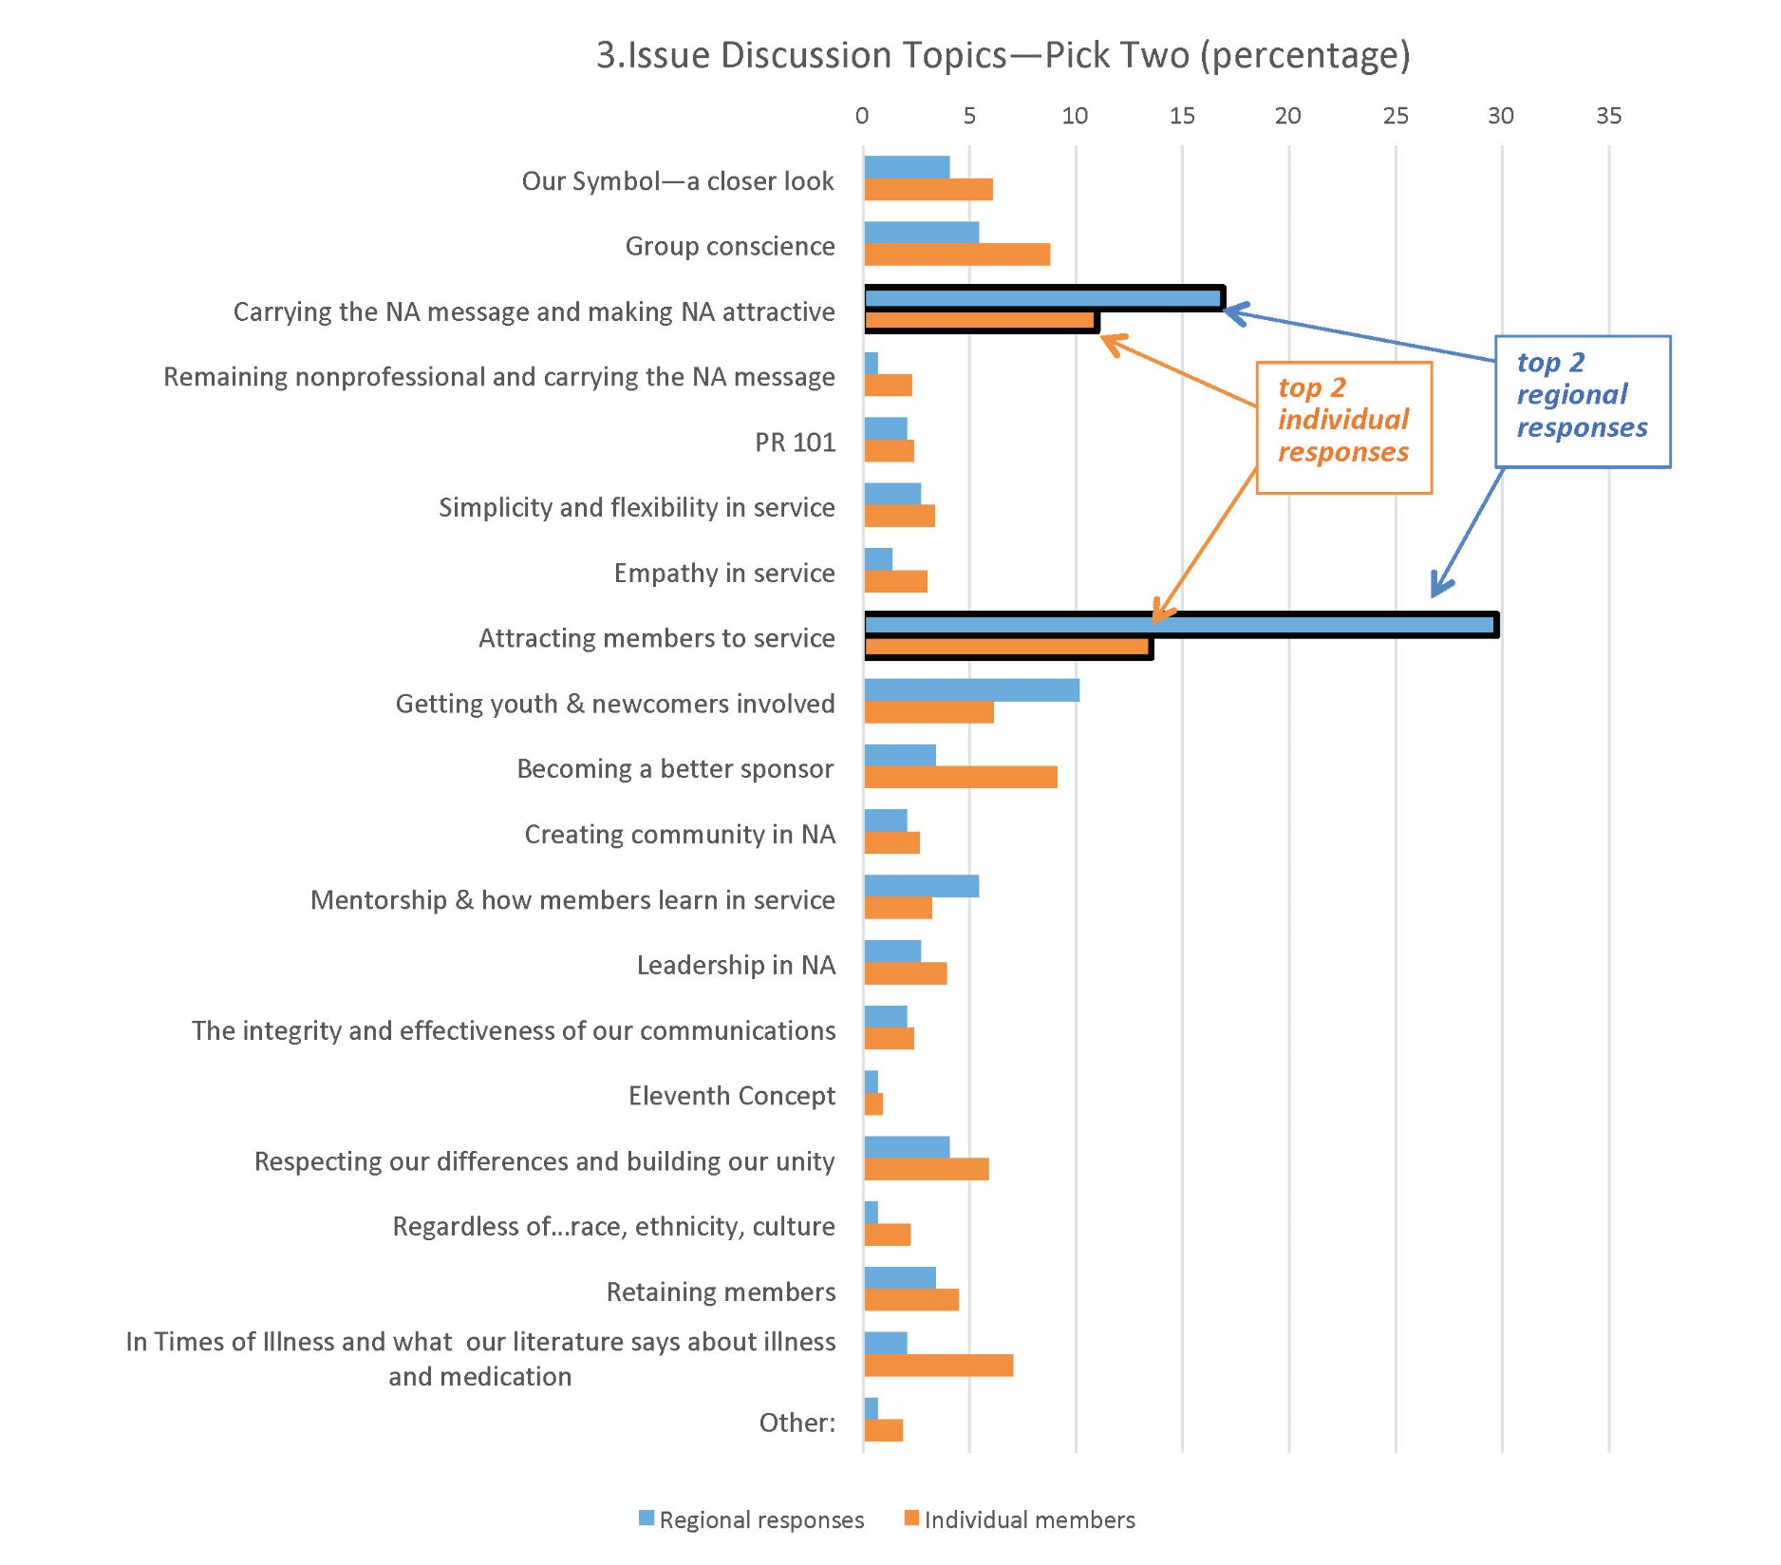

Slide 4
We want to make the newcomer feel welcome. We can all remember how frightened and apprehensive we were when we first came to NA. We welcomed that initial smile and learned a simple loving hug could make
all the difference in the world
when we felt alone. We needed
to find others like ourselves…
IP #2 The Group

Slide 5
Importance of First NA Meeting
Very important
Neutral
Important
Somewhat
Not important
55%
13%
16%
7%
9%
0% 10% 20% 30% 40% 50% 60%

Slide 6
Large-group Discussion
What was your first positive experience in NA that attracted you and made you want to come back and stay?

Slide 7
Small-group Discussion
What is our message, and how does our group demonstrate a commitment to it?
How does this commitment affect our members and our group, and what effect does it have in the greater community?
How can I help ensure that newcomers are welcomed with an “attitude of helpfulness, acceptance, and unconditional love”?
(It Works: How and Why, Tradition Three)

Slide 8
Next Steps
All three IDTs are available at www.na.org/idt.
Thank you for helping.
We always welcome your feedback: rd@bcrna.ca

