Slide 1

Attracting
Members to Service

Slide 2
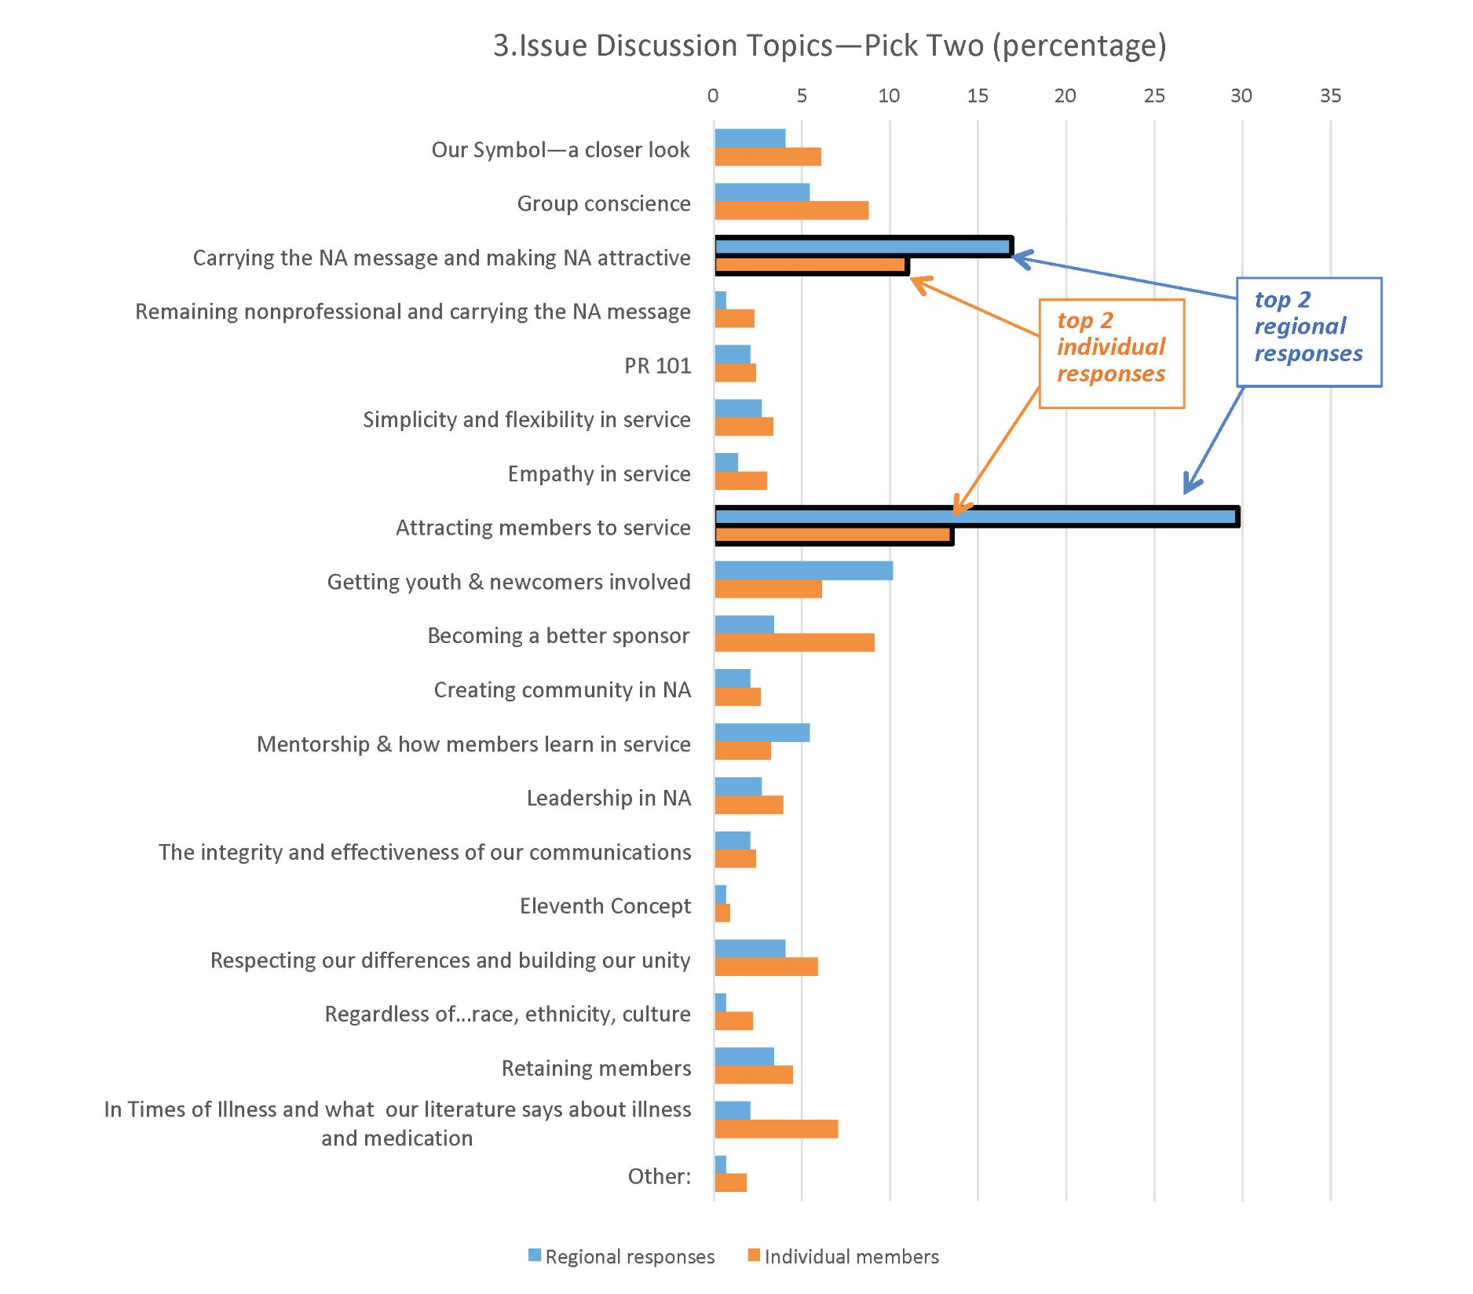

Slide 3
Where would you be if you never had the opportunity to hear the NA message?

Slide 4
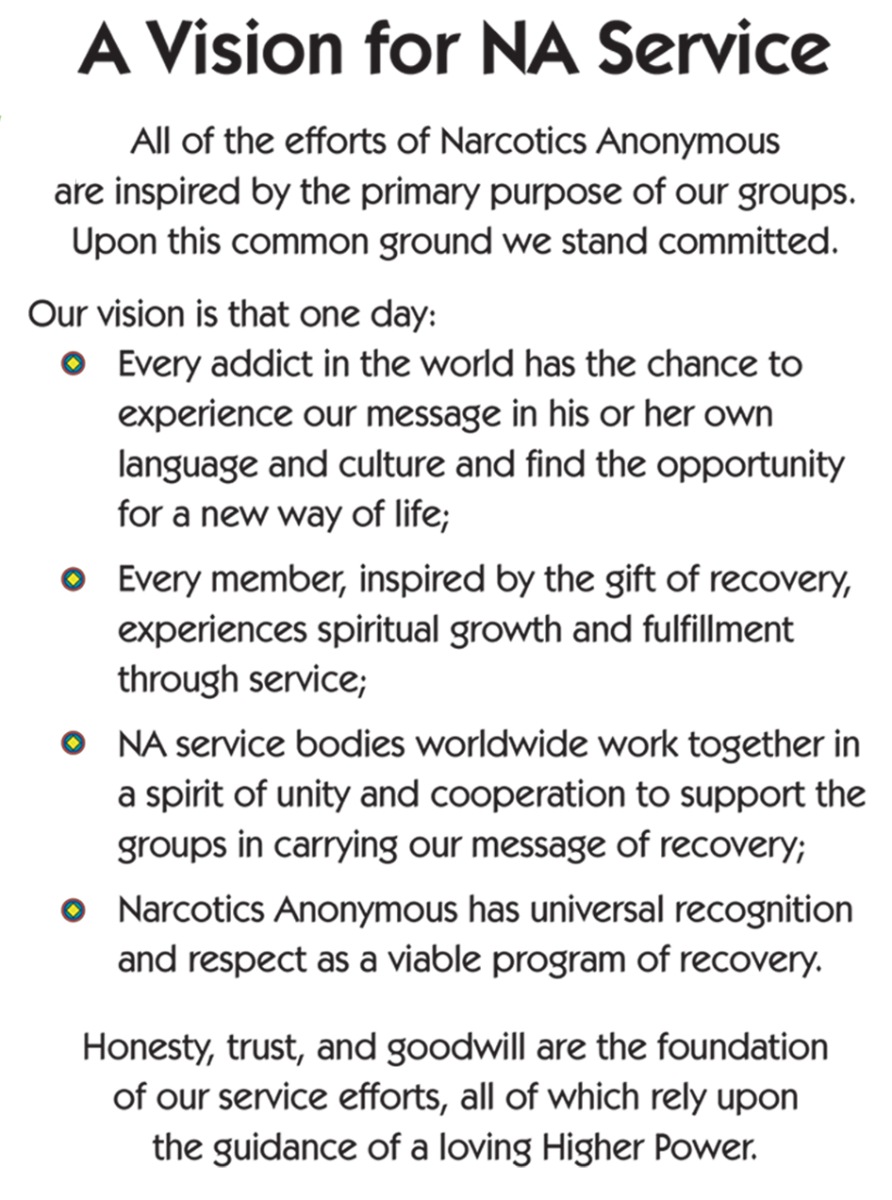

Slide 5
Concept One
To fulfill our fellowship’s primary purpose, the NA groups have joined together to create a structure which develops, coordinates, and maintains services on behalf of NA as a whole.

Slide 6
Basic Text quote
Everything that occurs in the course of NA service must be motivated by the desire to more successfully carry the message of recovery to the addict who still suffers.

Slide 7
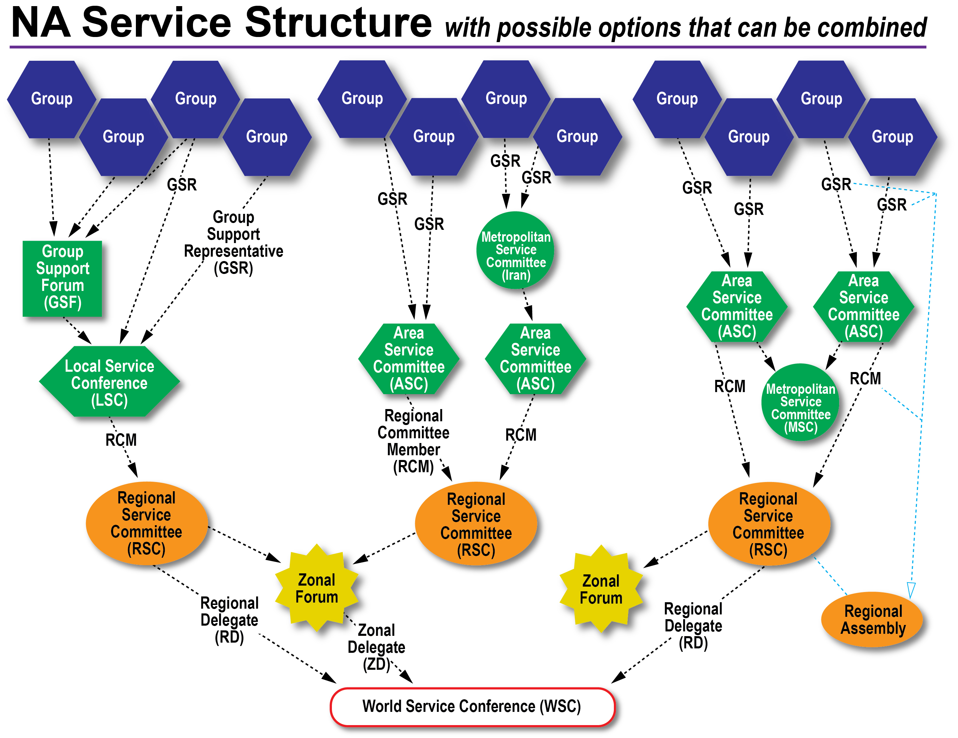

Slide 8
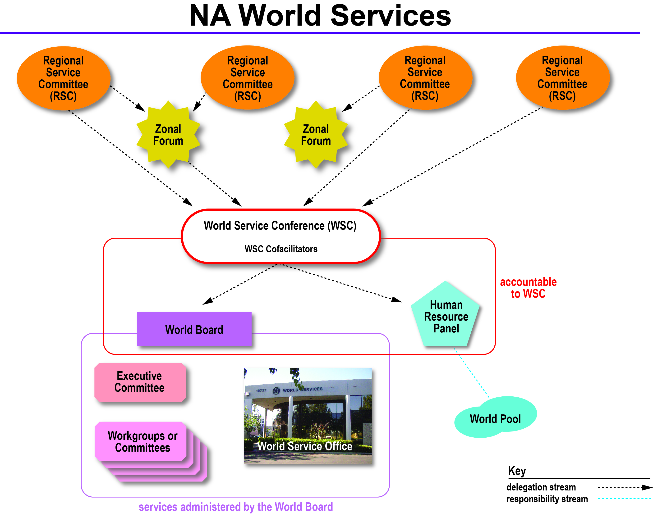

Slide 9
Large-group Discussion
What would NA look like without service?
Why is service such a significant part of the NA program?

Slide 10
Small-group Discussion
How have I personally benefited from NA service? How has it helped me stay clean and enhanced my recovery?
Imagine it’s five years from now. NA is growing in your area and members are excited about doing service. There are plenty of volunteers for each position and elections are contested. What has changed to make this possible? What about your NA community has made service so attractive?

Slide 11
Large-group Discussion
What changes can we make to our attitudes and practices to attract populations that are missing, such as younger members, to service?

Slide 12
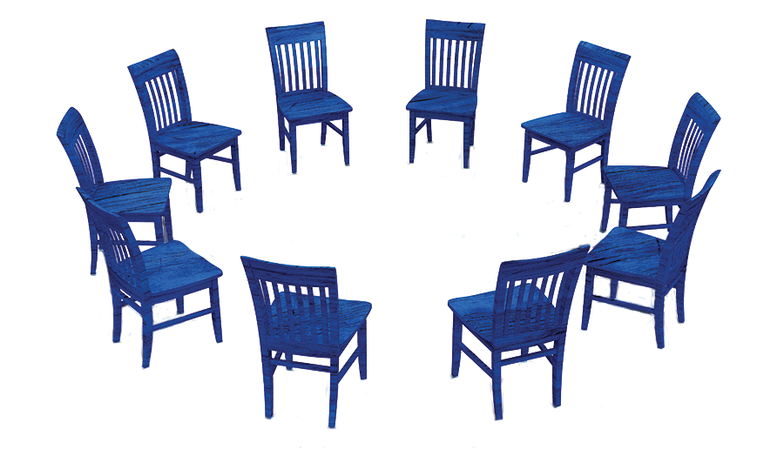
Next Steps
Thank you for participating.
You can find other IDT workshop sessions here www.na.org/idt.
Please email your ideas to wb@na.org.

