Slide 1
reaching our common goals PLANNING
supporting our primary purpose

Slide 2
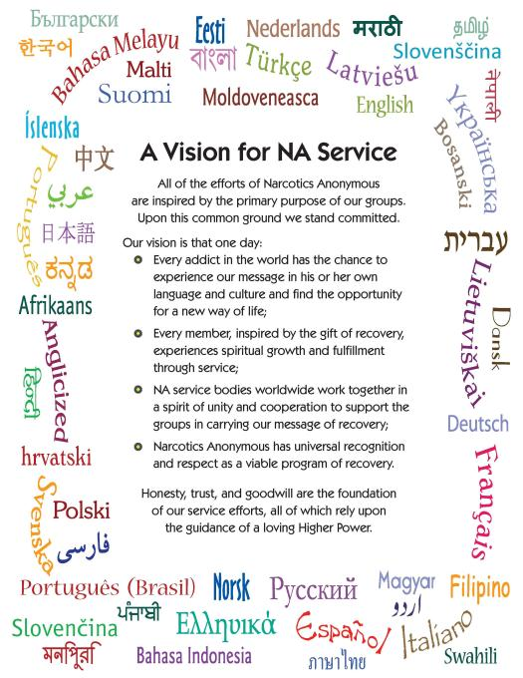
This is our future as a Fellowship

Slide 3
so, why plan?
1
2
3
More effective group influence
Do what we’re doing more effectively
Realize
Our
vision

Slide 4
Share a planning example from your personal life.
small group icebreaker

Slide 5
planning experience
Sweden
USA
Russia
Rethink and reimagine service delivery

Slide 6
planning experience
Sweden
The visionary work done at our group assembly is the foundation of our regional planning, ensures the groups’ needs will be met, and gives that beautiful feeling of unity.
Rethink and reimagine service delivery

Slide 7
planning experience
USA
Our new planning springs out of the fluctuation in group/area donations and regional convention income. Our convention is going through a greater forward-planning strategy now; we are around a year and a half ahead. We are trying for some stability in our incomes.
Rethink and reimagine service delivery

Slide 8
planning experience
We can see if we’re really moving toward our vision statement. That's why we plan.
Rethink and reimagine service delivery

Slide 9
Brainstorming Guidelines Suggested Ground Rules Facilitator’s Instructions
small group discussion
choose a facilitator and a recorder

Slide 10
What do you want your NA community or service body to look like 10 years from now?
1

Slide 11
decide on a goal
2
What should be our first focus?

Slide 12
identify actions/steps
3
How could we get there?

Slide 13
small group feedback
how will you achieve your goal?

Slide 14
It’s a simple, helpful process.
?
why
plan?
Every goal requires a plan.
Planning is okay!
Try it to see if it improves your service efforts!

Slide 15
reaching our common goals PLANNING
www.na.org/servicesystem
www.na.org/handbooks
worldboard@na.org
RESOURCES
supporting our primary purpose

