Slide 1
Group Support
GROUP SUPPORT
Supporting our NA groups locally

Slide 2

“
The primary purpose of an NA group is to carry the message of recovery…
“
The Group Booklet

Slide 3
Better Supporting Groups…
✓
Sharing experience of common challenges can be helpful.
ASCs don’t always have enough time for group issues.
A discussion about group support may attract different members
than other types of service.
✓
✓
Notes:
This workshop also offers an idea of how a group support forum might work.

Slide 4
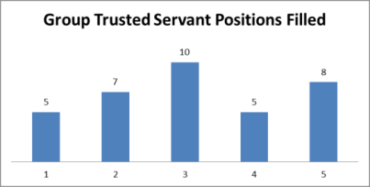
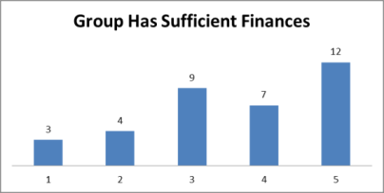
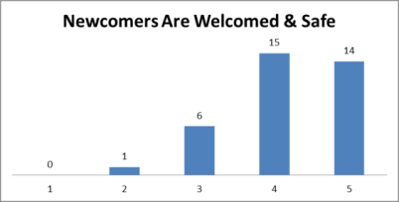
Today’s Process
Identifying our groups’ issues:
    Group reports to the local service body
    The result of an inventory process
    Brainstormed list from a workshop
Prioritize main issues
Brainstorm solutions
Share our ideas

Slide 5
Our Common Issues
Large Group Discussion
Brainstorm 6−8 issues
May be more in practice
Prioritize the top two
Everyone has two votes
In practice, the list could be revisited next month

Slide 6


Small Group Discussion Process
Use Brainstorming Guidelines, Suggested Ground Rules, and Facilitators Instructions.
Select a facilitator to keep discussion moving and watch the time.
Select a recorder to take notes.

Slide 7
Brainstorming Solutions
What is our experience?
What does the literature say?
Where can we find more information?
Do any of our groups have related strengths we can build on?

Slide 8
Small Group Discussion
Brainstorming Solutions
What experience or ideas do we have about our challenges?
Do we have ideas for solutions?
How can we build on our strengths?

Slide 9
Small Group
Feedback

Slide 10
Supporting Our Groups
Large Group Discussion

Slide 11
How can we better support our groups?
Some ASC ideas:
  Group report forms
  Open forums for group issues
  Alternate business and group support
Group Support Forums (GSFs)

Slide 12
The Group Support Forum
Not just a problem-solving body
May include workshops, training, and participation in projects such as the Traditions Book Project
All encouraged to attend
Size and scheduling adaptable

Slide 13
Resources to Support Our Efforts
The Group Booklet
Service Pamphlets
GSF tools at na.org/servicesystem
Other resources…
worldboard@na.org
na.org/IDT
na.org/traditions

Slide 14
“
Unity of action and purpose makes possible what seemed impossible for us―recovery.
“
Basic Text, The Fifth Tradition

