Slide 1
Medication for Opioid Use Disorder as It Relates to Narcotics Anonymous
Notes:
Introductions
Chris addict Harm Reduction and overdose prevention
Dezi Addict Harm Reduction and MOUD Services

Slide 2
Potential Outcomes of this Workshop
Increase understanding how NA members sometimes act toward addicts who are prescribed MOUD medications.
  This is not an outside issue.
Raise members’ awareness of Traditions 3, 10, 12 and how it relates to attendees prescribed MOUD
Reminder of our need for unity and strengthening the ties that bind us together
Notes:
Chris
Ask the audience:
Tradition 3 The only requirement for membership is a desire to stop using.
Tradition 10 Narcotics Anonymous has no opinion on outside issues; hence the NA name ought never be drawn into public controversy.
Tradition 12 Anonymity is the spiritual foundation of all of our traditions, ever reminding us to place principles before personalities
Today’s workshop is about maintaining NA unity and welcoming potential members who may be on medication assisted treatment so that they can stay long enough to hear our message. Our Basic Text says it best: An addict, any addict, can stop using drugs, lose the desire to use, and find a new way to live. You are welcome here. Please stay and be part of our growth, change, and recovery
Facilitator, ask:: Is anyone confused about what our message is? Does anyone think we’re trying to change that message?
So now that we are all on the same page that NA is a program of total abstinence, and will remain so, we can talk about ways to better carry our message to some of the people who need to hear it.

Slide 3
Opioid and Overdose Crises
Overdose deaths reached 107,622 people in 2021
Opioids were involved in 80,816 (~ 75%) of all OD deaths in 2021
Synthetic opioids (such as fentanyl) were involved in ~ 66.19% of all drug OD deaths in 2021
70% of methamphetamine OD deaths involved fentanyl2
At least 50% of cocaine OD deaths involved fentanyl2
Notes:
1:https://www.cdc.gov/nchs/pressroom/nchs_press_releases/2022/202205.htm
Chris
This is not an outside issue
Important for sponsors to understand what the newcomer is facing
More potent substances
An unsafe supply
Fentanyl
10-100 times more powerful than heroin
Makes relapse that much more deadly
Covid: isolation, lack of in person meeting, loss of traditional recovery supports and the opioid crisis have caused these spikes in overdose deaths
Overdose is not an outside issue
These are human beings, and they died preventable overdose deaths
It wasn’t for Mark T, it wasn’t for Ben K
Dead Addicts Don’t have a chance to get clean

Slide 4
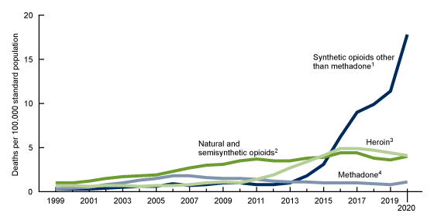
Opioid Overdoses
Notes:
Dezi-
While the disease of addiction has not changed the substances have and are more lethal. What year did you get clean?

Slide 5
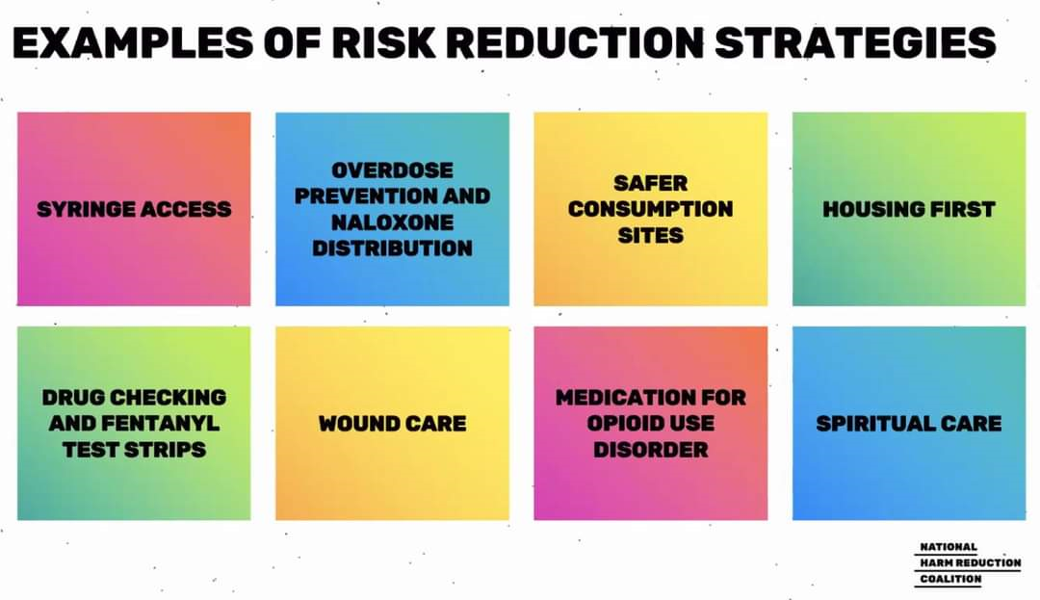
Harm Reduction Strategies
Notes:
Chris

Slide 6
What is MOUD?
Medication for Opioid Use Disorder (MOUD) is the use of medications, in combination with counseling and behavioral therapies, to provide a “whole-patient” approach to the treatment of substance abuse disorders.
Also referred to a “harm reduction” or “risk reduction.”
Notes:
Dezi

Slide 7
Forms of MOUD
Methadone- Full opioid agonist- Activates 100% of Opioid Receptors
Buprenorphine/Naloxone (Suboxone)- Partial Opioid agonist/antagonist
Buprenorphine (Subutex & Sublocade)- Partial opioid agonist
Naltrexone (Vivitrol)- Opioid antagonist
Notes:
Dezi
75% decrease in all cause mortality vs. non MAT treatment

Slide 8
MOUD & Recovery
Recovery is being redefined as any positive change.
MOUD is the gold standard of treatment for Opioid Use Disorder
MOUD has been available in Pima County Jail and is coming soon to Department of Corrections.
Elimination of the X-waiver for Suboxone prescription.
Notes:
There has been a shift in the recovery community and treatment community nationally. Progress is being made in reducing the stigma of MOUD. This is opening the door for increasing access to the medication for OUD. The goal of MOUD is to save lives.

Slide 9
Some Applicable Traditions
3. The only requirement for membership is a desire to stop using.
10. Narcotics Anonymous has no opinion on outside issues; hence the NA name ought never be drawn into public controversy.
12. Anonymity is the spiritual foundation of all our Traditions, ever reminding us to place principles before personalities.
Notes:
Dezi –
With those aims and background information in mind, here are the discussion questions that were prioritized by the Conference participants who discussed this topic last week. For the purposes of discussion today, let’s pick two of these questions and break into small groups to talk about them.

Slide 10
Discussion Question One
How can we focus on unity in NA meetings as more people arrive in NA who are prescribed MOUD medications?

Slide 11
Discussion Question Two
What actions can we take to help make people prescribed MOUD medications feel more welcome in NA meetings and more likely to stay long enough to understand NA’s message of recovery?

Slide 12
Discussion Question Three
How can we demonstrate compassion toward potential members prescribed MAT medication and assist them with understanding NA’s message
of recovery?
Notes:
Thank you for participating. We encourage you to discuss these issues in your homegroup business meeting if you believe that would be helpful.

Slide 13
Where We Are Today
MOUD attendees
NA Members
Notes:
Dezi
For most parts of the US as well as other places around the world, medication is required to treat addiction when an individual is receiving financial assistance from a government or insurance source. That is definitely an outside issue, but how we treat people when they walk into an NA meeting is not. Professionals who work with these persons have repeatedly stated that these potential members tend to receive less than a warm welcome at NA meetings and many have decided that it is easier to send people to other places. Many communities outside of the US have faced this issue for a longer time. It’s encouraging to see these communities welcoming people from a more peaceful, less emotionally charged place.

Slide 14
Where We Can Be in NA
MOUD
Therapy
Attend Meetings
Hear the Message
Total Abstinence
Notes:
Christopher

Slide 15
Sponsoring Those Prescribed MOUD
Are you willing to sponsor someone prescribed MOUD?
Would you be willing to sponsor someone prescribed MOUD if you had a mentor who has experience with sponsoring someone prescribed MOUD?
If not, can you ask around to determine who is open to sponsoring someone prescribed MOUD in case a newcomer asks you?
Whether you start step work with someone prescribed MOUD is a personal decision.
You may get some negative reactions from members who don’t have experience sponsoring members prescribed MOUD.
  Instead, turn to members with experience in this area, or who are openminded about MOUD.
Notes:
Dezi and Chris
MAT is not a magic fix all. Will it keep the withdrawal and craving at bay? Yes, but like I tell my client “you have to work on what is between your ears”. Having a positive the support system is necessary to properly taper off the medication in a safe manner and maintain long term recovery.

Slide 16
Wrap Up
As a Fellowship, we need to continue to grow and support new members, whether they understand the concept of total abstinence.
“A dead addict will never recover.”
  WSLD speaker, addictionologist
Comments
Questions
Notes:
Hopefully, as members become familiar with this Issue Discussion Topic, their awareness will increase and we will practice the principles contained in Traditions 3, 10, and 12 toward any members who are not yet clean and toward potential members.
Desire is not a measurable commodity; we are not able to judge anyone’s desire. Many of us may remember persons we met in meetings who we did not think would be able to stay clean and then we see them five years later living a drug-free life.
Many of us have opinions about this and other issues, but we need to be mindful of how and where we express our personal opinions. Potential members most likely will benefit more from a loving hug than from an opinion about how someone is being treated for their addiction. Consider how you were welcomed in to NA and extend that courtesy to others.

Slide 17
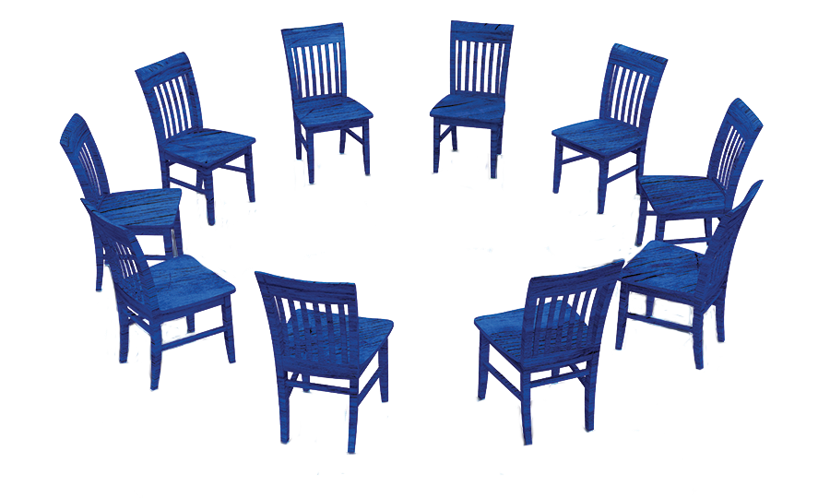
Thank you for participating
Resources for this and other workshops can be found at: www.na.org/idt

